Slide 1





Prayer Spaces in Schools
Learning from a prayer space
KS2 Lesson 1 of 4
What is prayer?
Learning opportunities for 7-11s on themes about prayer and reflection.
Prayer Spaces in Schools create extraordinary opportunities for children and young people to think about prayer and to consider spirituality in open-minded experiential ways.
This lesson is one of a series written by Lat Blaylock of RE Today and provided free to schools to enable learners to use critical and reflective thinking skills to learn about spirituality, prayer and reflection.
is part of
Notes:
These lessons are written by Lat Blaylock, RE Consultant with RE Today www.retoday.org.uk
Aims of these lessons:
To provide excellent and respected classroom resources for teachers of RVE / RME / RE to use in lessons when a PRAYER SPACES visit is coming, taking place or has happened,
To enable teachers and PRAYER SPACES volunteers to deliver quality RVE / RME / RE about prayer which connects to the experiences of the PRAYER SPACES provision.
To enable pupils to think for themselves about prayer and its meanings, and access opportunities for spiritual, moral, social and cultural development.

Slide 2
Providing quality ‘state of the art’ RE / RVE / RME lessons ready to use for
KS2 & KS3
Suitable for both teachers of RE / RVE / RME and Prayer Spaces volunteers
to deliver.
Suitable for pre-Prayer Space and post Prayer Space uses.
About these resources.
Suitable for all pupils in all kinds of schools
Encouraging open hearted and critical thinking about prayer and reflection
Enhancing the experience of using a Prayer Space in school with good learning
Offering learners the chance to develop their own personal ideas about philosophical and social questions on the themes of prayer and reflection
Engaging, creative and absorbing learning.
We provide well prepared presentations, lesson plans and training webinars and examples.
Introducing concepts and questions about Christian prayer. Providing resources to set high standards of RE / RVE / RME, deepening learning.
Adaptive suggestions in lesson plans to help volunteers or fit in with teachers’ needs.
Also including assembly delivered options for school worship / religious observance
Integrated with common RE / RVE / RME units of work and ‘Understanding Christianity’ resources.
A lesson for KS2 and a lesson for KS3 in advance of the Prayer Space visit.
Suitable for all schools and all pupils offering creativity and critical engagement in the lessons.
Using active learning, creative multi-disciplinary methods, explained and resourced to be ‘ready to go’.
Three lessons each for KS2 and KS3, all free standing, that follow up the visit.
Notes:
Teachers and Youth Workers can use this lesson, which is part of a larger ‘Prayer Spaces in School’ learning package.
The lessons:
Can be taught - with preparation - ‘off the shelf’ using the 6 PPT sequences provided
Will be understood better by teachers and youth workers if you watch our training recorded webinars from Lat Blaylock of RE today
Include examples of pupils’ work, art, writing and responses
Are suitable for use across the UK, recognizing what is distinctive about RME / RVE / RE in each of the four nations
Reference law, guidance and inspection requirements for RE / SMSCD / School Worship
Use some PRAYER SPACES case studies

Slide 3
Prayer Spaces in Schools
Learning from a prayer space
What is prayer?
This is one lesson in a set which enables learners to respond to questions such as:
What is prayer? Meditation? Reflection?
Why are some prayers answered, and some unanswered?
Can prayer make a person feel happy? Calm? Thankful? Forgiven? How?
What can we find out about praying from social studies? Philosophy? Theology?
What do Christians say about prayer and Jesus, their own prayer practices
and the ways prayer ‘works’?
What do learners say about these big questions?
Notes:
The topics addressed in these lessons include Biblical narrative and teaching, the Christian ‘Lord’s Prayer’, sociology of prayer, Christian experiences of prayer, creative prayer ideas, Christian theologies of prayer, Jesus and prayer, the phenomenon of ‘SBNR’ (spiritual but not religious) prayer, the experiences of answered prayer and unanswered prayer. Questions and diverse ideas are the focus: these lessons aim to open minds not to deliver one set of answers to these questions. The lessons are designed to compliment the opportunities for spiritual development that come from the experience of visiting and using a ‘Prayer Space’ in a school.

Slide 4
What is prayer?
Let’s start with two big questions.
What is prayer?
What’s your biggest question about prayer?

Slide 5
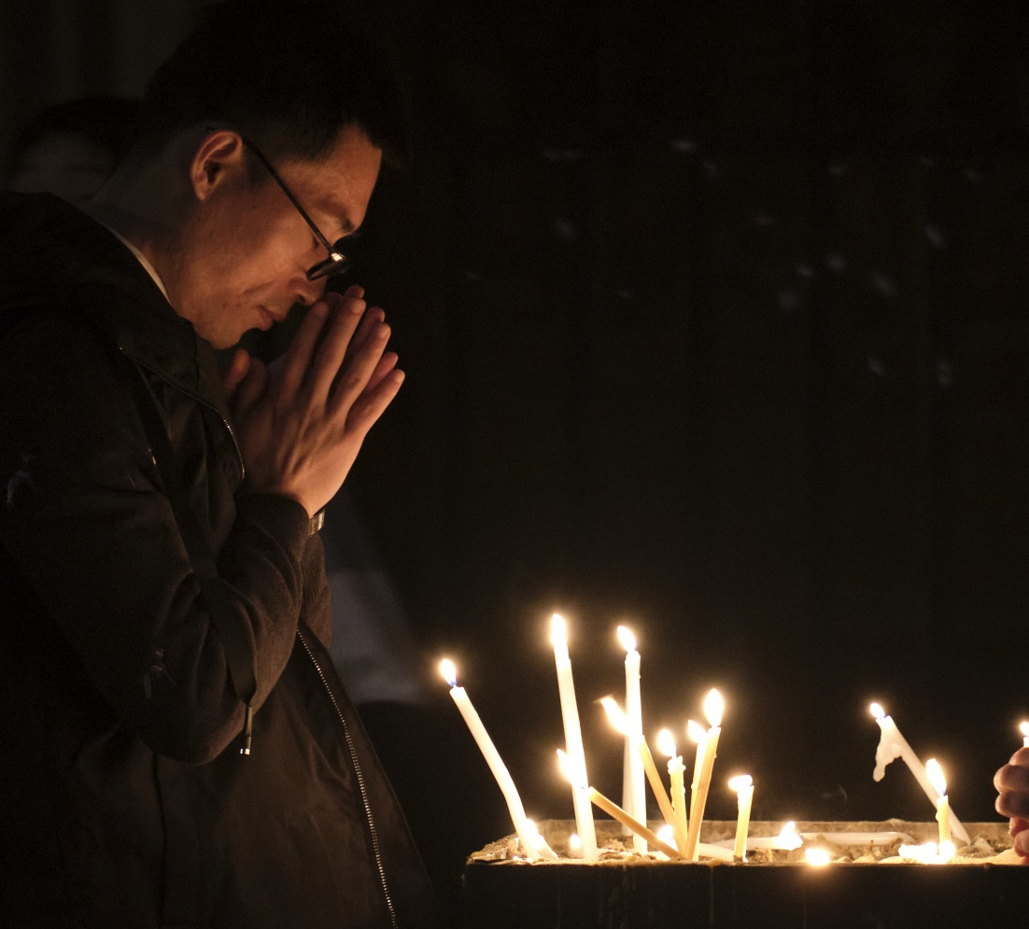
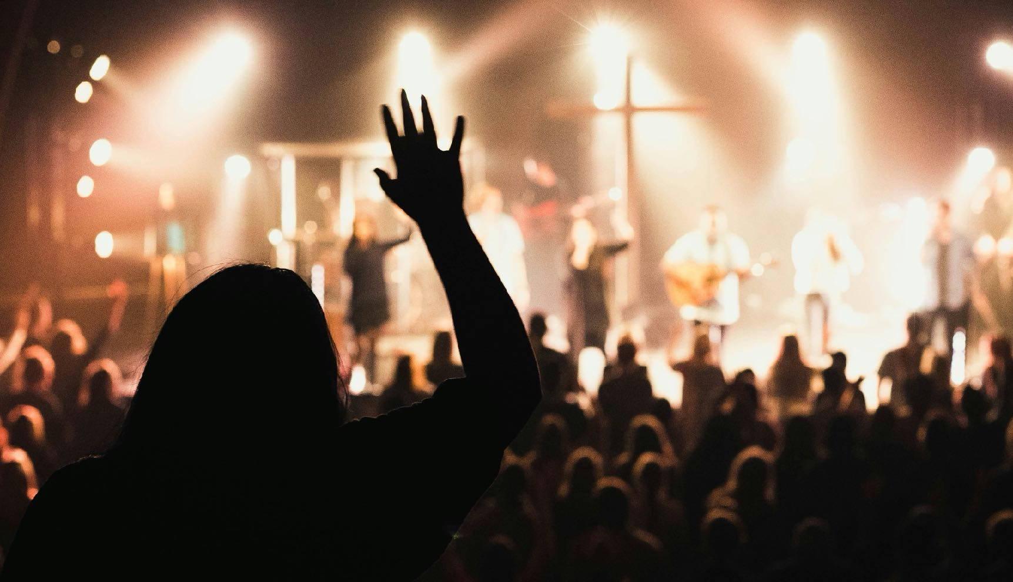
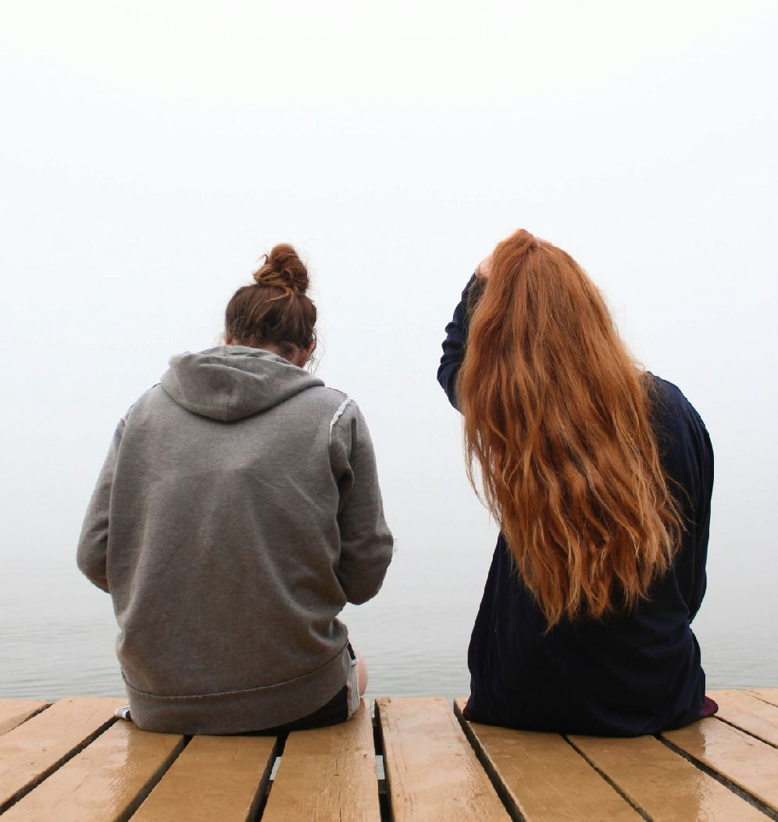
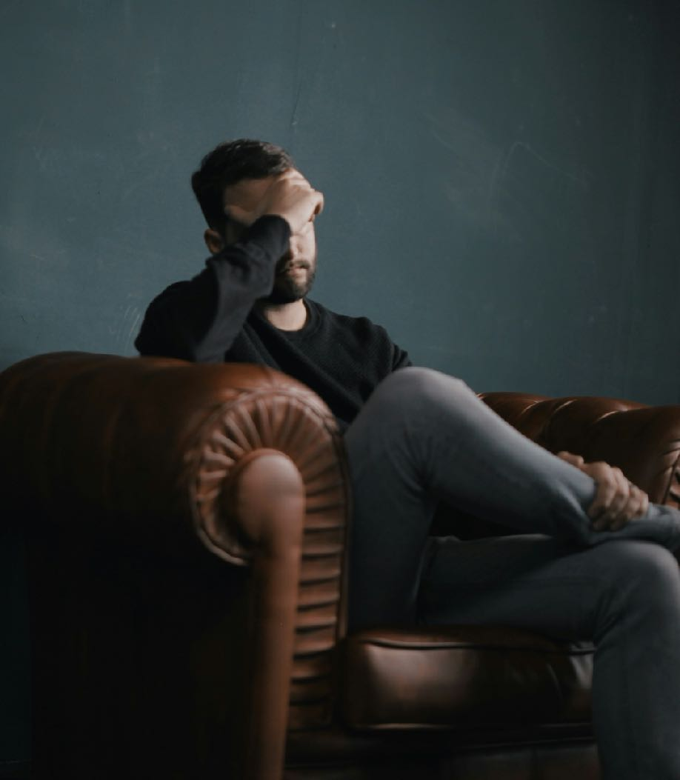

Thinking about praying
Notes:
This contribution to classroom RE / RVE / RME recognises the value of rich knowledge about prayer for pupils, and also encourages the deployment of that knowledge as pupils handle big questions and issues thoughtfully. This contributes to providing opportunities through the learning for spiritual development.
Stats from the Pew Research Centre.
https://www.pewresearch.org/religion/2018/06/13/how-religious-commitment-varies-by-country-among-people-of-all-ages/#:~:text=Compared%20with%20weekly%20worship%20attendance,and%20Latin%20America%20(62%25).

Slide 6
Thinking about praying
Far more people pray in the UK and in the world than those who go to holy buildings. In a worldwide survey, guess how many people pray every day…
It’s 49%. Surprised?
Some evidence suggests more young people pray than older people.
How many people in your age group do you think like to pray?
Notes:
This contribution to classroom RE / RVE / RME recognises the value of rich knowledge about prayer for pupils, and also encourages the deployment of that knowledge as pupils handle big questions and issues thoughtfully. This contributes to providing opportunities through the learning for spiritual development.
Stats from the Pew Research Centre.
https://www.pewresearch.org/religion/2018/06/13/how-religious-commitment-varies-by-country-among-people-of-all-ages/#:~:text=Compared%20with%20weekly%20worship%20attendance,and%20Latin%20America%20(62%25).

Slide 7
Expressing your own viewpoints
We asked lots of young learners to say WHAT THEY THINK ABOUT PRAYING. Read these examples out loud, and say: do you agree or disagree? Write your own 50 word opinions on praying.
Male, 10 – “In my prayers, I’d ask: what is the meaning of life? What do you look like? Is there an afterlife? Is Satan your evil twin or something? What if half my life is good and half is bad – will I go to heaven?” | Female, 12 – “I pray every night before I go to sleep. I find it's the least I can do for him after all that he has done for me.” | Female, 10 – “Dear God, how can you be everywhere at once? How can you be so loving and caring when people are doing wrong? What would you do if everything went wrong and the world did not communicate?”
Female, 9 – “I would like to say thank you to God for putting me on this planet and giving me the things that I have. When I pray it makes me feel good because I'm am talking to Him and he is giving me good advice. I would like to ask: ‘what is heaven like?” | Male, 11 – “Prayer make me feel happy and sad because if you pray to God and say God will you make sure my dog is alright in heaven, it makes you think up sad memories but if you say to God thank you for sparing my dog's life it makes you happy.” | Male, 7 – "If I could talk to God! Well I would ask God to kill every disease in the world and I would love him with all my soul. I would pray ‘Please help other people to be nice’. I’d ask: What is it like in heaven?”
Male, 10 – “I would like to ask God: why do you do pollution? Why do you let people throw litter? Why do you let people smoke and take drugs? Are my relatives in heaven with you? I think people should get on with each other. I’d ask God to help.” | Female, 10 – “Prayer makes me feel safe and as if I have done my duty, and God can share wisdom with me. I would like to say to God: ‘why is there war and hatred in the world? Is there any way you can stop it? Do you hear me when I pray?’ I would like to tell him how much I look up to him and how much I believe that he watches over me and looks after me.” | Female, 8 – "I would ask God why he's letting people fight and die in the world but I would tell him that if he knows better than me to keep looking after the world how he thinks is best. I would ask God if he ever gets tired because he watches everybody all of the time. Thank you God for my life, for my family and friends. What can I do to make your world a better place to live?”
Notes:
One aspect of these lessons (which can also be used as assembly outlines with simple adaptation) is that they give pupils frequent opportunities to clarify and express their own views and ideas about prayer. We welcome the contested nature of this conversation: from different religions and worldviews there are many Varied perspectives from which to learn.
Look at thousands of search bale answer to this question here: https://old.natre.org.uk/db/results.php

Slide 8
Learning creatively: prayer-art
We asked some children to show us their beliefs about prayer in a work of art. You are going to see four of these.
The children have written about their prayers as well.
Give them a score out of ten for their art, and their writing.
Which one is best?
We are asking the question: What is prayer? Some people answer by saying something like ‘hands together, eyes closed, Our Father…’ But others say prayer is many things – reflecting, sitting silently, listening for God, wishing, saying sorry…
What do you think?
When you visit the prayer space, your ideas about praying may be challenged.
Take an open mind with you.
Notes:
We work from the view that there is a close frontier between spiritual learning and creativity: the experience of using a prayer space often feels highly creative, and prompts creativity for pupils.

Slide 9
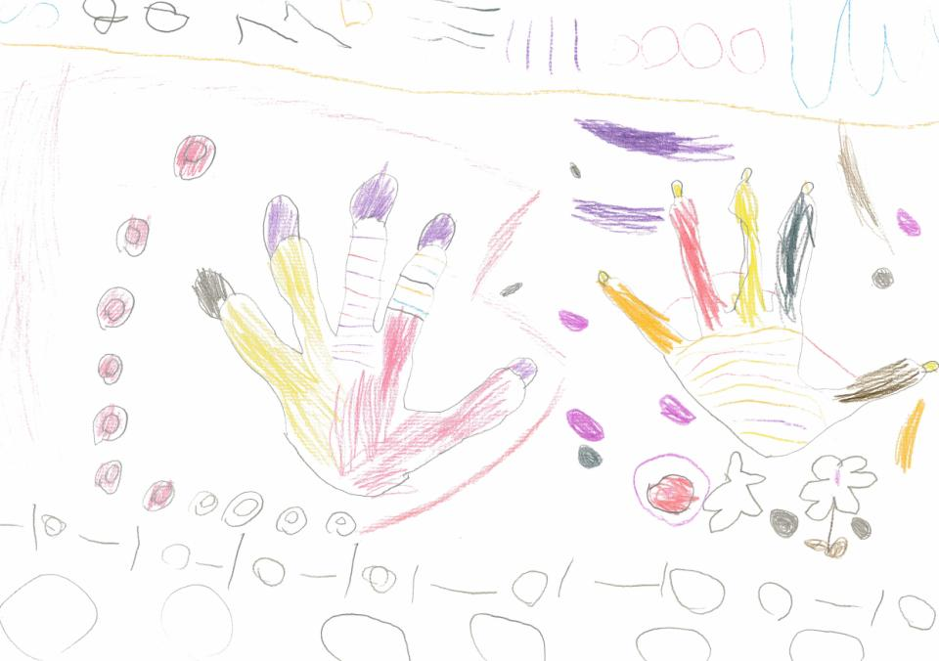
Imogen and Bethany, both 5 said: “God listens to all languages”
“Our work shows our hands praying. The patterns are different languages because God listens to all languages.”
Do you think God hears all the prayers of people from all the languages in the world?
Did you think the girls did well for 5 year olds?

Slide 10
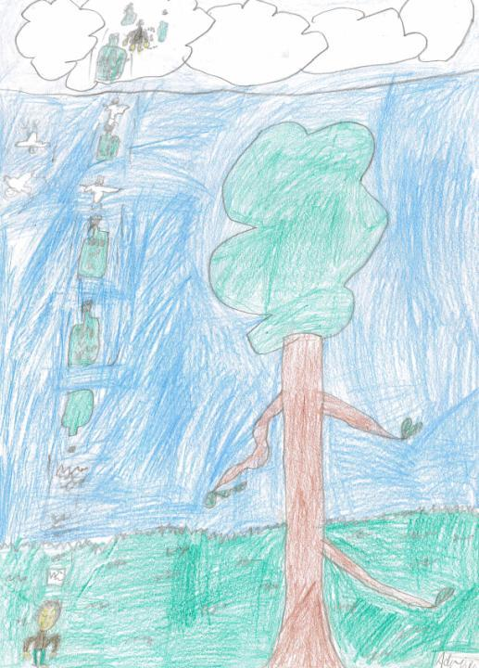
PRAYER FOR THE TREES Adriana is 7.
“I wrote a prayer about the trees on our school playground. They give us shade and are where lots of insects and birds live. In my picture I was praying that the trees stay safe and aren’t harmed by people picking the leaves or pulling the branches off. I chose a bottle to carry my prayers up to God because it had a lid and my prayers wouldn’t come out. God can take off the lid when he is ready to hear my prayer. When the doves have delivered my prayers the bottles can be used again.”
Do you think we should pray more about our environment?
In our Prayer Space, you can pray about anything. What do you think of the Christian belief that God hears every prayer, and comes close to people when they pray?
What would you like to ask God. If you could?

Slide 11
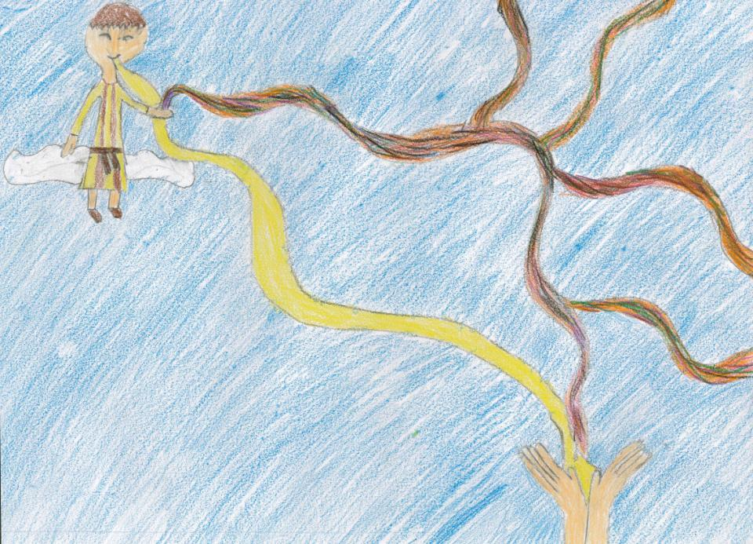
Jessica, 10
The first prayer
“I have drawn a picture of when you say your first prayer to God for forgiveness. I have drawn when your tangled life goes up to God and he catches it and renews you and you get a new, better life. What I like best about my work is that it really explains the first prayer. When I was making this, my main thoughts were how happy God must be when people decide to join Him. My inspiration for this work came from when I became a Christian.”
Do you think God is happy when we pray?
Why or why not?

Slide 12
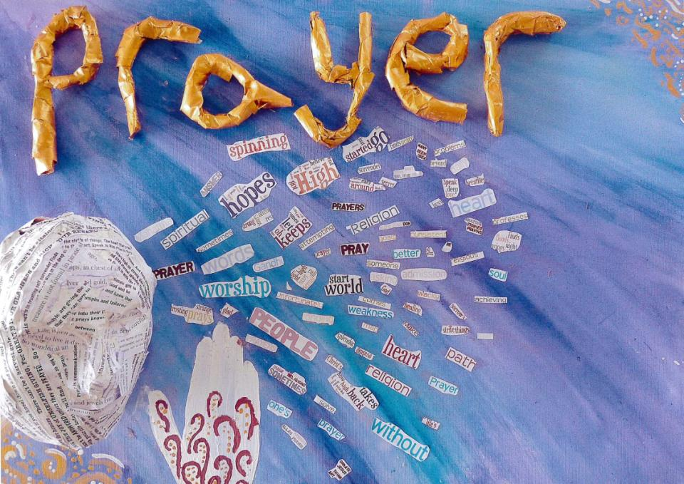
Group work – these 15 years old called their work:
“The face of Prayer”
We have based our piece of art on a quotation from C.S. Lewis. We believe that prayer is about sharing our thoughts. Prayer should make a difference to us and to our lives.
C. S . Lewis said: “I pray because I can’t help myself. I pray because I’m helpless. I pray because the need flows out of me all the time, waking and sleeping. It doesn’t change God, it changes me.”
C. S. Lewis, the creator of Narnia
Coming out of the persons mouth are words that a person may say during prayer, asking for help, asking ‘Why?’ Words that say why a person may pray - for hope, or in weakness.”
Notes:
Additional text from the pupils who made this: “We came up with the words when as a group we spoke about what we thought of when we thought about prayer and what prayer might mean to us, we also thought about whether we have ever had to pray or anyone we know that has and what they prayed for. We also included actions to make changes in our lives. The 3D face has also got words on but these are examples of prayer songs and poems. Our person is praying in the most common method of prayer with both palms touching and their fingertips pointing upward towards the sky. We used a head to show how we feel we communicate via our thoughts and words. As in the quotation the words are flowing out of the person into the air around them. The eyes cannot be seen indicating that prayer can occur at any time. This is reflected in the quotation.
We choose the colour gold for the lettering in our title because gold shows a sign of value and trust in God through prayer, gold is also a very auspicious colour in many religions. We chose a mixture of blues and purples for our backgrounds as they are calming colours and when you pray it is soothing and calming as it is just you communicating directly to God.

Slide 13
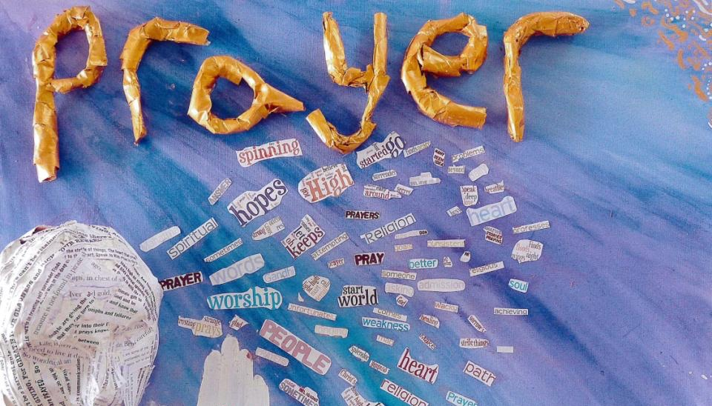
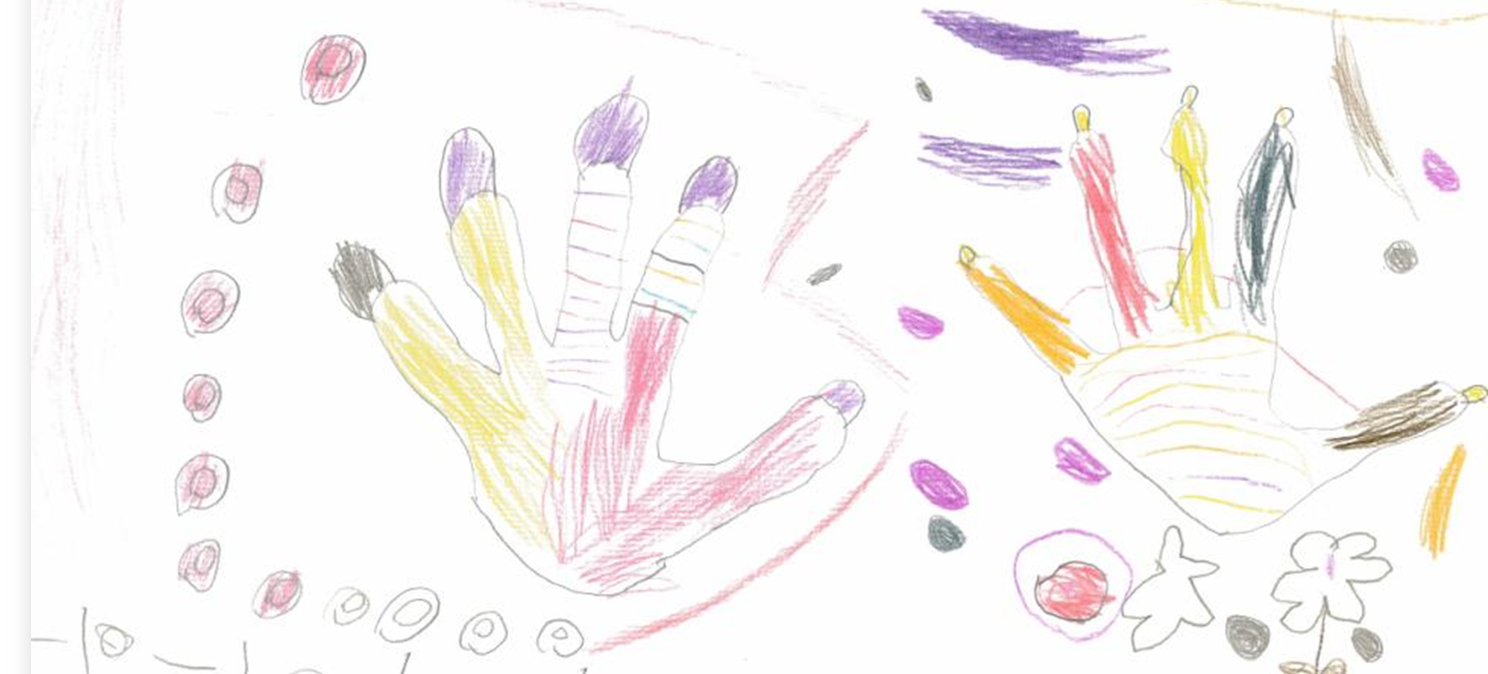
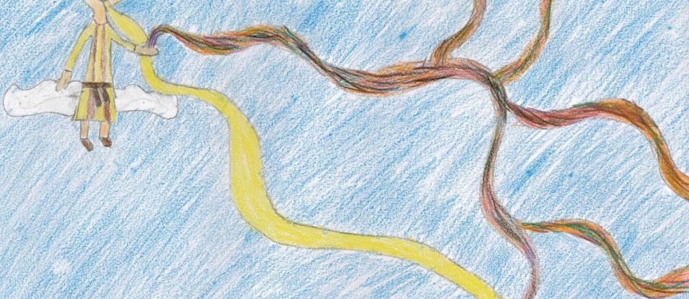
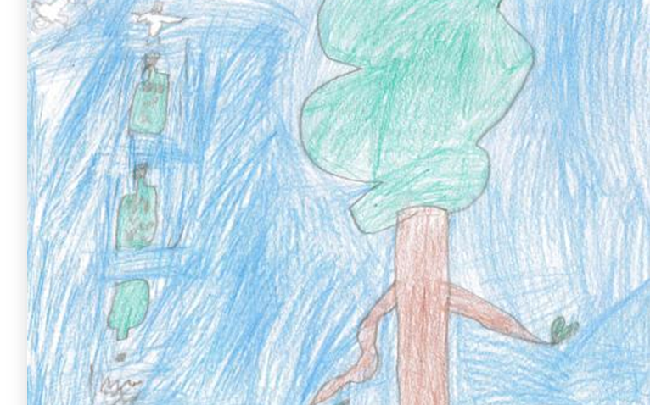
Which of these four did you like best? Why?
Which ideas do you agree with about prayer,
and which do you disagree with?
If you made an artwork to show your ideas about prayer, what would you picture?
Prayer Spaces in Schools: Good learning for all

Slide 14
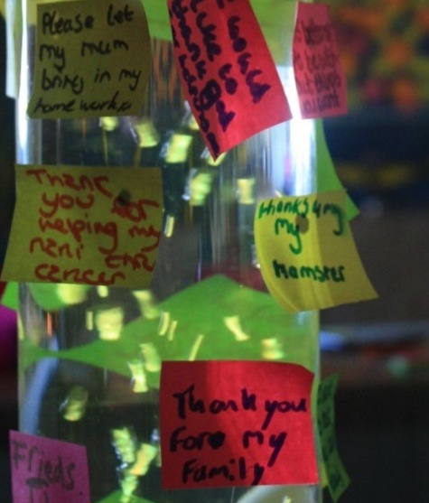
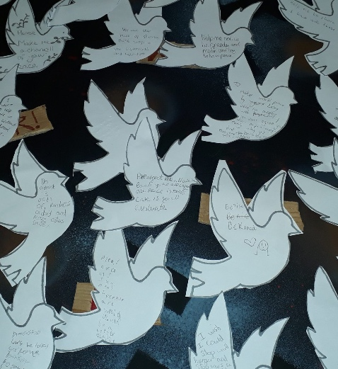
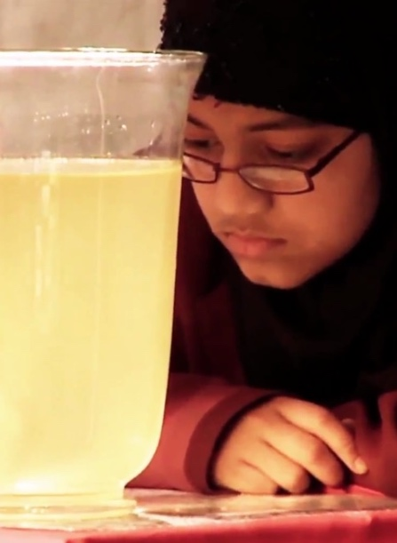
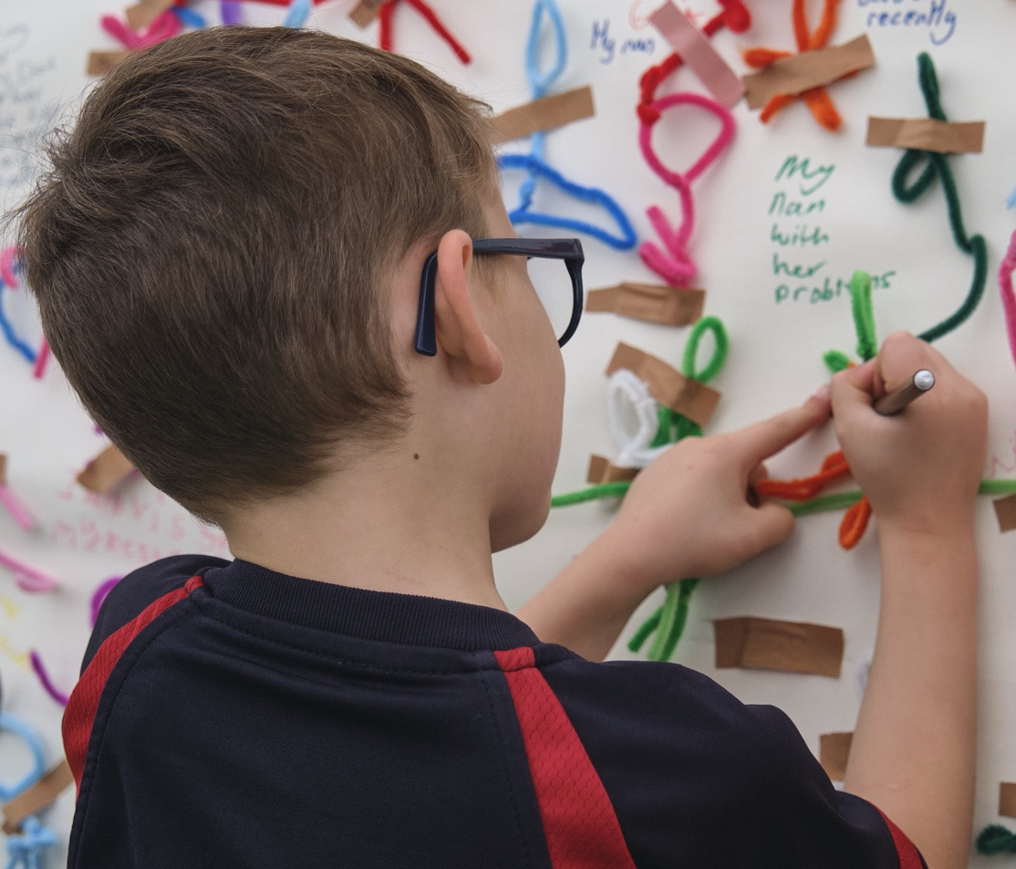
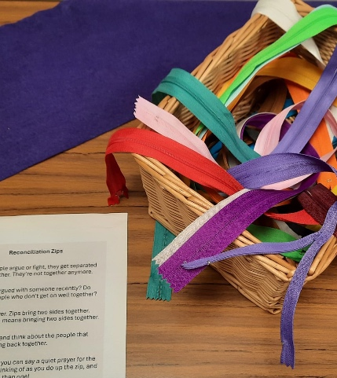
Notes:
Teaching may need the focus on welcome and open hearts and minds because sometimes pupils (perhaps rightly) wary of religion in school: they wonder if someone is trying to force them to think one way.
These lessons are about getting young students to think for themselves, not to accept anyone else’s dogma. Of course, there’s an important argument about ‘whose dogma’ our contemporary culture places centrally: for some, it is the possibility of religion being taken seriously and appreciated that our culture denies. Others see this the other way round.
The point here is to show pupils both sides of these questions and invite increasingly informed responses.

Slide 15
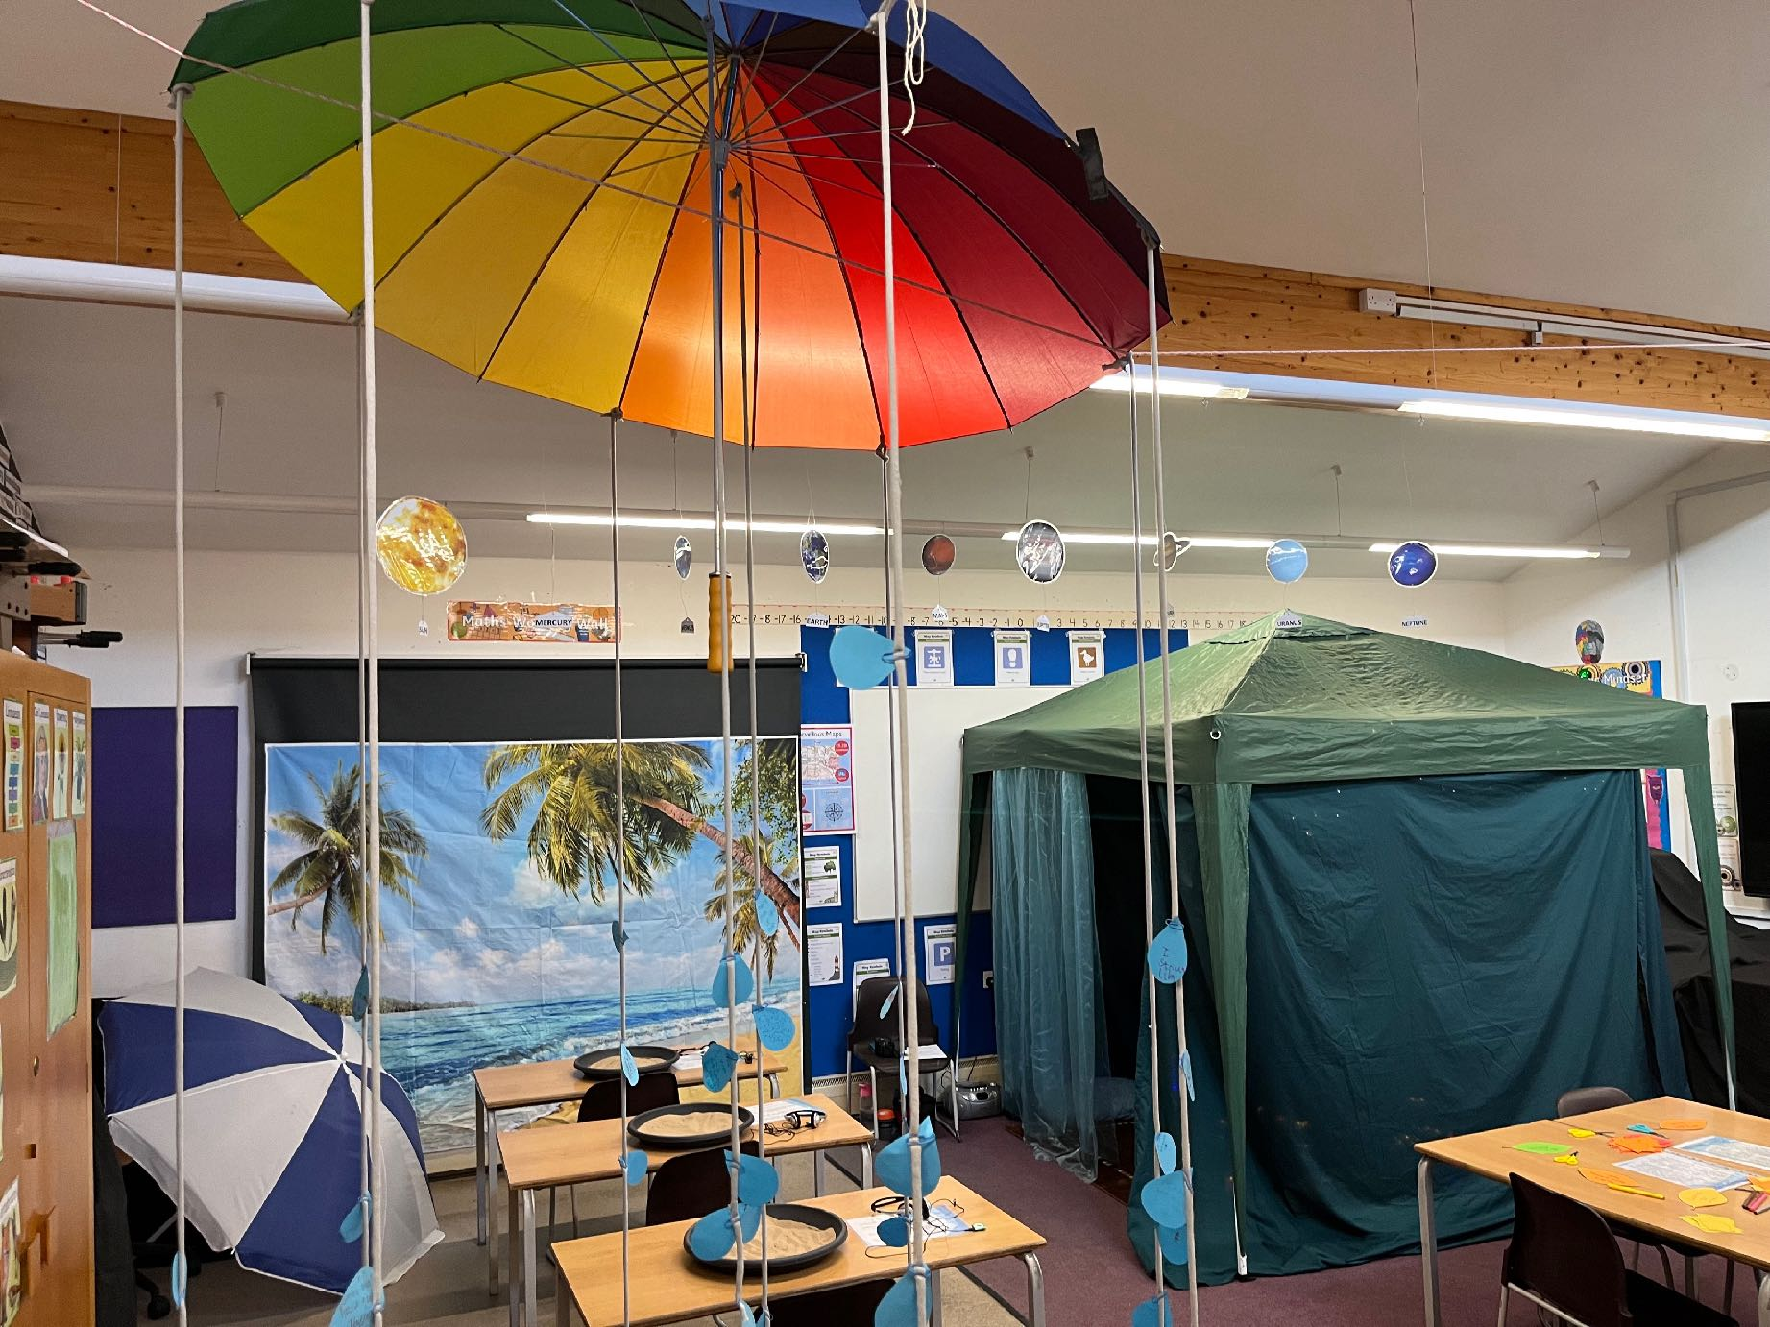
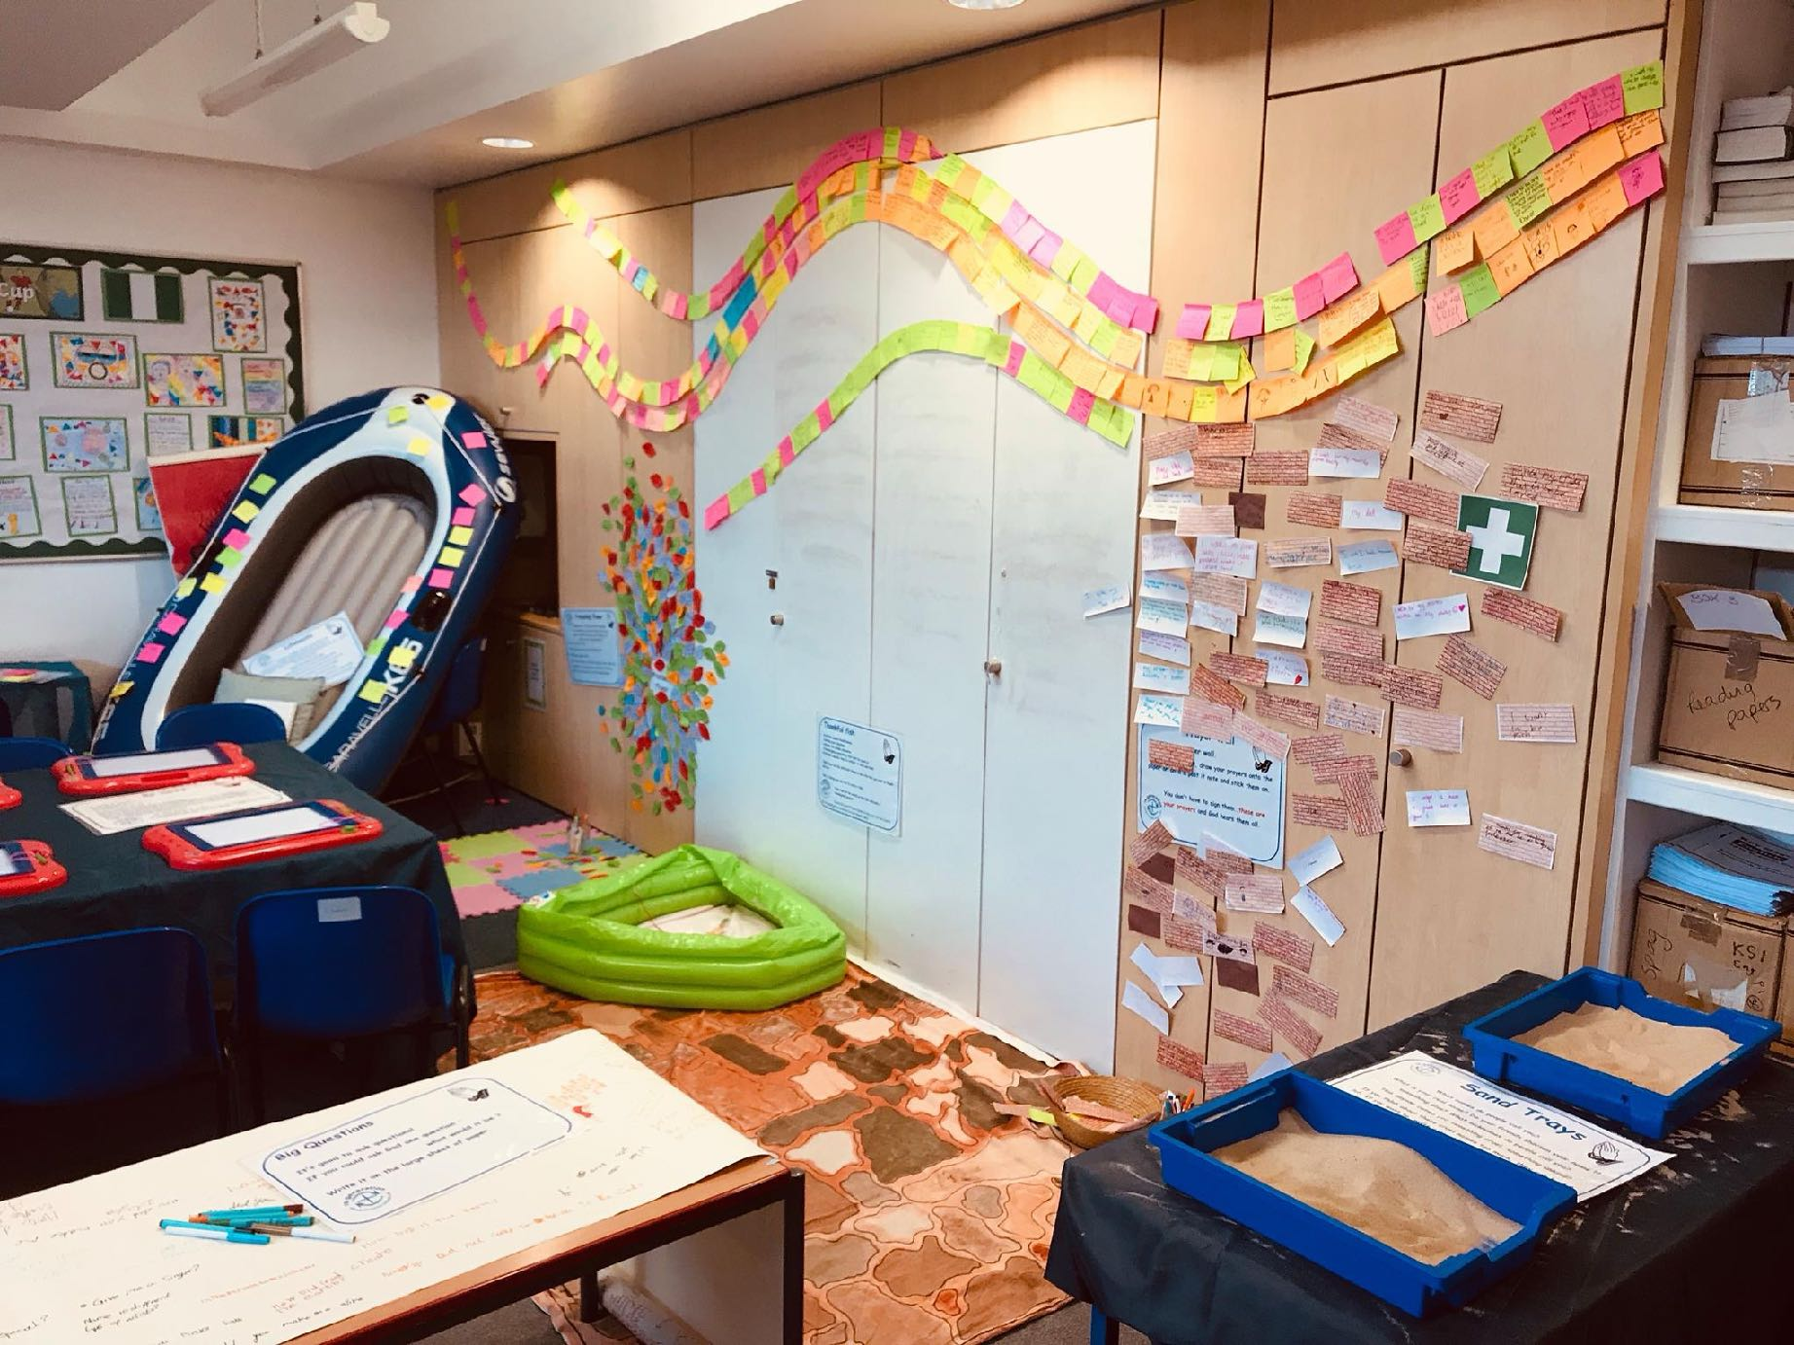
What is a ‘Prayer Space’?
We will make an area of your school look a bit different by turning it into what we call a ‘Prayer Space’. It might be in your hall, a classroom or even outside.
Notes:
For teachers and lesson leaders: Prayer Spaces are hugely varied. They use a broad understanding of prayer. Activities in a Prayer Space in School may enable pupils to reflect deeply or profoundly on themselves, their relationships, their place on the earth and their connection with ‘the big beyond’ – God, as many say.
These spaces use activities which engage with happiness and sorrow, success and failure, strength and weakness, faith and doubt. The activities are often and by turns responsive, provocative, creative ,imaginative, focused on the human spirit. They make space for the spiritual. No two prayer spaces are the same, and each individual’s experience of the Space will be unique.
These Spaces are never coercive – we don’t think there is any such thing as ‘forced prayer’. Instead, the Prayer Spaces open up new horizons of imagination, possibility and faith.

Slide 16
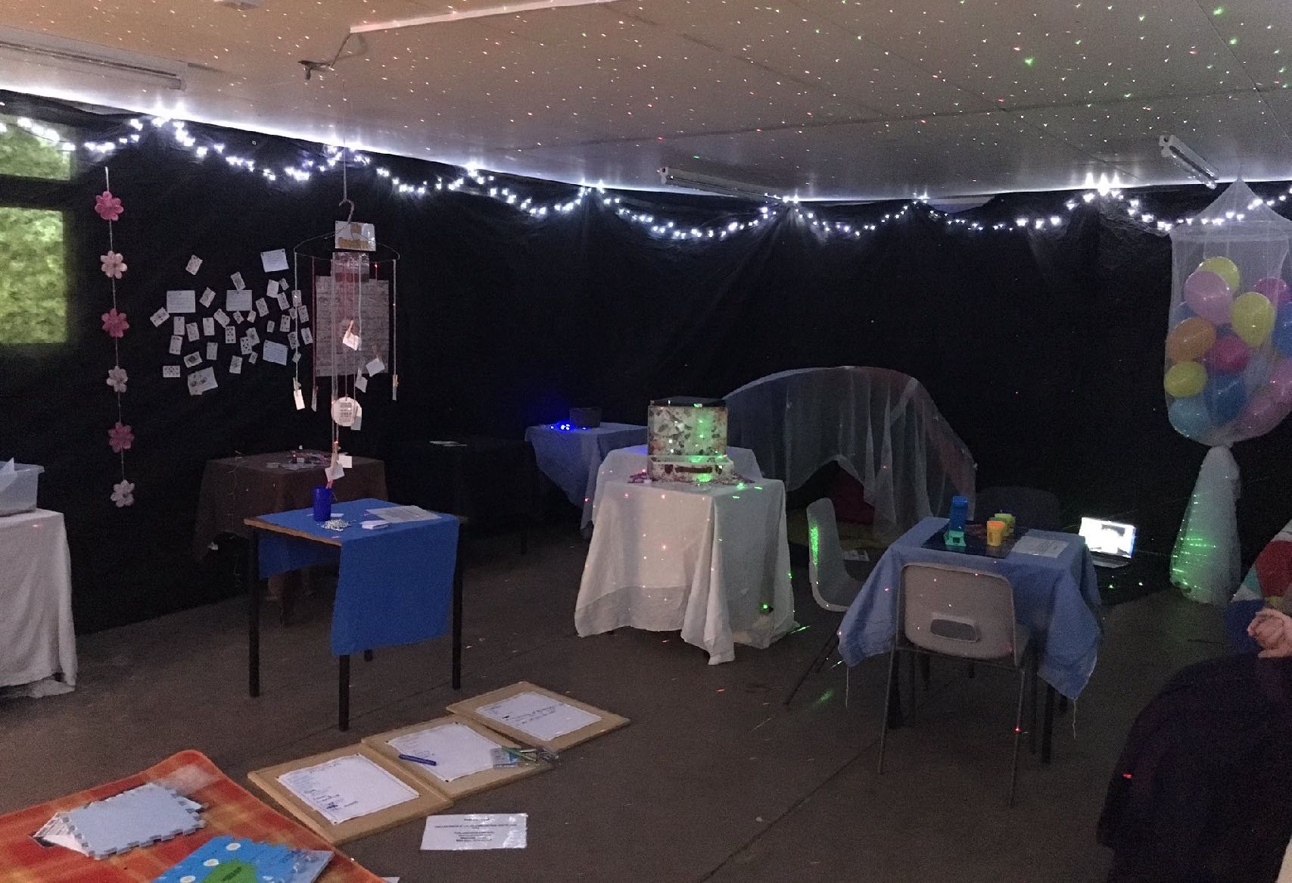
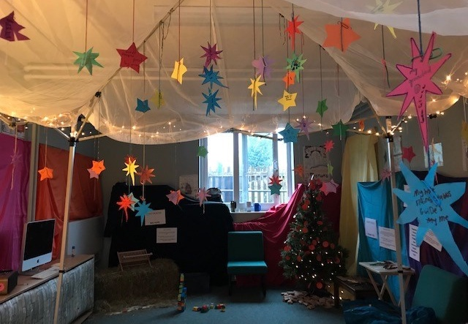
What is a ‘Prayer Space’?
If it’s inside, the space might not be as bright as usual and will feel peaceful, with coloured lights and calm music. You might see tables, tents, teepees, mats, cushions and chairs.
When you arrive we will start by gathering together to chat about what we will be doing.
Notes:
For teachers and lesson leaders: Prayer Spaces are hugely varied. They use a broad understanding of prayer. Activities in a Prayer Space in School may enable pupils to reflect deeply or profoundly on themselves, their relationships, their place on the earth and their connection with ‘the big beyond’ – God, as many say.
These spaces use activities which engage with happiness and sorrow, success and failure, strength and weakness, faith and doubt. The activities are often and by turns responsive, provocative, creative ,imaginative, focused on the human spirit. They make space for the spiritual. No two prayer spaces are the same, and each individual’s experience of the Space will be unique.
These Spaces are never coercive – we don’t think there is any such thing as ‘forced prayer’. Instead, the Prayer Spaces open up new horizons of imagination, possibility and faith.

Slide 17
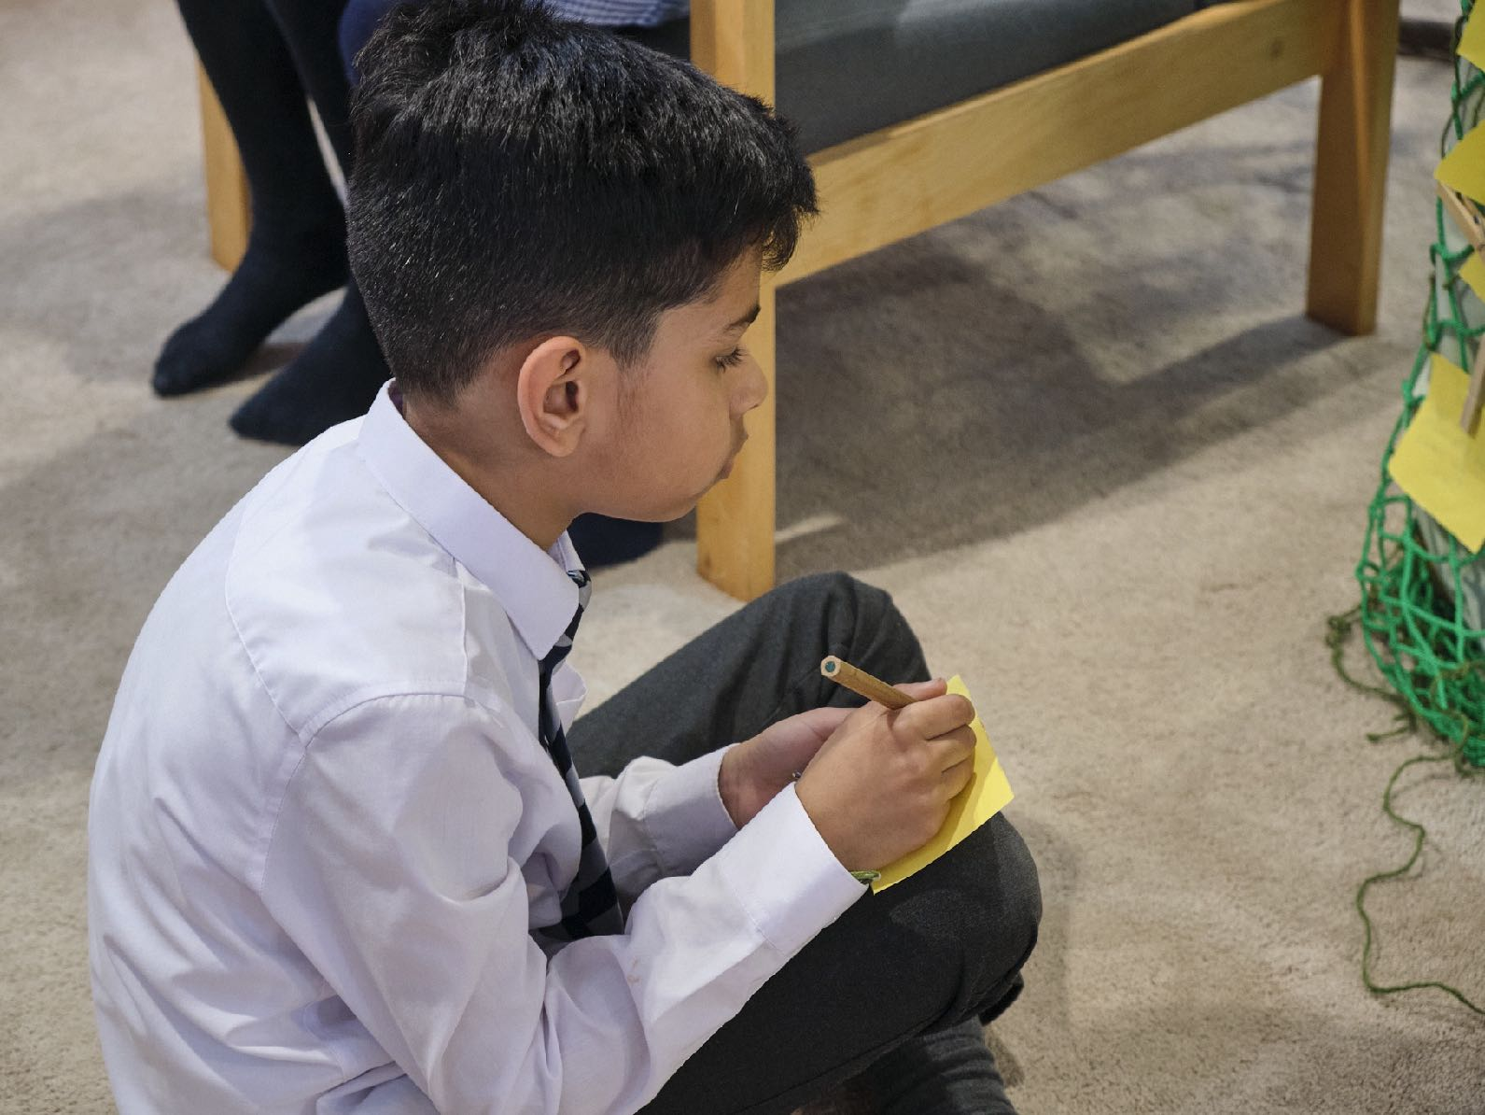
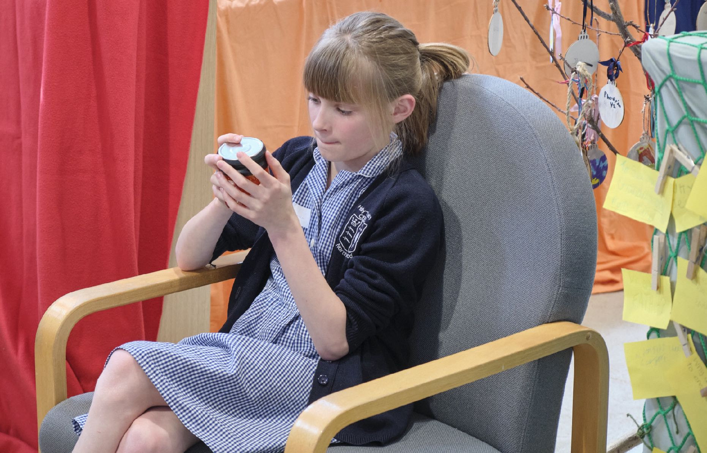
What is a ‘Prayer Space’?
You don’t have to be religious to like this.
It’s a chance to think really deeply or to feel really fully.
You can ponder some big issues and questions, or find calm, or peace. Lots more too.
Notes:
For teachers and lesson leaders: Prayer Spaces are hugely varied. They use a broad understanding of prayer. Activities in a Prayer Space in School may enable pupils to reflect deeply or profoundly on themselves, their relationships, their place on the earth and their connection with ‘the big beyond’ – God, as many say.
These spaces use activities which engage with happiness and sorrow, success and failure, strength and weakness, faith and doubt. The activities are often and by turns responsive, provocative, creative ,imaginative, focused on the human spirit. They make space for the spiritual. No two prayer spaces are the same, and each individual’s experience of the Space will be unique.
These Spaces are never coercive – we don’t think there is any such thing as ‘forced prayer’. Instead, the Prayer Spaces open up new horizons of imagination, possibility and faith.

Slide 18
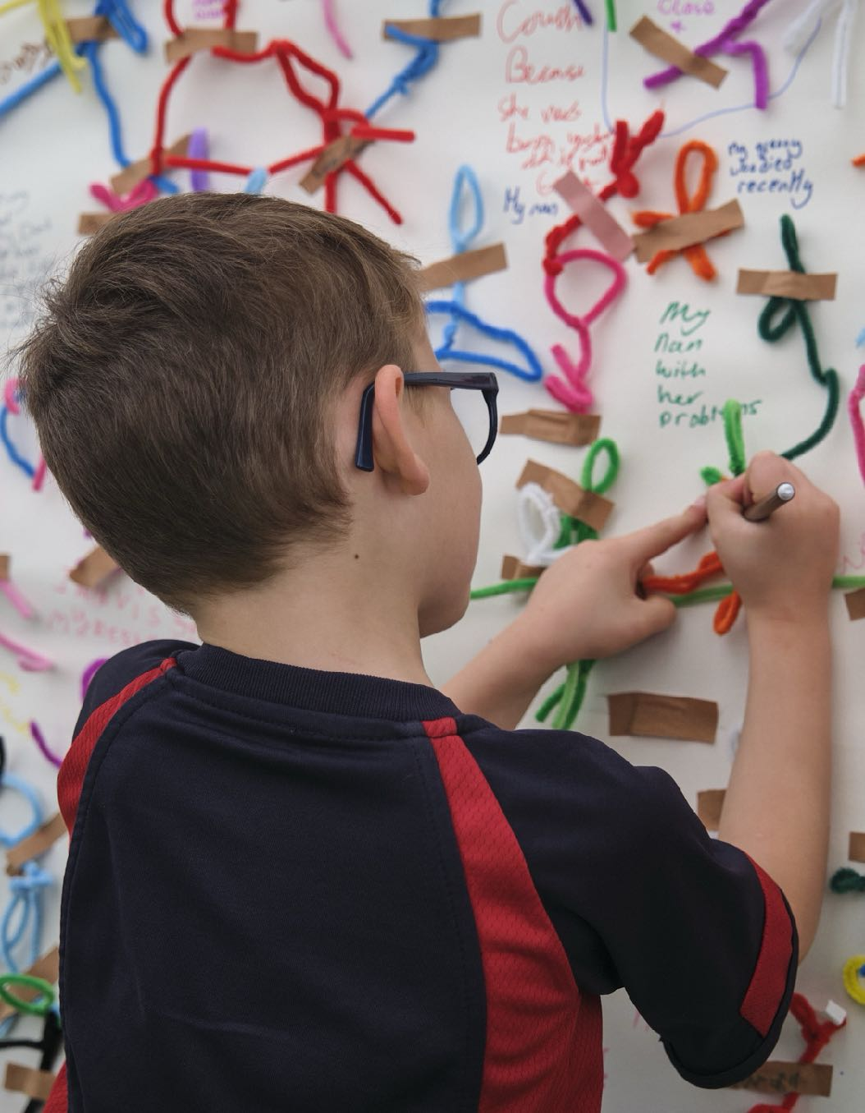
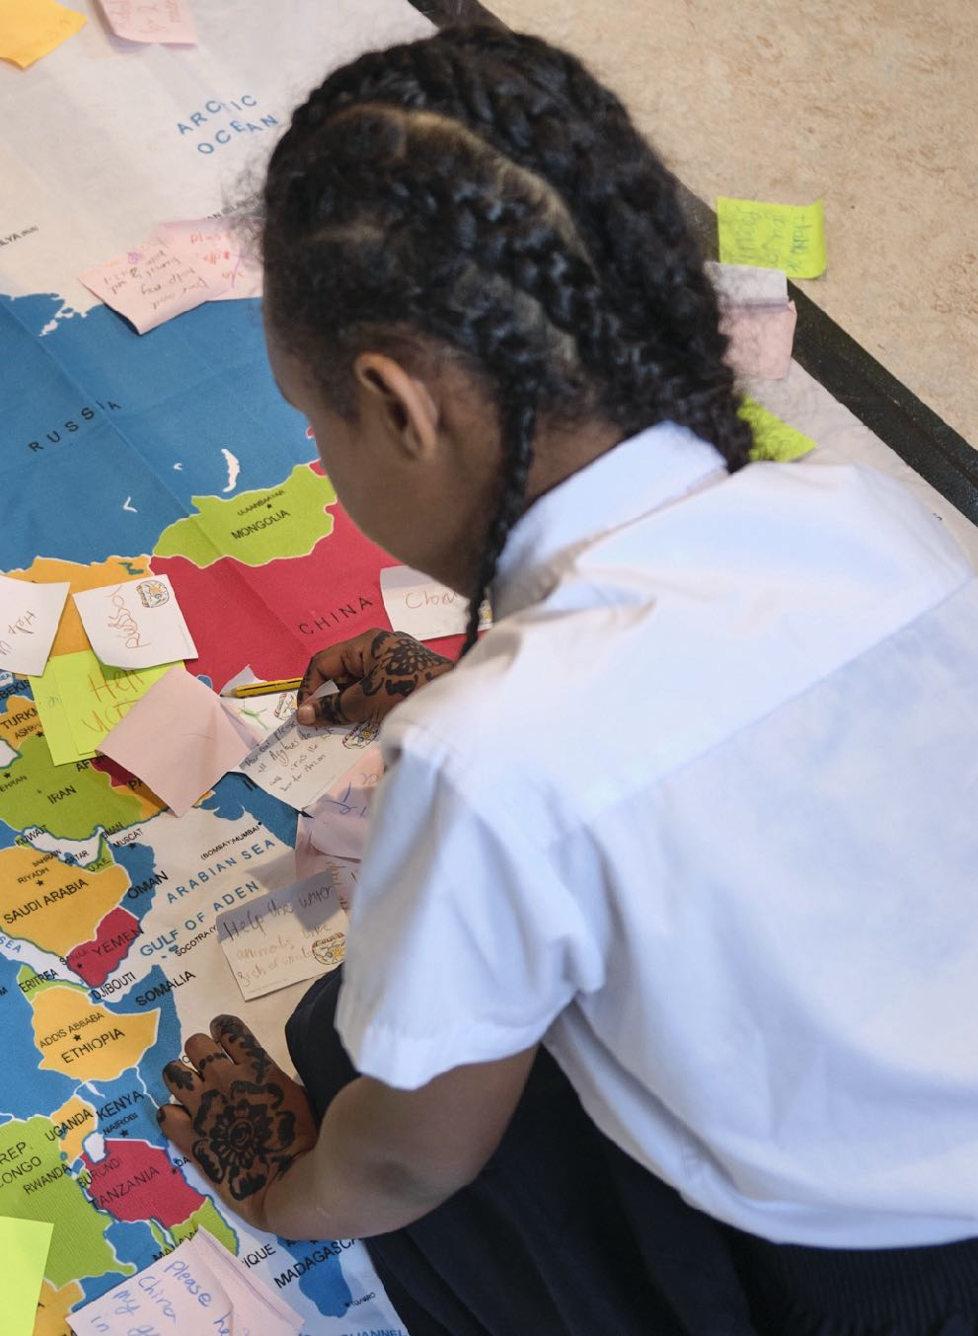
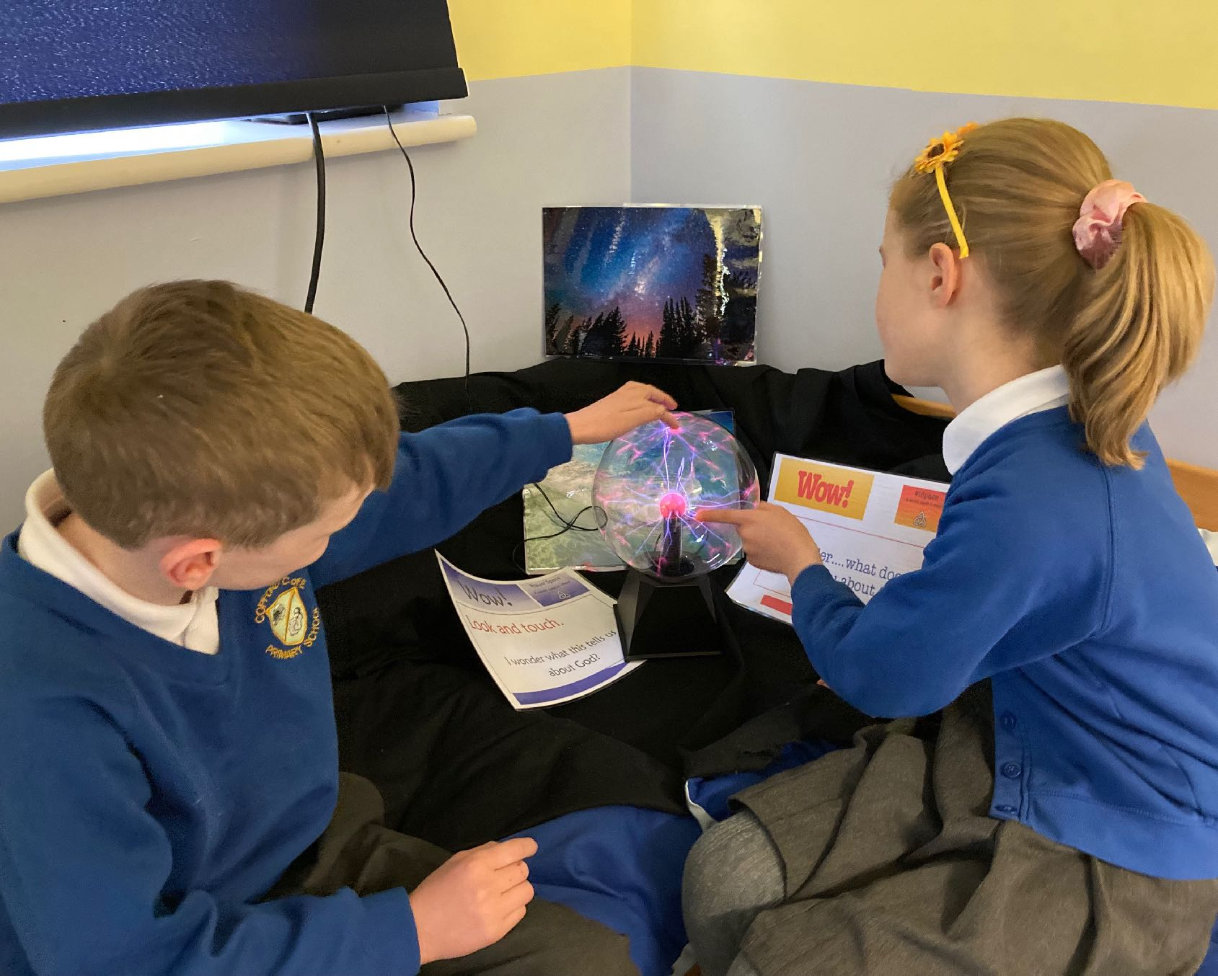
What is a ‘Prayer Space’?
It’s about you, your relationships, our earth and ideas about God or the ‘Big Beyond’.
Notes:
For teachers and lesson leaders: Prayer Spaces are hugely varied. They use a broad understanding of prayer. Activities in a Prayer Space in School may enable pupils to reflect deeply or profoundly on themselves, their relationships, their place on the earth and their connection with ‘the big beyond’ – God, as many say.
These spaces use activities which engage with happiness and sorrow, success and failure, strength and weakness, faith and doubt. The activities are often and by turns responsive, provocative, creative ,imaginative, focused on the human spirit. They make space for the spiritual. No two prayer spaces are the same, and each individual’s experience of the Space will be unique.
These Spaces are never coercive – we don’t think there is any such thing as ‘forced prayer’. Instead, the Prayer Spaces open up new horizons of imagination, possibility and faith.

Slide 19
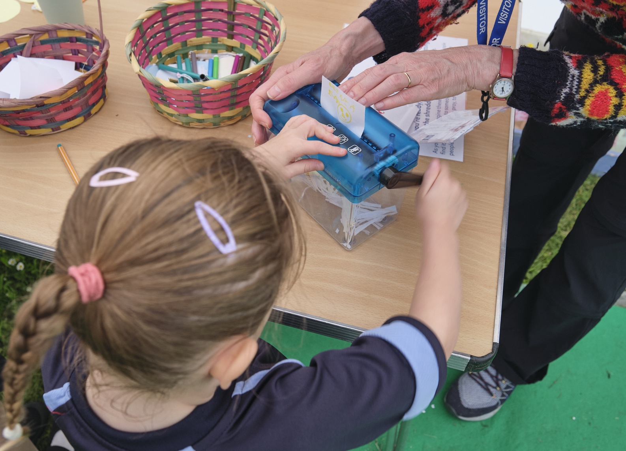
What is a ‘Prayer Activity’?
There will be different activities or ‘stations’ each with their own special area.
At each activity there will be a sign for you to read. It will give you an idea to think about, and some instructions about something you can do as a way to pray or reflect.
This one is called ‘Letting go’.
It helps us to let go of our worries by writing them down and shredding them.
Notes:
The instructions for this prayer activity say:
Sometimes we can feel weighed down by our worries. Some worries just slow us
down, but some worries can stop us enjoying the good things in our lives.
Take a piece of paper and write or draw the thing that’s causing you to worry or feel
stressed. How would it feel to let go of this worry?
When you’re ready, let go of the worry by putting it into the shredder and turning the
handle.
As you do this, imagine these worries disappearing.
Many people find it helpful to talk to someone about their worries, and some people
find it helpful to pray, to talk to God.

Slide 20
Broad views of prayer and spirituality
Prayer: not just ‘hands together, eyes closed.’
Some people pray with music, silence, dance or words.
Some people pray alone, in a holy building, in the open air or in private
In a Prayer Space, you might find you can use colour or bubbles, body language or post it notes, big ideas or big questions to pray. See how it works for you.
What would you like to ask your teacher about the Prayer Space?
Notes:
Prayer is a controversial topic, and in writing these lessons we are pleased to present some activities that ask pupils to use their critical thinking skills. Ideas and materials form different religions and from atheist and agnostic perspectives enrich the learning, which has mind-opening intentions.

Slide 21
What does the Bible offer to help us understand Christian prayer?
In Matthew’s Gospel, chapter 6, Jesus talks to his followers about private prayer:
“When you pray, go into your room, close the door and pray to your Father, who is in heaven. Then your Father, who sees what is done in secret, will reward you.”
Why do you think Jesus told his followers to do this?
How might people follow this teaching today?
Notes:
These lessons enable pupils to learn a lot specifically about Christian prayer, and use Biblical quotations, examples and texts to enrich pupils’ understanding.
Teachers who use this slide make strong connections with the curriculum.

Slide 22
What does the Bible offer to help us understand Christian prayer?
Saint Paul writes, in his letter to Christians at Thessalonica:
“Rejoice always, pray continually, give thanks in all circumstances!
For this is God’s will for you in Christ Jesus.”
Why do you think Saint Paul told the Christians to do this?
How might people follow this teaching today?
Notes:
These lessons enable pupils to learn a lot specifically about Christian prayer, and use Biblical quotations, examples and texts to enrich pupils’ understanding.
Teachers who use this slide make strong connections with the curriculum.

Slide 23
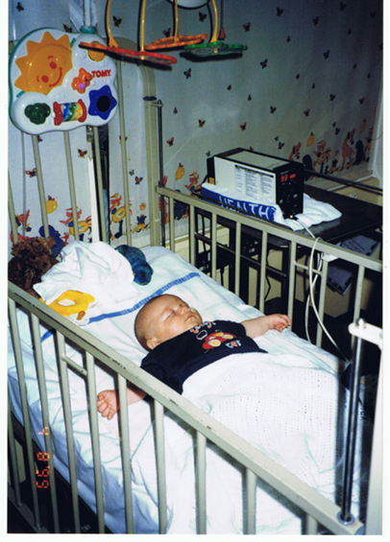
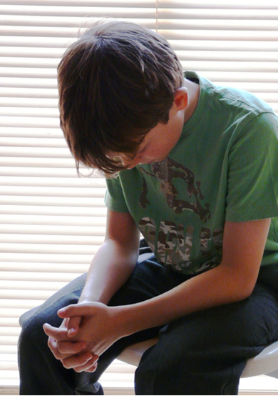
Who prays what and when?
Look at the two pictures, and use your imagination.
Write the prayer that you think the boy might be praying.
Notes:
This activity is useful but be aware of children in the class for whom this example might be too sensitive. The aim is to invite pupils to write prayers ‘as if’ from the boy’s POV, engaging imagination so believers in prayer or non-believers can have a go – there are no correct answers.

Slide 24
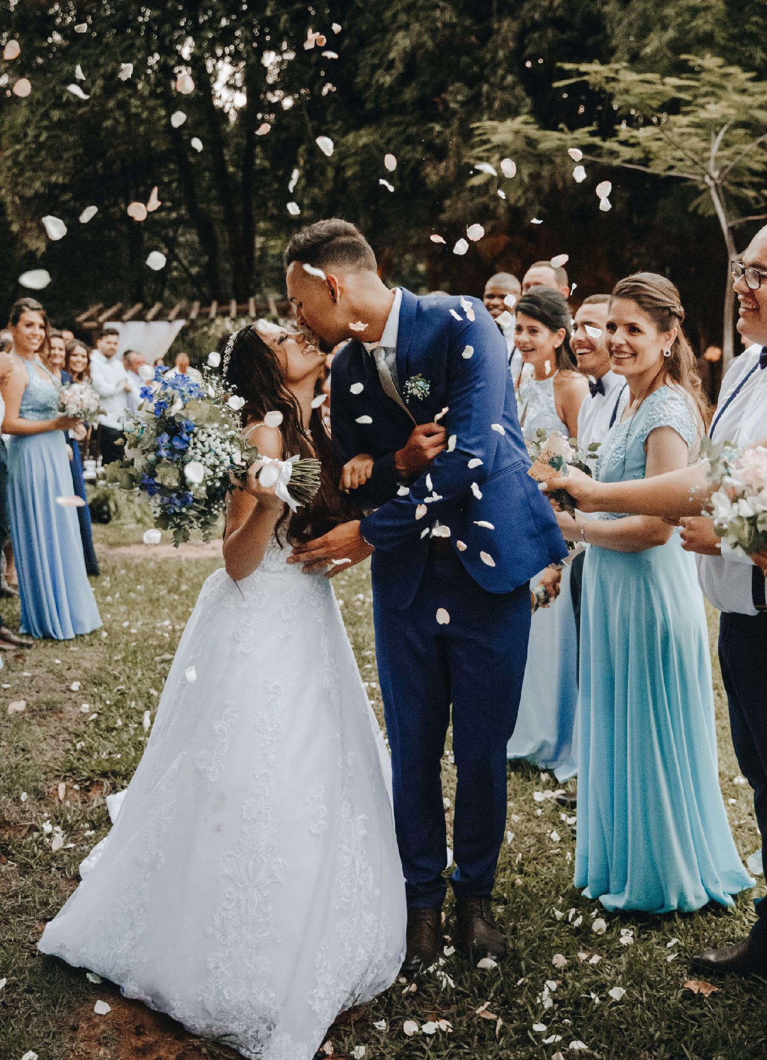
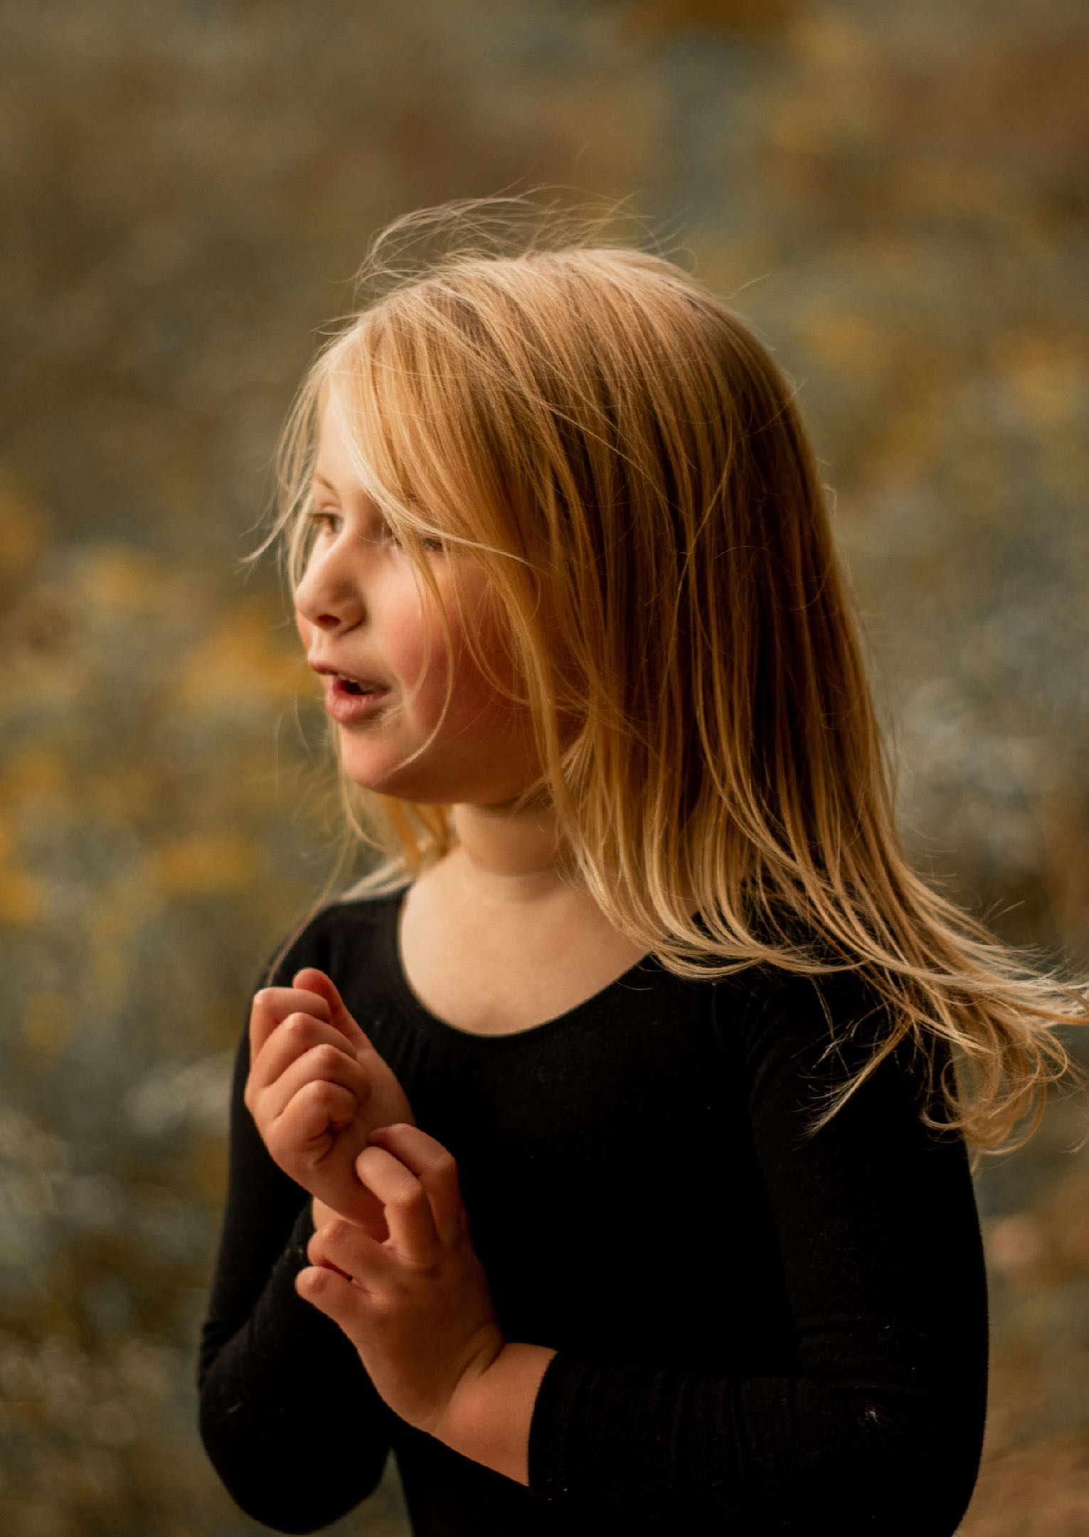
Who prays what and when?
Look at the two pictures, and use your imagination.
Write the prayer that you think the girl might be praying.
Notes:
Here is another scenario with an invitation for to invite pupils to write prayers ‘as if’ from the girl’s POV, engaging imagination so believers in prayer or non-believers can have a go – there are no correct answers.

Slide 25
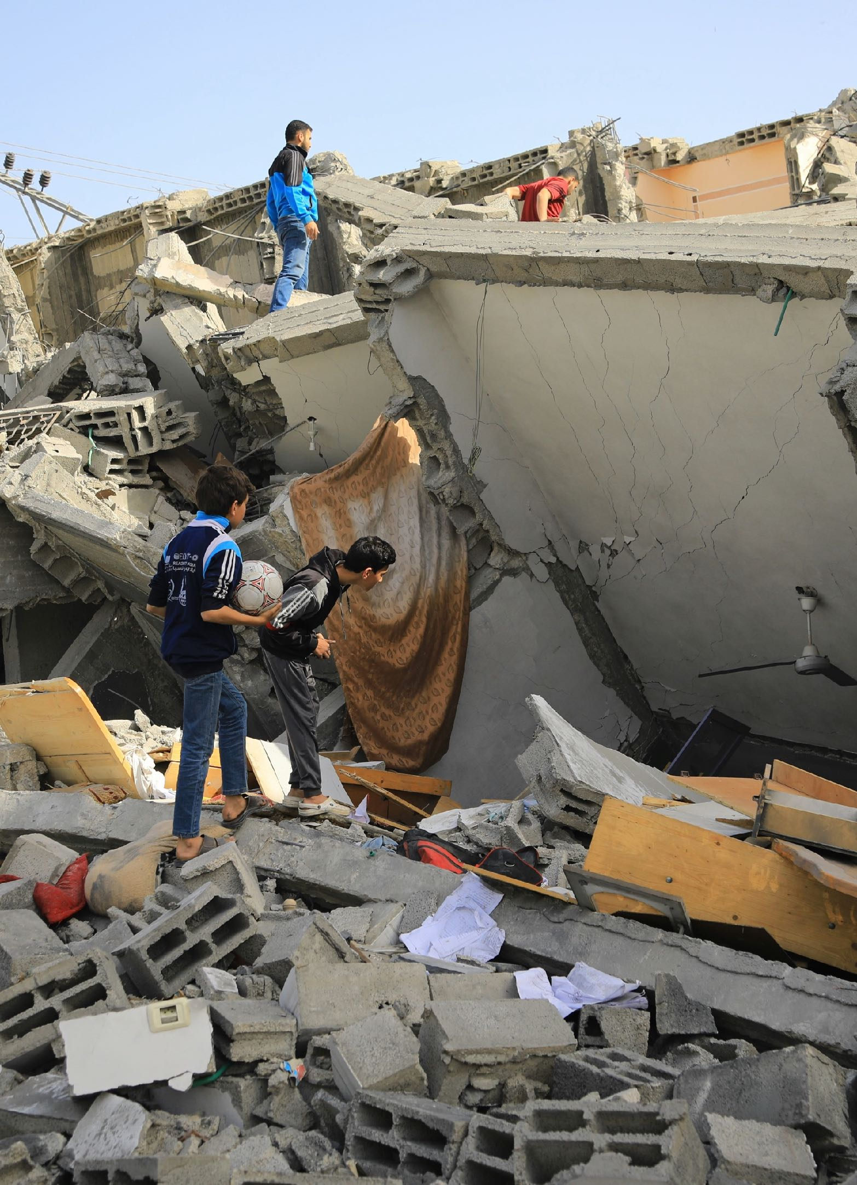
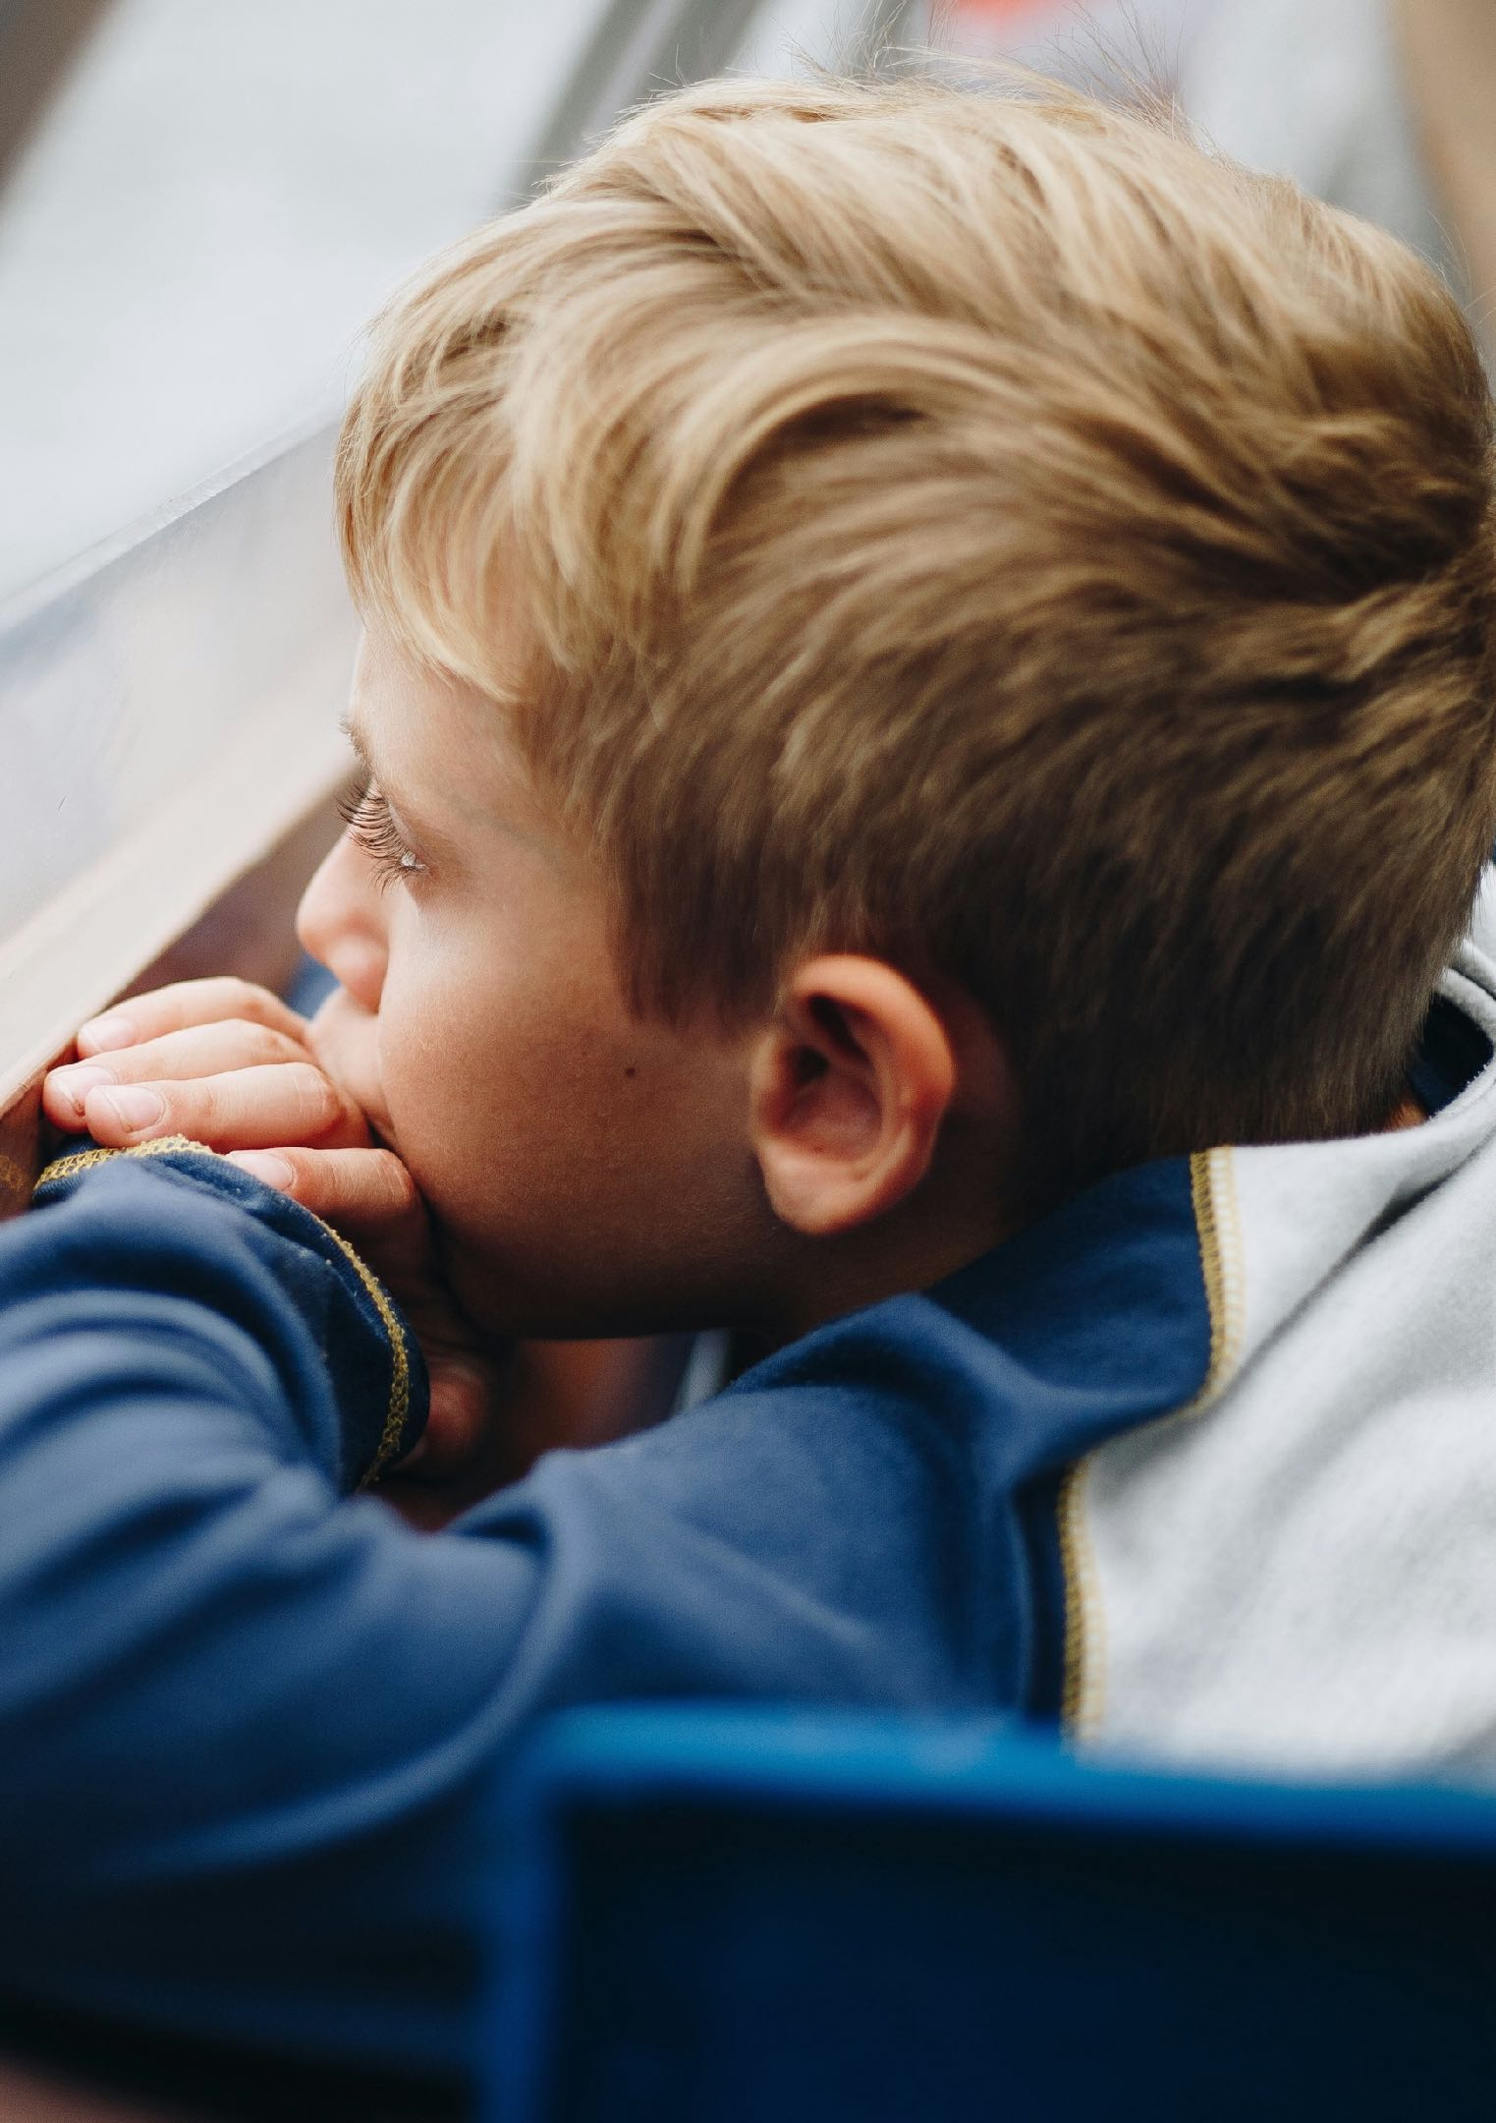
Who prays what and when?
Look at the two pictures, and use your imagination.
Write the prayer that you think the boy might be praying.
Notes:
Here is another scenario with an invitation for to invite pupils to write prayers ‘as if’ from the girl’s POV, engaging imagination so believers in prayer or non-believers can have a go – there are no correct answers.

Slide 26
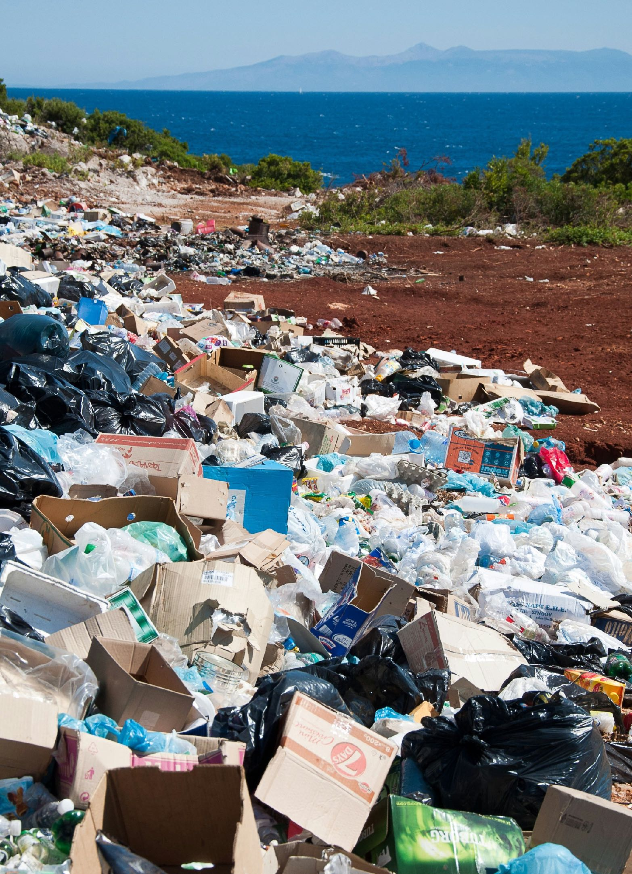
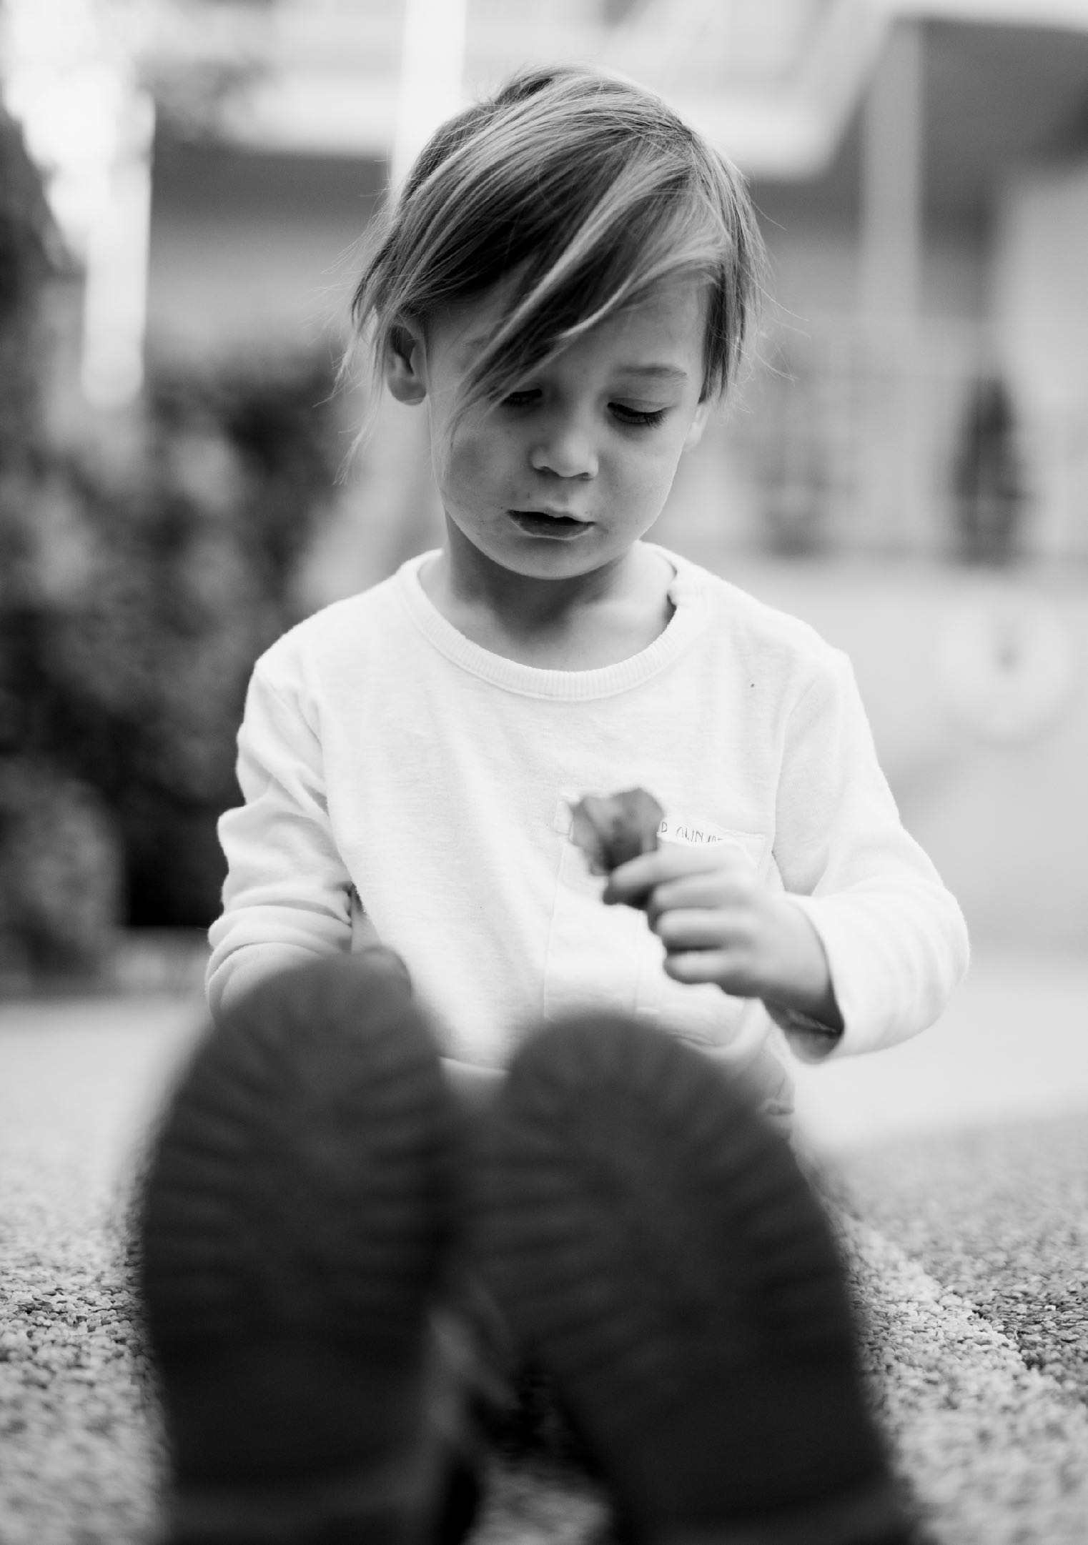
Who prays what and when?
Look at the two pictures, and use your imagination.
Write the prayer that you think the girl might be praying.
Notes:
Here is another scenario with an invitation for to invite pupils to write prayers ‘as if’ from the girl’s POV, engaging imagination so believers in prayer or non-believers can have a go – there are no correct answers.

Slide 27
When you visit the Prayer Space in your school…
Expect it to be a bit different from everyday school
Take an open minded attitude
It’s a free and welcoming experience – no one will force you to do anything
Be ready to use your imagination
Don’t worry: it is inclusive and everyone is welcome, if you believe in prayer and pray lots, or if you’ve never done that and don’t believe in prayer, there will be some interesting things to think about
Talk, talk, talk: it’s great when pupils using prayer spaces to speak up about their feelings, their ideas and their experience
Silence, silence, silence: what happens in the prayer space might be personal, emotional, spiritual. Keep it private if you want to – and take the silence as a gift. We probably need a bit more calm and quietness in our lives…
Notes:
This slide tries to offer pupils a reassuring description of the ways the Prayer Space might work for them. Teachers will do well to familiarise themselves wit the particular activities and ideas in the Prayer Space at their school and refer to them with pupils. The website has hundreds of examples, but each Prayer Space is unique.

Slide 28
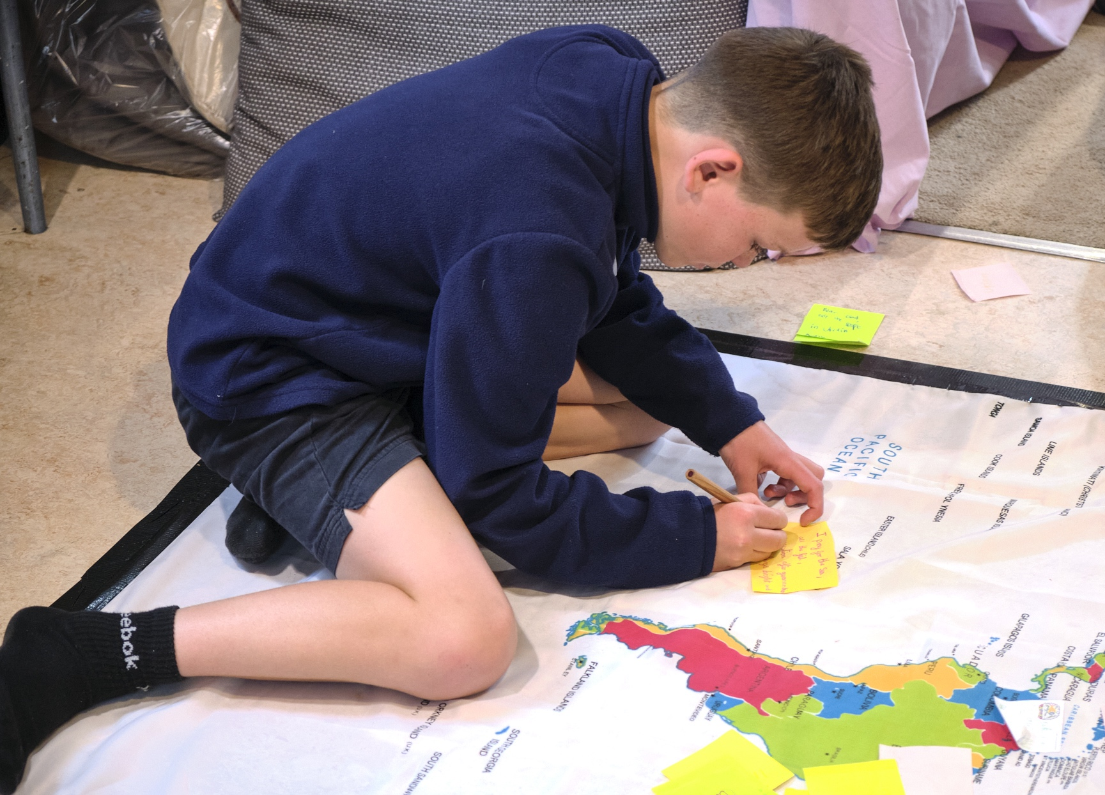
10 year old boy:
“Prayer makes me feel like I really have a part in life instead of being here for no reason. Everyone has a reason why they were born but not many people know that reason yet. And they have a gift (prayer, help) and lots more. It’s just that not everyone has discovered their gift yet: but they should do soon enough.”
Maybe the Prayer Space in your school can help you to discover a gift.
Notes:
This lesson will set up some pupils for their experience of a Prayer Space – it also enables them to think critically about their own big ideas about prayer – and God.

