Slide 1





Prayer Spaces in Schools
Learning from a prayer space
KS2 Lesson 2 of 4 What is prayer?
Learning opportunities for 7-11s on themes about prayer and reflection.
Prayer Spaces in Schools create extraordinary opportunities for children and young people to think about prayer and to consider spirituality in open-minded experiential ways.
This lesson is one of a series written by Lat Blaylock of RE Today and provided free to schools to enable learners to use critical and reflective thinking skills to learn about spirituality, prayer and reflection.
is part of
Notes:
These lessons are written by Lat Blaylock, RE Consultant with RE Today www.retoday.org.uk
Aims of these lessons:
To provide excellent and respected classroom resources for teachers of RVE / RME / RE to use in lessons when a PRAYER SPACES visit is coming, taking place or has happened,
To enable teachers and PRAYER SPACES volunteers to deliver quality RVE / RME / RE about prayer which connects to the experiences of the PRAYER SPACES provision.
To enable pupils to think for themselves about prayer and its meanings, and access opportunities for spiritual, moral, social and cultural development.

Slide 2
Providing quality ‘state of the art’ RE / RVE / RME lessons ready to use for KS2 & KS3
Suitable for both teachers of RE / RVE / RME and Prayer Spaces volunteers to deliver.
Suitable for pre-Prayer Space and post Prayer Space uses.
About these resources.
Suitable for all pupils in all kinds of schools
Encouraging open hearted and critical thinking about prayer and reflection
Enhancing the experience of using a Prayer Space in school with good learning
Offering learners the chance to develop their own personal ideas about philosophical and social questions on the themes of prayer and reflection
Engaging, creative and absorbing learning.
We provide well prepared presentations, lesson plans and training webinars and examples.
Adaptive suggestions in lesson plans to help volunteers or fit in with teachers’ needs.
Introducing concepts and questions about Christian prayer. Providing resources to set high standards of RE / RVE / RME, deepening learning.
Also including assembly delivered options for school worship / religious observance
Integrated with common RE / RVE / RME units of work and ‘Understanding Christianity’ resources.
A lesson for KS2 and a lesson for KS3 in advance of the Prayer Space visit.
Suitable for all schools and all pupils offering creativity and critical engagement in the lessons.
Using active learning, creative multi-disciplinary methods, explained and resourced to be ‘ready to go’.
Three lessons each for KS2 and KS3, all free standing, that follow up the visit.
Notes:
Teachers and Youth Workers can use this lesson, which is part of a larger ‘Prayer Spaces in School’ learning package.
The lessons:
Can be taught - with preparation - ‘off the shelf’ using the 6 PPT sequences provided
Will be understood better by teachers and youth workers if you watch our training recorded webinars from Lat Blaylock of RE today LINK:
Include examples of pupils’ work, art, writing and responses
Are suitable for use across the UK, recognizing what is distinctive about RME / RVE / RE in each of the four nations
Reference law, guidance and inspection requirements for RE / SMSCD / School Worship
Use some PRAYER SPACES case studies

Slide 3
Prayer Spaces in Schools
Learning from a prayer space
Experiencing the spiritual
This is one lesson in a set which enables learners to respond to questions such as:
What is prayer? Meditation? Reflection?
Why are some prayers answered, and some unanswered?
Can prayer make a person feel happy? Calm? Thankful? Forgiven? How?
What can we find out about praying from social studies? Philosophy? Theology?
What do Christians say about prayer and Jesus, their own prayer practices and the ways prayer ‘works’?
What do learners say about these big questions?
This lesson is very full, so do be selective in which parts you use, or spread it over two sessions.
Notes:
The topics addressed in these lessons include Biblical narrative and teaching, the Christian ‘Lord’s Prayer’, sociology of prayer, Christian experiences of prayer, creative prayer ideas, Christian theologies of prayer, Jesus and prayer, the phenomenon of ‘SBNR’ (spiritual but not religious) prayer, the experiences of answered prayer and unanswered prayer.
Questions and diverse ideas are the focus: these lessons aim to open minds not to deliver one set of answers to these questions.
The lessons are designed to compliment the opportunities for spiritual development that come from the experience of visiting and using a ‘Prayer Space’ in a school.

Slide 4
A human and humane model of spirituality
Spiritual growth is about…
Notes:
There is a vast literature and a continuing conversation about the nature of spirituality. The work of Dr Rebecca Nye, University of Cambridge, is useful in plural settings like school. Founded in research, her exposition of spirituality is child-centred, alert to Christianity and many other faiths and clear.
If you are interested to go further into the topic, two books are recommended: Children's Spirituality: What it is and Why it Matters (Sure Foundations) 2009, The Spirit of the Child: Revised Edition, DLT, 2006, by David Hay and Rebecca Nye.

Slide 5
A human and humane model of spirituality
Relating to myself – my inner life
Spiritual growth is about…
Notes:
There is a vast literature and a continuing conversation about the nature of spirituality. The work of Dr Rebecca Nye, University of Cambridge, is useful in plural settings like school. Founded in research, her exposition of spirituality is child-centred, alert to Christianity and many other faiths and clear.
If you are interested to go further into the topic, two books are recommended: Children's Spirituality: What it is and Why it Matters (Sure Foundations) 2009, The Spirit of the Child: Revised Edition, DLT, 2006, by David Hay and Rebecca Nye.

Slide 6
A human and humane model of spirituality
Relating to myself – my inner life
Spiritual growth is about…
Relating to others – living in love and community
Notes:
There is a vast literature and a continuing conversation about the nature of spirituality. The work of Dr Rebecca Nye, University of Cambridge, is useful in plural settings like school. Founded in research, her exposition of spirituality is child-centred, alert to Christianity and many other faiths and clear.
If you are interested to go further into the topic, two books are recommended: Children's Spirituality: What it is and Why it Matters (Sure Foundations) 2009, The Spirit of the Child: Revised Edition, DLT, 2006, by David Hay and Rebecca Nye.

Slide 7
A human and humane model of spirituality
Relating to myself – my inner life
Spiritual growth is about…
Relating to others – living in love and community
Relating to the earth – connecting with nature and the planet
Notes:
There is a vast literature and a continuing conversation about the nature of spirituality. The work of Dr Rebecca Nye, University of Cambridge, is useful in plural settings like school. Founded in research, her exposition of spirituality is child-centred, alert to Christianity and many other faiths and clear.
If you are interested to go further into the topic, two books are recommended: Children's Spirituality: What it is and Why it Matters (Sure Foundations) 2009, The Spirit of the Child: Revised Edition, DLT, 2006, by David Hay and Rebecca Nye.

Slide 8
A human and humane model of spirituality
Relating to myself – my inner life
Relating to the ultimate – the ‘Big Beyond’ - as some say, ‘God’
Spiritual growth is about…
Relating to others – living in love and community
Relating to the earth – connecting with nature and the planet
Notes:
There is a vast literature and a continuing conversation about the nature of spirituality. The work of Dr Rebecca Nye, University of Cambridge, is useful in plural settings like school. Founded in research, her exposition of spirituality is child-centred, alert to Christianity and many other faiths and clear.
If you are interested to go further into the topic, two books are recommended: Children's Spirituality: What it is and Why it Matters (Sure Foundations) 2009, The Spirit of the Child: Revised Edition, DLT, 2006, by David Hay and Rebecca Nye.

Slide 9
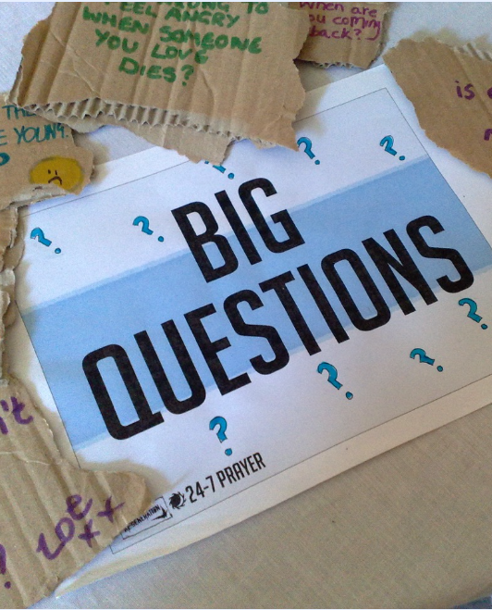
What did you think of the ‘Prayer Space’?
This lesson gives you the chance to learn about prayer, after your visit to the Prayer Space in your school.
Begin with a paired conversation.
Discuss these questions.
Prayer Spaces in Schools: Good learning for all
Notes:
For teachers and lesson leaders: Prayer Spaces are hugely varied. They use a broad understanding of prayer. Activities in a Prayer Space in School may enable pupils to reflect deeply or profoundly on themselves, their relationships, their place on the earth and their connection with ‘the big beyond’ – God, as many say. These spaces use activities which engage with happiness and sorrow, success and failure, strength and weakness, faith and doubt. The activities are often and by turns responsive, provocative, creative ,imaginative, focused on the human spirit. They make space for the spiritual.
No two prayer spaces are the same, and each individual’s experience of the Space will be unique. These Spaces are never coercive – we don’t think there is any such thing as ‘forced prayer’. Instead, the Prayer Spaces open up new horizons of imagination, possibility and faith.
These personal evaluative questions can be the subject of discussion only, but if you get written responses as well, the Prayer Space team will be VERY interested to see them – maybe give pupils three post-it sticky notes to record their thoughts.

Slide 10
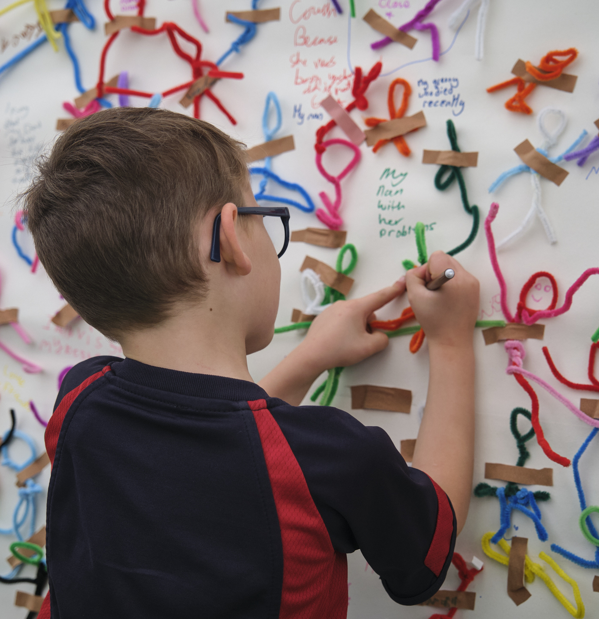
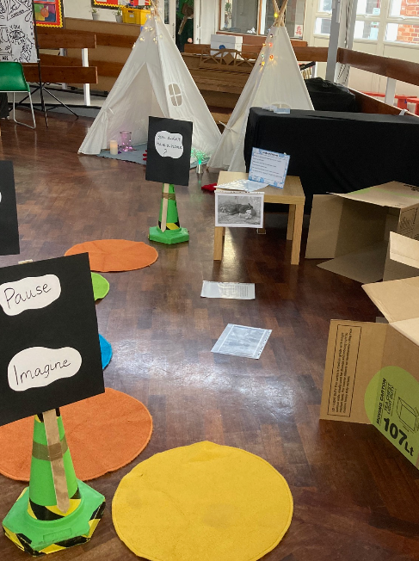
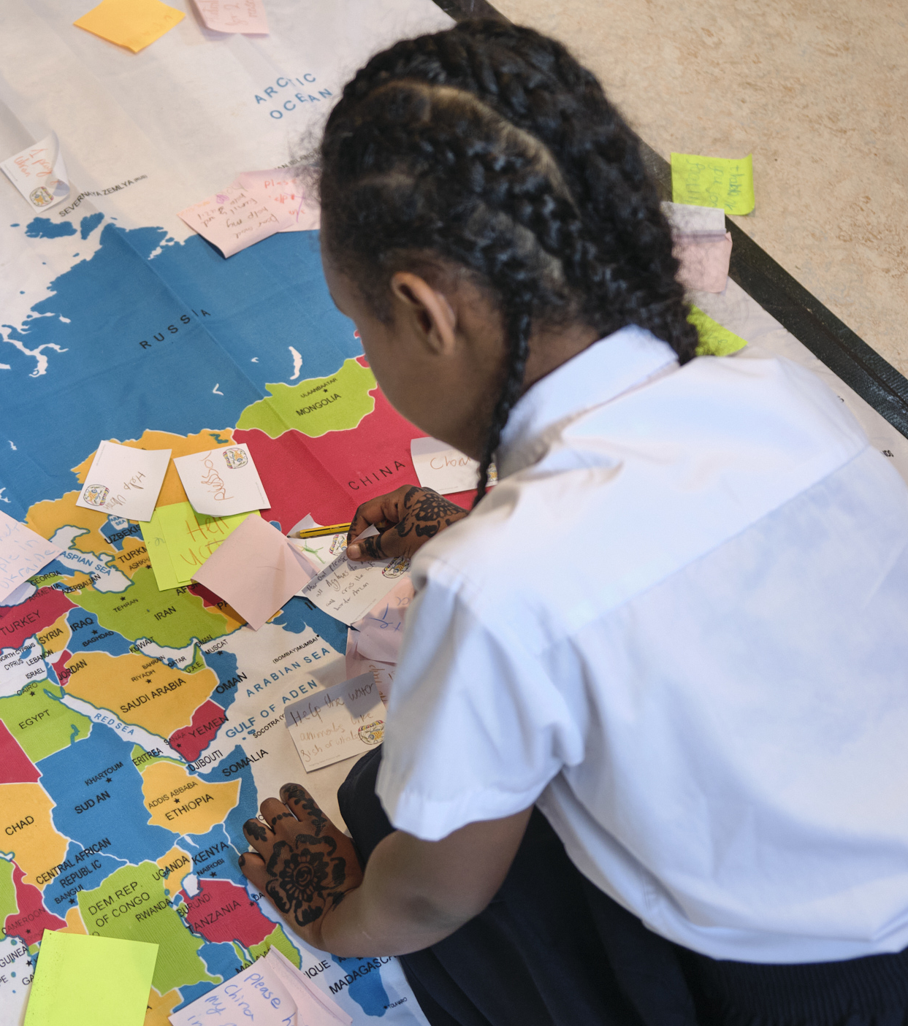
What did you like / dislike about the Prayer Space?
The aim is to give you some space in your life to get in touch with your ‘spiritual side’. How did that work for you?
What advice would you give to the people using the Prayer Space tomorrow?
Write your thoughts about the three points down briefly after your discussion.
Prayer Spaces in Schools: Good learning for all
Notes:
For teachers and lesson leaders: Prayer Spaces are hugely varied. They use a broad understanding of prayer. Activities in a Prayer Space in School may enable pupils to reflect deeply or profoundly on themselves, their relationships, their place on the earth and their connection with ‘the big beyond’ – God, as many say. These spaces use activities which engage with happiness and sorrow, success and failure, strength and weakness, faith and doubt. The activities are often and by turns responsive, provocative, creative ,imaginative, focused on the human spirit. They make space for the spiritual. No two prayer spaces are the same, and each individual’s experience of the Space will be unique. These Spaces are never coercive – we don’t think there is any such thing as ‘forced prayer’. Instead, the Prayer Spaces open up new horizons of imagination, possibility and faith.
These personal evaluative questions can be the subject of discussion only, but if you get written responses as well, the Prayer Space team will be VERY interested to see them – maybe give pupils three post-it sticky notes to record their thoughts.

Slide 11
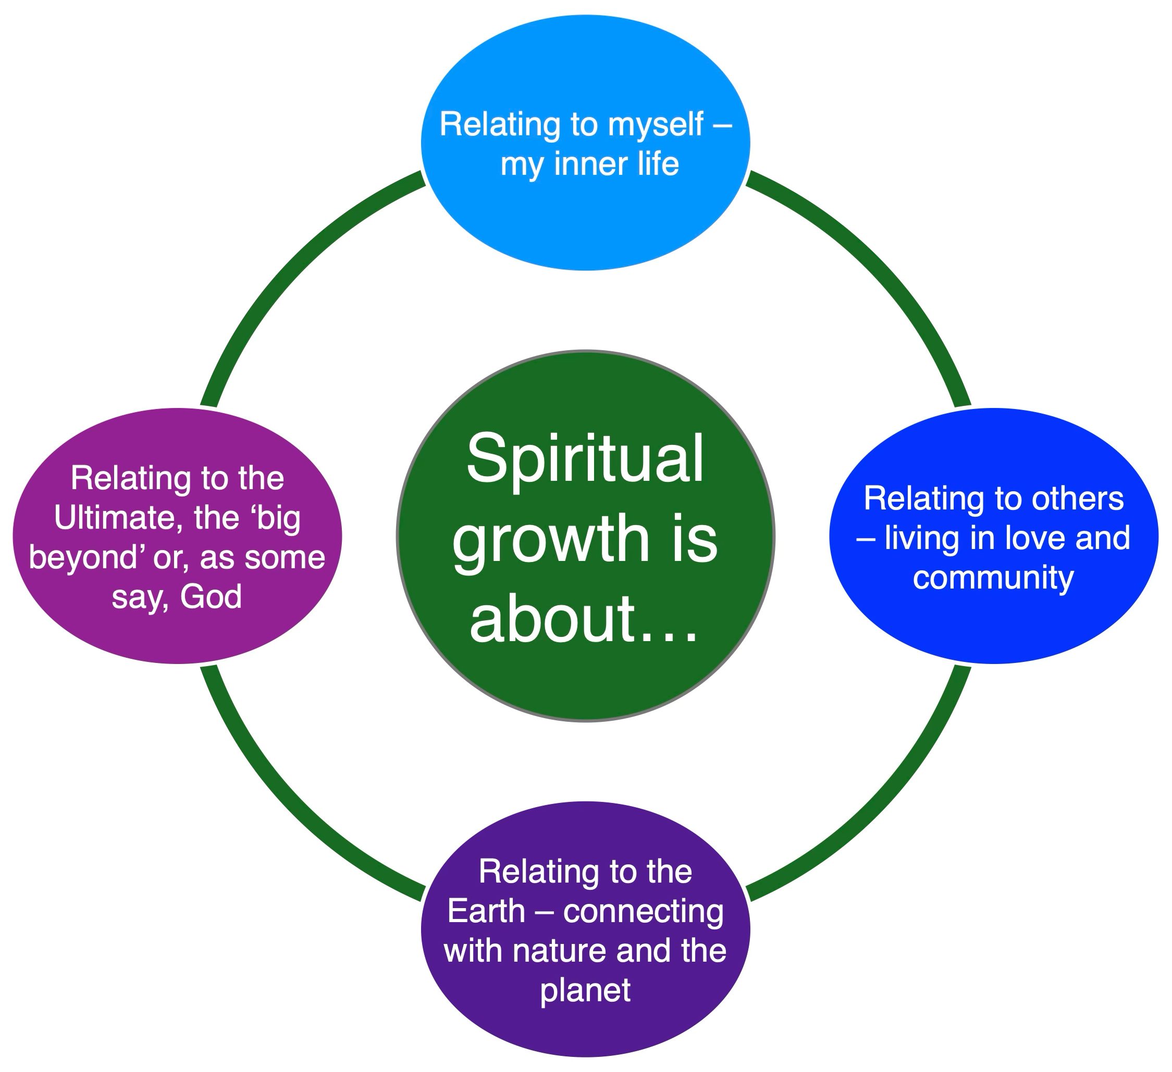
A human and humane model of spirituality
Prayer Spaces are for spirituality. So what does that word mean?
There are different definitions, but the one we use has four aspects.
These four parts of spiritual life are simple in a way: it’s about how you relate ‘in, out, down and up’
Demonstrate this with four arm actions:
In, put your hands to your chest.
Out, throw your arms out wide.
Down, open your palms to the earth.
Up, push the sky upwards
How fast can you chant it ten times?
Notes:
There is a vast literature and a continuing conversation about the nature of spirituality. The work of Dr Rebecca Nye, University of Cambridge, is useful in plural settings like school. Founded in research, her exposition of spirituality is child-centred, alert to Christianity and many other faiths and clear.
If you are interested to go further into the topic, two books are recommended: Children's Spirituality: What it is and Why it Matters (Sure Foundations) 2009, The Spirit of the Child: Revised Edition, DLT, 2006, by David Hay and Rebecca Nye.
Get the class to understand that these four aspects of spiritual life are simple in a way: it’s about how you relate ‘in, out, down and up’
Use the simple demonstration of ‘spiritual’ It may be a tough concept for 7-11s, but no harder than loads we use in literacy, science or geography. And maybe more useful than long division, fronted adverbials or even 6 figure grid references. Chant this:
Spiritual: it’s a big word – but the meaning is clear.
Four ways to relate to everything that’s dear.
Inner life matters, put your hands to your chest.
Outward from yourself, loving others is the best.
Down for the ground we live upon: care for the earth.
Up is a sign for what’s above us, things of greatest worth.
Or write a better chant yourself!

Slide 12
A human and humane model of spirituality
Spiritual: it’s a big word – but the meaning is clear.
Four ways to relate to everything that’s dear.
Inner life matters, put your hands to your chest.
Outward from yourself, loving others is the best.
Down for the ground we live upon, care for the earth.
Up is a sign for what’s above us, things of greatest worth.
Notes:
There is a vast literature and a continuing conversation about the nature of spirituality. The work of Dr Rebecca Nye, University of Cambridge, is useful in plural settings like school. Founded in research, her exposition of spirituality is child-centred, alert to Christianity and many other faiths and clear.
If you are interested to go further into the topic, two books are recommended: Children's Spirituality: What it is and Why it Matters (Sure Foundations) 2009, The Spirit of the Child: Revised Edition, DLT, 2006, by David Hay and Rebecca Nye.
Get the class to understand that these four aspects of spiritual life are simple in a way: it’s about how you relate ‘in, out, down and up’
Use the simple demonstration of ‘spiritual’ It may be a tough concept for 7-11s, but no harder than loads we use in literacy, science or geography. And maybe more useful than long division, fronted adverbials or even 6 figure grid references. Chant this:
Spiritual: it’s a big word – but the meaning is clear.
Four ways to relate to everything that’s dear.
Inner life matters, put your hands to your chest.
Outward from yourself, loving others is the best.
Down for the ground we live upon: care for the earth.
Up is a sign for what’s above us, things of greatest worth.
Or write a better chant yourself!

Slide 13
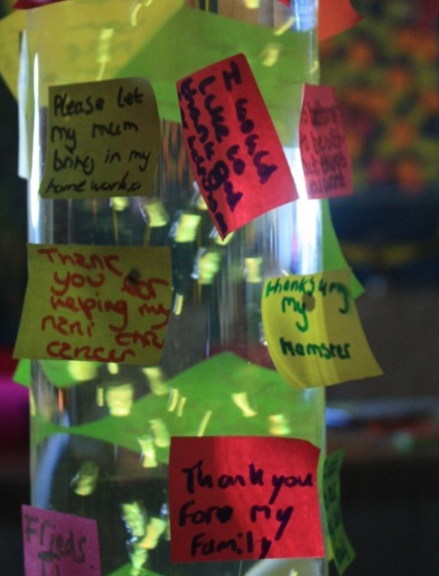
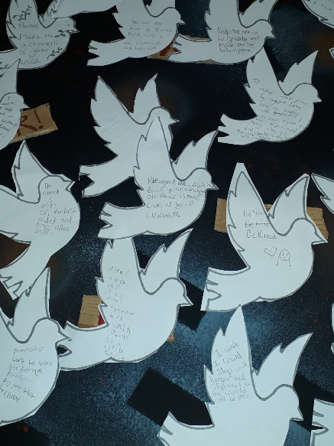
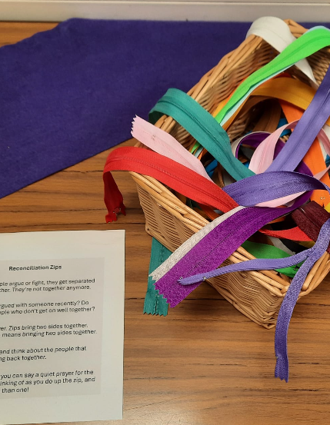
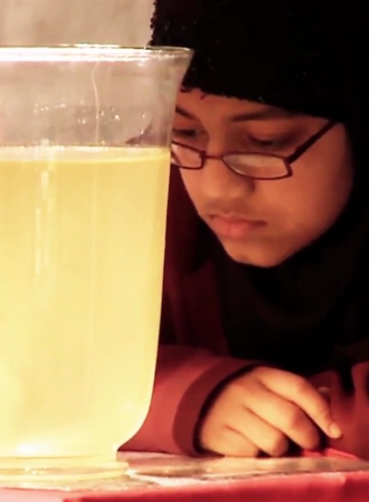
Prayer Spaces engage with many spiritual values. What were the main values you thought about in the Prayer Space at your school?
Did you think, for example, about the values of…
Self: hope / inner peace / self respect?
Others: kindness / forgiveness / generosity?
Earth: care for nature / love of animals / green visions?
God: faith / prayer / doubt / the meaning of life?

Slide 14

Think about Prayer: The big question mark!
Your teacher will give you one of these on A3 paper for your group of three.
Think about the questions they would like to ask God – if there is a God – or an imaginary being that knows everything.
Write all your questions in the middle of the question mark.
Can you come up with 10 questions? 20 questions? Ask for another sheet if you fill it!
Notes:
This contribution to classroom RE / RVE / RME recognises the value of rich knowledge about prayer for pupils, and also encourages the deployment of that knowledge as pupils handle big questions and issues thoughtfully. This contributes to providing opportunities through the learning for spiritual development.
All opinions are welcome in this kind of RE – and all may be questioned, discussed, deepened and developed by the processes of critical and empathic RE / RVE / RME.

Slide 15
Think about Prayer: The big question mark!
Swap your question mark with another group, and read their ideas.
Highlight or circle what you think are their BEST THREE questions.
For each of these three, suggest three possible answers which God or ‘the person who knows everything’ might say.
Write these in the spaces outside the question mark, connecting them with a line to the question.
Pass the question mark back to the group that wrote the questions and discuss with them: do they like your answers?
Next slide: some examples of questions asked by Year 5
Notes:
This contribution to classroom RE / RVE / RME recognises the value of rich knowledge about prayer for pupils, and also encourages the deployment of that knowledge as pupils handle big questions and issues thoughtfully. This contributes to providing opportunities through the learning for spiritual development.
All opinions are welcome in this kind of RE – and all may be questioned, discussed, deepened and developed by the processes of critical and empathic RE / RVE / RME.

Slide 16
Thinking about prayer: 7-11s asking God some questions.
Does God always forgive everyone no matter what they do?
What are next week’s lottery numbers?
Is my Gran safe in heaven with you?
Why do some peoples’ prayers in rich countries get answered when some people in poor countries don’t have their prayers answered?
Is it alright to pray for yourself or is that selfish?
How do we know God can hear us and listens to us?
What would God want us to pray for the most?
God, can you hear all our hopes and prayers?
Will God listen to the prayers of the bad people?
Why is it that there are times that we feel like God hasn’t listened to our prayers?
Can you see the future? Will I play for Liverpool?
How did you feel when you created the world?
Did you make the world in 6 days, or by evolution?
Do you like all of our religions?
Why did you make so many religions when you could have given us just one?
Which of these questions do you like best?
Which do you think is hardest to answer?
Which do you think is most important?
Notes:
This contribution to classroom RE / RVE / RME recognises the value of rich knowledge about prayer for pupils, and also encourages the deployment of that knowledge as pupils handle big questions and issues thoughtfully. This contributes to providing opportunities through the learning for spiritual development.
Ask the class: which of these questions do you like best? Think is hardest to answer? Think is most important?
Miss out the next slide if you have got enough ideas from the pupils from this slide.

Slide 17
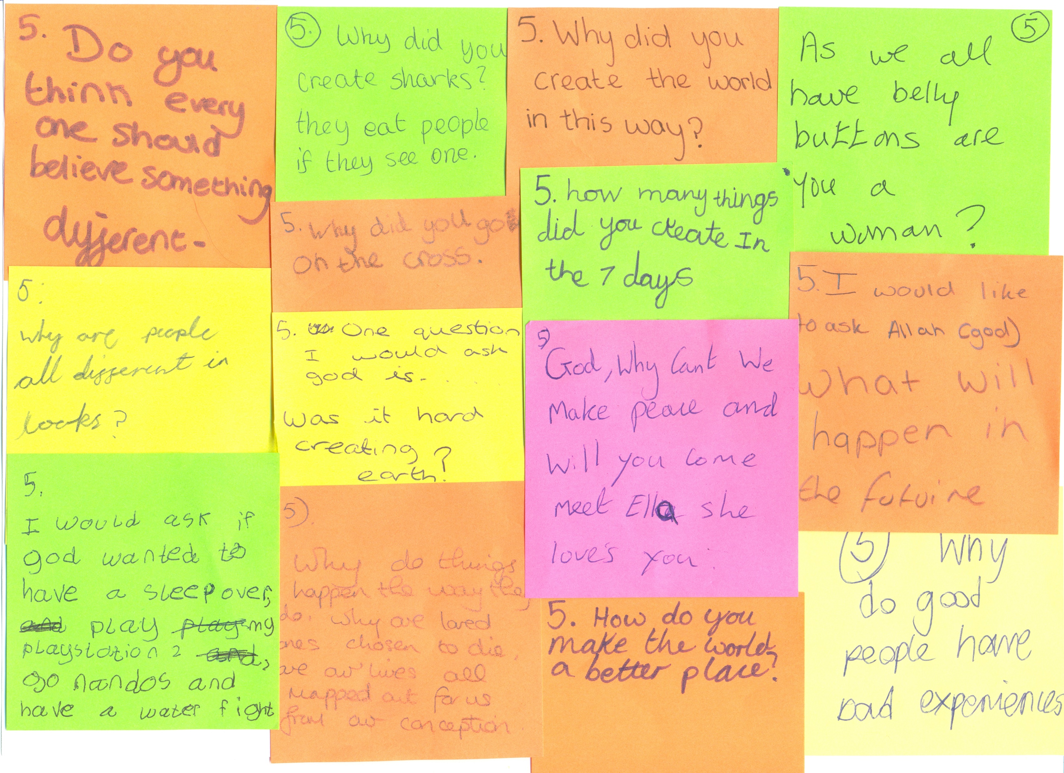
Which of these questions do you like best?
Which do you think is hardest to answer?
Which do you think is most important?
Notes:
One aspect of these lessons (which can also be used as assembly outlines with simple adaptation) is that they give pupils frequent opportunities to clarify and express their own views and ideas about prayer. We welcome the contested nature of this conversation: from different religions and worldviews there are many varied perspectives from which to learn.
All ideas and arguments, experiences and points of view are welcome.

Slide 18
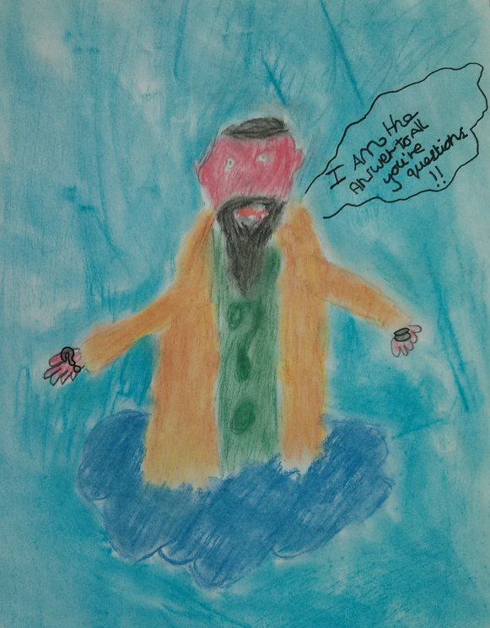
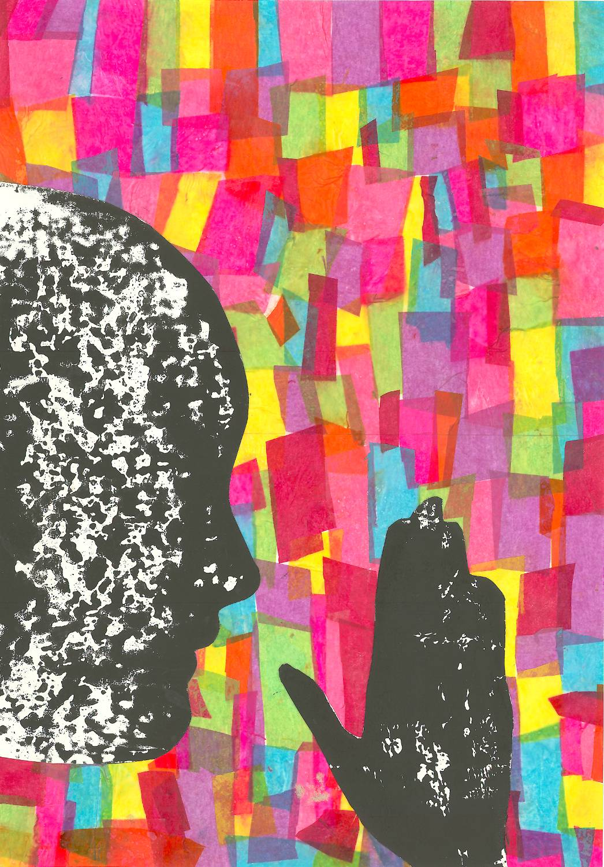
Learning creatively: two art works
“God is in prayer. This is spiritual because the colours stand for all the good things the person is praying for. God loves everyone just as much as everyone else.”
Olivia & Hannah are both 11.
Zak, age 10
“I know God is not really like an old man on a cloud. But God is the person who knows all the answers, if he is real.”
Notes:
We work from the view that there is a close frontier between spiritual learning and creativity: the experience of using a prayer space often feels highly creative, and prompts creativity for pupils.
Ask pupils if they made a work of art to show their ideas about spirituality and prayer, what theirs would be like. You may have time in other RE lessons to create this.

Slide 19

What does the Bible offer to help us understand prayer? Read this story by Jesus.
A Pharisee and a Tax Collector
Jesus told a story to some people who thought they were better than others and who looked down on everyone else:
Two men went into the temple to pray. One was a Pharisee and the other a tax collector. The Pharisee stood over by himself and prayed, “God, I thank you that I am not greedy, dishonest, and unfaithful in marriage like other people. And I am really glad that I am not like that tax collector over there. I go without eating for two days a week, and I give you one tenth of all I earn.”
The tax collector stood off at a distance and did not think he was good enough even to look up toward heaven. He was so sorry for what he had done that he pounded his chest and prayed, “God, have pity on me! I am such a sinner.”
Then Jesus said, “When the two men went home, it was the tax collector and not the Pharisee who was pleasing to God. If you put yourself above others, you will be put down. But if you humble yourself, you will be honoured.”
Tax collectors – everybody hated them in Jesus’ day. They were often crooks, and worked for the hated Romans.
The Pharisees were the most strict and committed members of their religion. People were a bit impressed by how holy they were.
What do you think are the hidden messages in Jesus’ story of the Pharisee and the Tax Collector?
Notes:
These lessons enable pupils to learn a lot specifically about Christian prayer, and use Biblical quotations, examples and texts to enrich pupils’ understanding. This story is from Luke 18:9-14. Explain that the Pharisees were the most religious and committed members of the Jewish religion in Jesus time. People admired their strict ways of following their religion. Tax collectors were hated for collaborating with the Roman enemy – and fleecing everyone for money!
Bible Gateway is the source for this text – a great site for RE teachers. https://www.biblegateway.com/passage/?search=Luke%2018%3A9-14&version=CEV
We provide a six card sorting activity of this text.
A brilliant free visual version of this story is available to download at: https://diglib.library.vanderbilt.edu/act-imagelink.pl?RC=48268

Slide 20
A Pharisee and a Tax Collector: what does the story mean?
Here are six ideas about what this story means. Which ones do you think are the best? Put them in order of importance.
If tax collectors go to a Prayer Space, they should wait outside with the other baddies.
There is no point boasting to God – because God knows everything anyway.
Praying in a big-headed way is useless.
God is pleased if you accept that you’re not perfect.
There’s no sin or evil so bad that God can’t forgive it.
Being religious on the outside is no use: it’s better to be spiritual on the inside!
Notes:
These lessons enable pupils to learn a lot specifically about Christian prayer, and use Biblical quotations, examples and texts to enrich pupils’ understanding. This story is from Luke 18:9-14. Explain that the Pharisees were the most religious and committed members of the Jewish religion in Jesus time. People admired their strict ways of following their religion. Tax collectors were hated for collaborating with the Roman enemy – and fleecing everyone for money!
Bible Gateway is the source for this text – a great site for RE teachers. https://www.biblegateway.com/passage/?search=Luke%2018%3A9-14&version=CEV

Slide 21
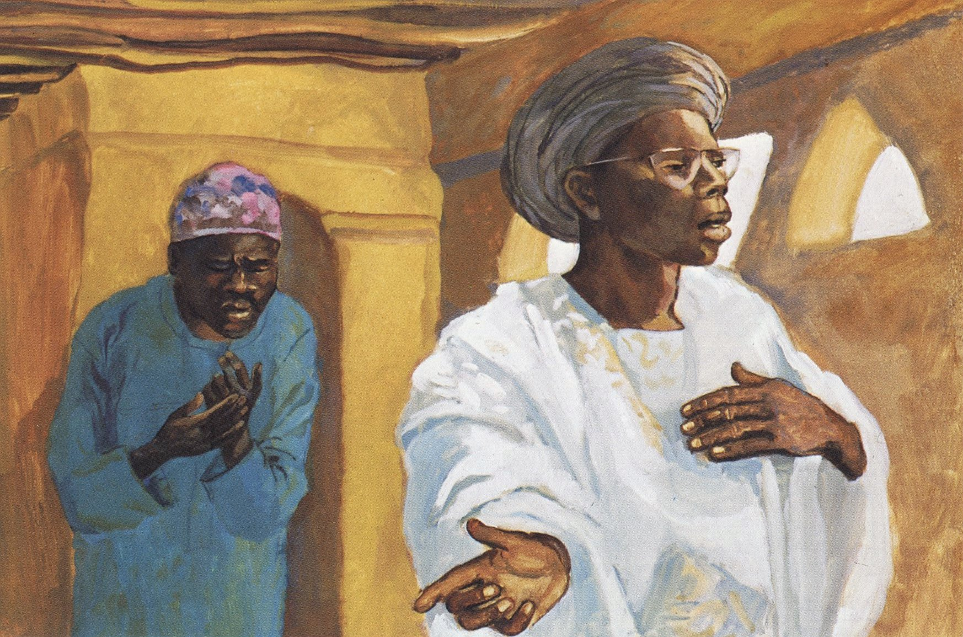
A Pharisee and a Tax Collector
How does the artist show both pride and humility in the picture?
What do you think are the hidden messages in Jesus’ story of the Pharisee and the Tax Collector?
Notes:
https://diglib.library.vanderbilt.edu/act-imagelink.pl?RC=48268
This brilliant image is freely available from the Christian Art collection at Vanderbilt University, along with 80+ others. It is a good example of global Christian art because it shows the narratives of the gospels from an African setting, in the Mafa region of Cameroon.

Slide 22

Broad views of prayer and spirituality to discuss
A learning strategy: ‘washing line’
Use a fat marker pen to put your first name in large letters on a piece of paper folded in half, so that you can hang it on a ‘washing line’ – a string stretched across your classroom.
Sit round the ‘washing line’ in a circle.
Two big labels at each end: ‘Strongly Agree’ is at one end, ‘Strongly Disagree’ at the other.
You will be reading and listening to some quotes about praying and spirituality. You will hear them twice, with a pause for thinking.
Hang your name label on the line to show what you think of each quote.
You may be surprised how wide a range of views there are in your class.
Sit back down and look at the opinions expressed.
Any comments?? Take the chance to speak up, even if you don’t usually do so in class.
Notes:
Washing Line – a brilliant class discussion strategy.
Prayer is a controversial topic, and in writing these lessons we are pleased to present some activities that ask pupils to use their critical thinking skills. Ideas and materials form different religions and from atheist and agnostic perspectives enrich the learning, which has mind-opening intentions.
Get 6 learners to read these quotations aloud and ask for ‘any thoughts’ from the class after each one has been heard. If you have time for a longer discussion, use the strategy called ‘washing line’ where pupils have a name label on a folded piece of paper. String a line across the classroom and sit round it in a circle. ‘Strongly Agree’ is at one end, ‘strongly disagree’ at the other. Read the quotes out twice with a pause for thinking. Ask pupils to hang their name label on the line at a suitable point and sit down and look at the opinions expressed. Any comments?? There will be loads.
This strategy improves participation in class discussion form an average of under 20% of children to usually 60% plus!! Invite comments from ‘the quiet ones’ and affirm them.
https://thenounproject.com/icon/clothes-line-6364718/

Slide 23
Think about each of these statements. Don’t just ‘follow the crowd’ – think for yourself!
“Praying is like whistling in the dark. It can comfort you.”
“I believe God listens to people’s prayers”
“Praying for someone else is like giving them a little gift.”
“Sometimes God doesn’t seem to answer prayers, but some people still carry on – that is faith.”
“Praying quietly by myself can be helpful to make me calm or confident”
“Praying might make people feel better, even if there is no God listening”
Prayer Spaces in Schools: Good learning for all
Notes:
Washing Line – a brilliant class discussion strategy.
Prayer is a controversial topic, and in writing these lessons we are pleased to present some activities that ask pupils to use their critical thinking skills. Ideas and materials form different religions and from atheist and agnostic perspectives enrich the learning, which has mind-opening intentions.
Get 6 learners to read these quotations aloud and ask for ‘any thoughts’ from the class after each one has been heard. If you have time for a longer discussion, use the strategy called ‘washing line’ where pupils have a name label on a folded piece of paper. String a line across the classroom and sit round it in a circle. ‘Strongly Agree’ is at one end, ‘strongly disagree’ at the other. Read the quotes out twice with a pause for thinking. Ask pupils to hang their name label on the line at a suitable point and sit down and look at the opinions expressed. Any comments?? There will be loads.
This strategy improves participation in class discussion form an average of under 20% of children to usually 60% plus!! Invite comments from ‘the quiet ones’ and affirm them.
https://thenounproject.com/icon/clothes-line-6364718/

Slide 24
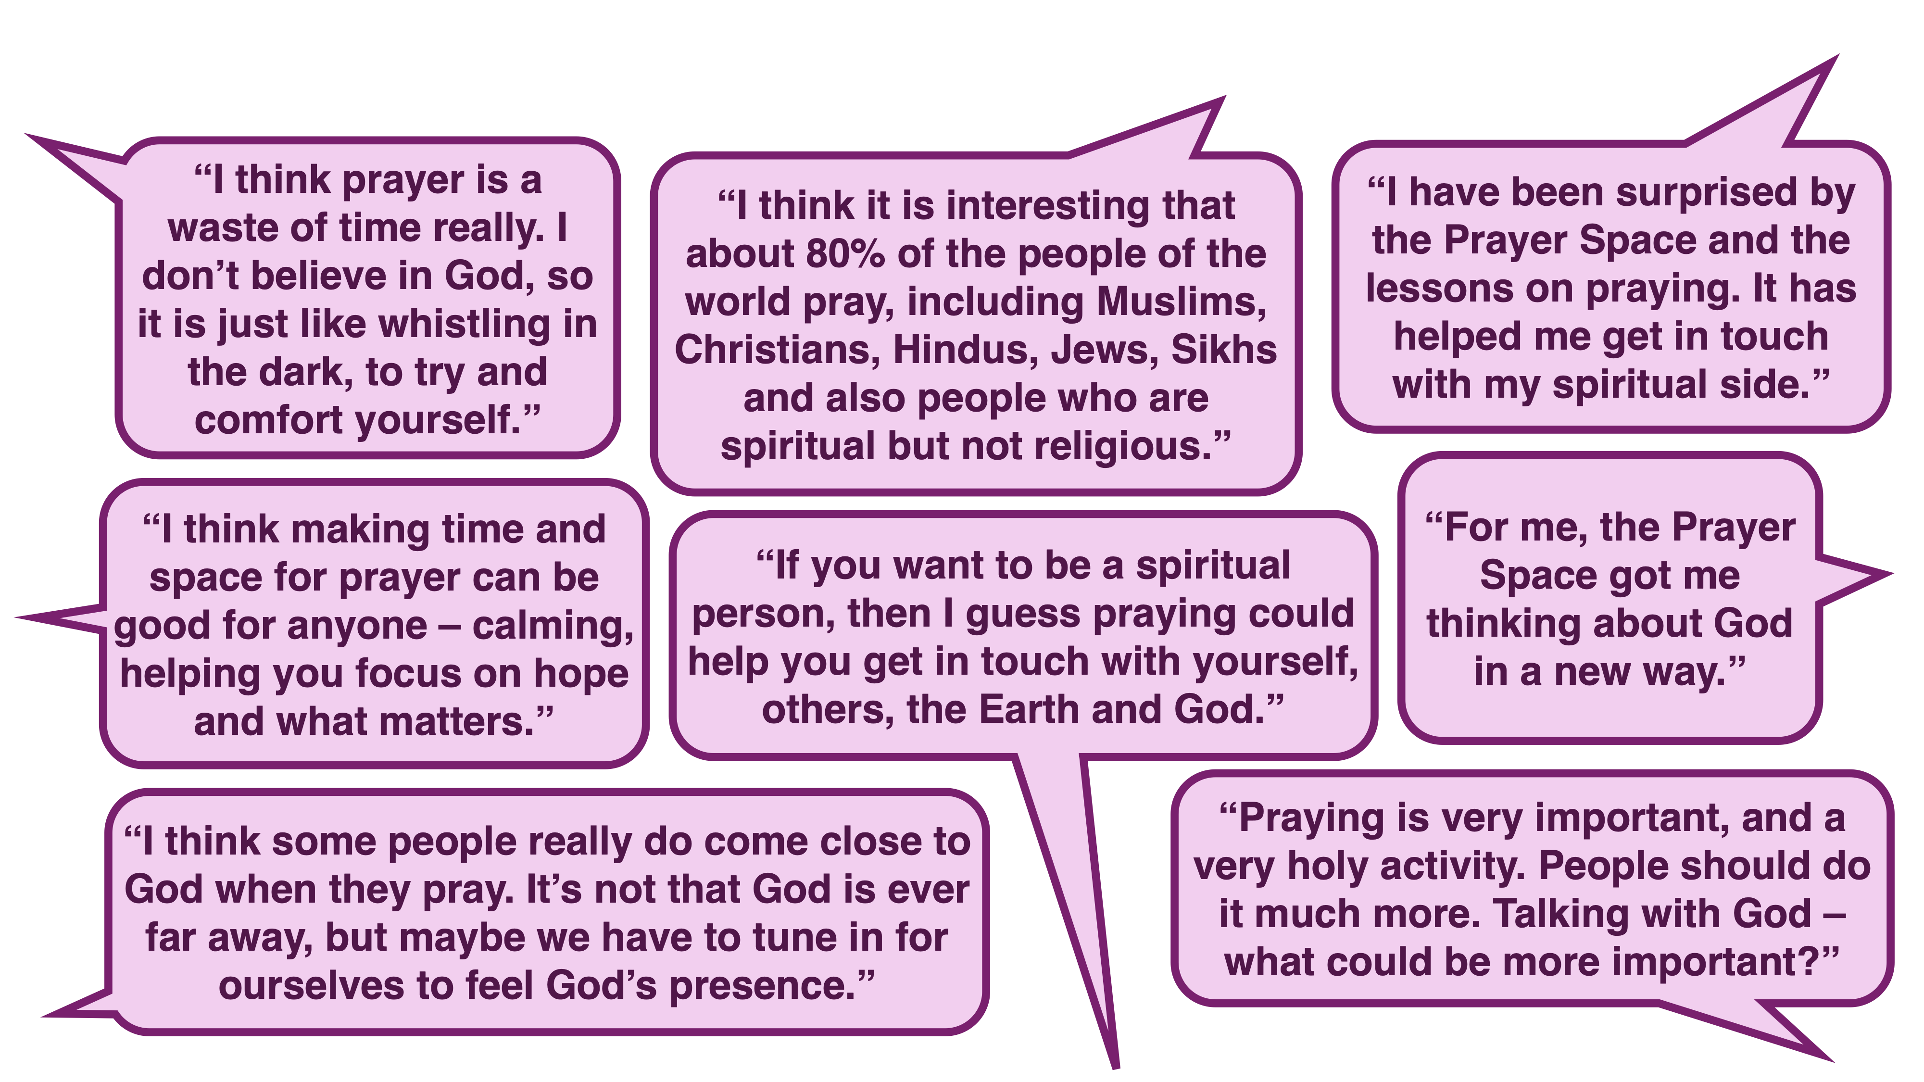
Broad views of prayer and spirituality to discuss
Notes:
Prayer is a controversial topic, and in writing these lessons we are pleased to present some activities that ask pupils to use their critical thinking skills. Ideas and materials form different religions and from atheist and agnostic perspectives enrich the learning, which has mind-opening intentions. Get 5 learners to read these quotations aloud and ask for ‘any thoughts’ from the class after each one has been heard. If you have time for a longer discussion, use the strategy called ‘washing line’ where pupils have a name label on a folded piece of paper. String a line across the classroom and sit round it in a circle. ‘Strongly Agree’ is at one end, ‘strongly disagree’ at the other. Read the quotes out twice with a pause for thinking. Ask pupils to hang their name label on the line at a suitable point and sit down and look at the opinions expressed. Any comments?? There will be loads.

Slide 25
A human and humane model of spirituality
Remember that our description of ‘spiritual’ is about 4 ways to relate.
In, put your hands to your chest.
Out, throw your arms out wide.
Down, open your palms to the earth.
Up, push the sky upwards.
Homework task: take a sheet with this diagram in the middle of it and use words, pictures, symbols, logos and ideas to show examples of the things that are spiritual for you.
Notes:
There is a vast literature and a continuing conversation about the nature of spirituality. The work of Dr Rebecca Nye, University of Cambridge, is useful in plural settings like school. Founded in research, her exposition of spirituality is child-centred, alert to Christianity and many other faiths and clear. If you are interested to go further into the topic, two books are recommended: Children's Spirituality: What it is and Why it Matters (Sure Foundations) 2009, The Spirit of the Child: Revised Edition, DLT, 2006, by David Hay and Rebecca Nye.
Get the class to understand that these four aspects of spiritual life are simple in a way: it’s about how you relate ‘in, out, down and up’
Use the simple demonstration of ‘spiritual’ It may be a tough concept for 7-11s, but no harder than loads we use in literacy, science or geography. And maybe more useful than long division, fronted adverbials or even 6 figure grid references. Chant this:
Spiritual: it’s a big word – but the meaning is clear.
Four ways to relate to everything that’s dear.
Inner life matters, put your hands to your chest.
Outward from yourself, loving others is the best.
Down for the ground we live upon: care for the earth.
Up is a sign for what’s above us, things of greatest worth.
Or write a better chant yourself!

Slide 26

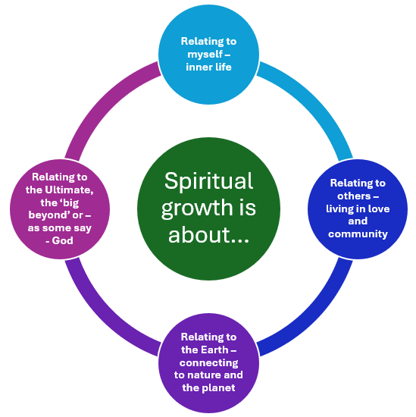





Add logos, symbols, emojis or other images to the page to produce an identikit spiritual you.
Expressing your own viewpoints
Take a page with the spirituality diagram in its centre.
Design your own.
Dreamer
Fit the 6 words you chose for your ‘spiritual identikit’ inside the circle.
Aware
Loving
Open to the sacred
Hopeful
Peaceful
Here’s an example.
Notes:
One aspect of these lessons (which can also be used as assembly outlines with simple adaptation) is that they give pupils frequent opportunities to clarify and express their own views and ideas about prayer. We welcome the contested nature of this conversation: from different religions and worldviews there are many Varied perspectives from which to learn.
The logos in this slide come from the Noun Project and are free to use. Other pix from Prayer Spaces could be used. Here are the links to them.
Dream: https://thenounproject.com/icon/dream-5757100/
Aware: https://thenounproject.com/icon/aware-5810536/
Sacred: https://thenounproject.com/icon/holy-5242745/
Hope: https://thenounproject.com/icon/hope-4878877/
Peace: https://thenounproject.com/icon/peace-dove-6747640/
Love: https://thenounproject.com/icon/love-7436717/

Slide 27
A human and humane model of spirituality
Spiritual: it’s a big word – but the meaning is clear.
Four ways to relate to everything that’s dear.
Inner life matters, put your hands to your chest.
Outward from yourself, loving others is the best.
Down for the ground we live upon, care for the earth.
Up is a sign for what’s above us, things of greatest worth.
Notes:
There is a vast literature and a continuing conversation about the nature of spirituality. The work of Dr Rebecca Nye, University of Cambridge, is useful in plural settings like school. Founded in research, her exposition of spirituality is child-centred, alert to Christianity and many other faiths and clear. If you are interested to go further into the topic, two books are recommended: Children's Spirituality: What it is and Why it Matters (Sure Foundations) 2009, The Spirit of the Child: Revised Edition, DLT, 2006, by David Hay and Rebecca Nye.
Get the class to understand that these four aspects of spiritual life are simple in a way: it’s about how you relate ‘in, out, down and up’
Use the simple demonstration of ‘spiritual’ It may be a tough concept for 7-11s, but no harder than loads we use in literacy, science or geography. And maybe more useful than long division, fronted adverbials or even 6 figure grid references. Chant this:
Spiritual: it’s a big word – but the meaning is clear.
Four ways to relate to everything that’s dear.
Inner life matters, put your hands to your chest.
Outward from yourself, loving others is the best.
Down for the ground we live upon: care for the earth.
Up is a sign for what’s above us, things of greatest worth.
Or write a better chant yourself!

Slide 28
So what did we learn?
“From the Prayer Space I learned…”
“My experience of getting in touch with my spiritual side was good / not so good because…”
“From the ‘Questions for God’ activity, I learned…”
“From the Bible story about the Pharisee and the Tax Collector I learned…”
“From the Washing Line discussion I learned…”
“What I found out about spirituality is…”
“The word ‘spiritual’ means…”
“I also want to say…”
Notes:
Use these prompts for final conversation in pairs, groups or whole class, or for writing if you need it. These provide OFSTED and inspection processes with excellent evidence of pupils’ understandings of spirituality, if that is what you need.
This lesson is very full, so do be selective in which parts you use, or spread it over two sessions.

