Slide 1





Prayer Spaces in Schools
Learning from a prayer space
KS2 Lesson 3 of 4
What is prayer?
Learning opportunities for 7-11s on themes about prayer and reflection.
Prayer Spaces in Schools create extraordinary opportunities for children and young people to think about prayer and to consider spirituality in open-minded experiential ways.
This lesson is one of a series written by Lat Blaylock of RE Today and provided free to schools to enable learners to use critical and reflective thinking skills to learn about spirituality, prayer and reflection.
is part of
Notes:
These lessons are written by Lat Blaylock, RE Consultant with RE Today www.retoday.org.uk
Aims of these lessons:
To provide excellent and respected classroom resources for teachers of RVE / RME / RE to use in lessons when a PRAYER SPACES visit is coming, taking place or has happened,
To enable teachers and PRAYER SPACES volunteers to deliver quality RVE / RME / RE about prayer which connects to the experiences of the PRAYER SPACES provision.
To enable pupils to think for themselves about prayer and its meanings, and access opportunities for spiritual, moral, social and cultural development.

Slide 2
Providing quality ‘state of the art’ RE / RVE / RME lessons ready to use for
KS2 & KS3
Suitable for both teachers of RE / RVE / RME and Prayer Spaces volunteers
to deliver.
Suitable for pre-Prayer Space and post Prayer Space uses.
About these resources.
Suitable for all pupils in all kinds of schools
Encouraging open hearted and critical thinking about prayer and reflection
Enhancing the experience of using a Prayer Space in school with good learning
Offering learners the chance to develop their own personal ideas about philosophical and social questions on the themes of prayer and reflection
Engaging, creative and absorbing learning.
We provide well prepared presentations, lesson plans and training webinars and examples.
Adaptive suggestions in lesson plans to help volunteers or fit in with teachers’ needs.
Introducing concepts and questions about Christian prayer. Providing resources to set high standards of RE / RVE / RME, deepening learning.
Also including assembly delivered options for school worship / religious observance
Integrated with common RE / RVE / RME units of work and ‘Understanding Christianity’ resources.
A lesson for KS2 and a lesson for KS3 in advance of the Prayer Space visit.
Suitable for all schools and all pupils offering creativity and critical engagement in the lessons.
Using active learning, creative multi-disciplinary methods, explained and resourced to be ‘ready to go’.
Three lessons each for KS2 and KS3, all free standing, that follow up the visit.
Notes:
Teachers and Youth Workers can use this lesson, which is part of a larger ‘Prayer Spaces in School’ learning package.
The lessons:
Can be taught - with preparation - ‘off the shelf’ using the 6 PPT sequences provided
Will be understood better by teachers and youth workers if you watch our training recorded webinars from Lat Blaylock of RE today
Include examples of pupils’ work, art, writing and responses
Are suitable for use across the UK, recognizing what is distinctive about RME / RVE / RE in each of the four nations
Reference law, guidance and inspection requirements for RE / SMSCD / School Worship
Use some PRAYER SPACES case studies

Slide 3
Prayer Spaces in Schools
Learning from a prayer space
Christian prayer: connections
This is one lesson in a set which enables learners to respond to questions. This lesson focuses on Jesus’ ‘Lord’s Prayer’, the ‘Our Father…’
What is prayer? What is the Lord’s Prayer?
How does prayer work? Can prayer make a person feel happy?
Calm? Thankful? Forgiven? How?
What do Christians say about prayer and Jesus?
How do Christians use the Lord’s Prayer in their own prayer practices?
What does this famous prayer mean?
What do learners say about the big questions that come up
when we think about the Lord’s Prayer?
Notes:
The topics addressed in these lessons include Biblical narrative and teaching, the Christian ‘Lord’s Prayer’, sociology of prayer, Christian experiences of prayer, creative prayer ideas, Christian theologies of prayer, Jesus and prayer, the phenomenon of ‘SBNR’ (spiritual but not religious) prayer, the experiences of answered prayer and unanswered prayer. Questions and diverse ideas are the focus: these lessons aim to open minds not to deliver one set of answers to these questions. The lessons are designed to compliment the opportunities for spiritual development that come from the experience of visiting and using a ‘Prayer Space’ in a school.

Slide 4
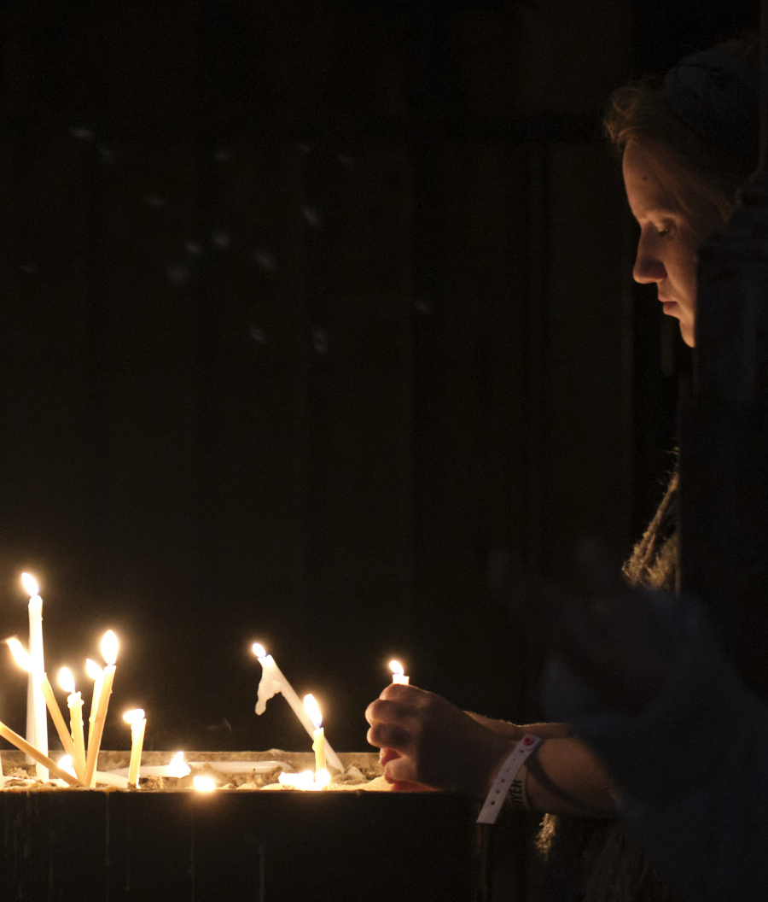
‘Prayer Space’ - Learning about Christian prayer
This lesson asks for your thoughts about Christian prayer.
Christians are all different – but they all worship God in Jesus, and they follow Jesus’ teaching about prayer.
Pretty much every one of the world’s 2 600 000 000 Christians (that’s 2.6 billion, or 32% of the world population) knows and uses the prayer Jesus taught.
Notes:
For teachers and lesson leaders: Prayer Spaces are hugely varied. They use a broad understanding of prayer.
Activities in a Prayer Space in School may enable pupils to reflect deeply or profoundly on themselves, their relationships, their place on the earth and their connection with ‘the big beyond’ – God, as many say. These spaces use activities which engage with happiness and sorrow, success and failure, strength and weakness, faith and doubt. The activities are often and by turns responsive, provocative, creative ,imaginative, focused on the human spirit. They make space for the spiritual.
No two prayer spaces are the same, and each individual’s experience of the Space will be unique.
These Spaces are never coercive – we don’t think there is any such thing as ‘forced prayer’. Instead, the Prayer Spaces open up new horizons of imagination, possibility and faith.

Slide 5
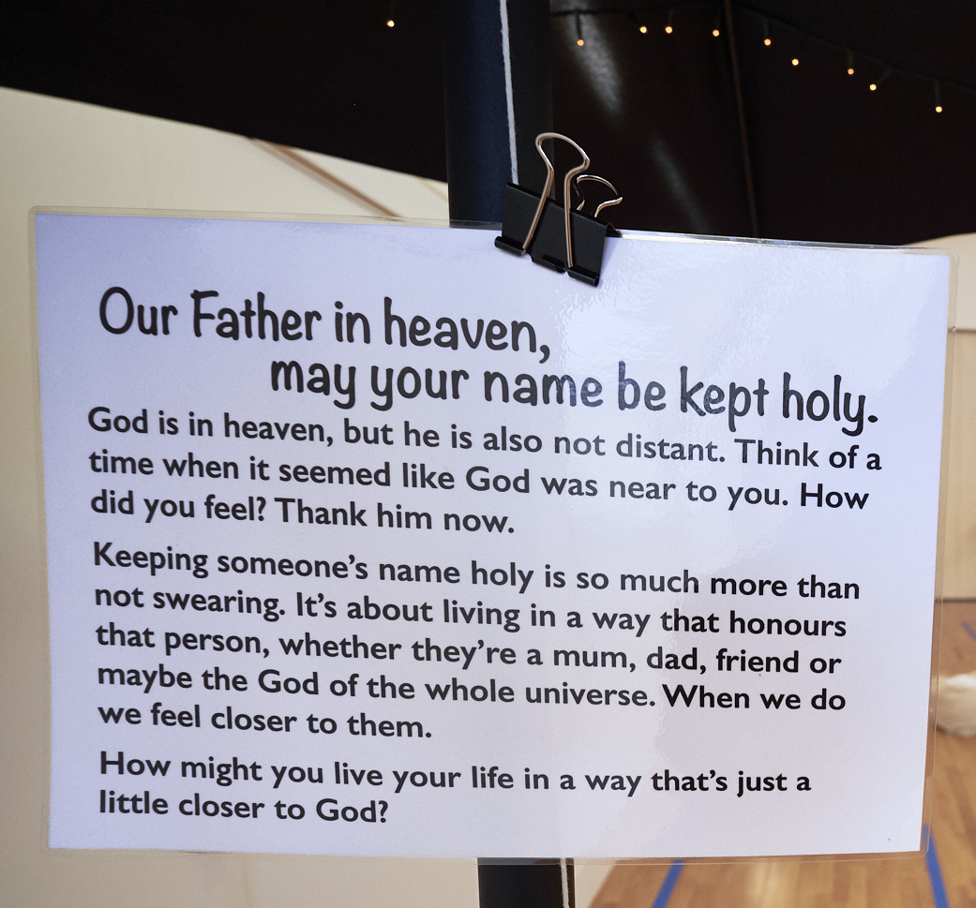
‘Prayer Space’ - Learning about Christian prayer
It’s sometimes called
the Lord’s Prayer,
or the ‘Our Father…’
In this lesson you will work out a bit about the meanings of this famous prayer, and think for yourself about the ideas in it.
Notes:
For teachers and lesson leaders: Prayer Spaces are hugely varied. They use a broad understanding of prayer.
Activities in a Prayer Space in School may enable pupils to reflect deeply or profoundly on themselves, their relationships, their place on the earth and their connection with ‘the big beyond’ – God, as many say. These spaces use activities which engage with happiness and sorrow, success and failure, strength and weakness, faith and doubt. The activities are often and by turns responsive, provocative, creative ,imaginative, focused on the human spirit. They make space for the spiritual.
No two prayer spaces are the same, and each individual’s experience of the Space will be unique.
These Spaces are never coercive – we don’t think there is any such thing as ‘forced prayer’. Instead, the Prayer Spaces open up new horizons of imagination, possibility and faith.

Slide 6
What does the Bible offer
to help us understand Christian prayer?
Jesus taught his disciples to pray.
Matthew and Luke tell us about the Lord’s Prayer in their Gospels.
It has been translated into over 500 languages.
There are several English versions – some more modern, some more traditional.
About 2.6 billion Christians in most countries of the world know this prayer.
It has been used for about 2000 years.
What makes it so important, loved and valued?
Notes:
These lessons enable pupils to learn a lot specifically about Christian prayer, and use Biblical quotations, examples and texts to enrich pupils’ understanding. Jesus’ famous ‘Lord’s Prayer must be the second-most used prayer on earth (the Muslim prayer is 5 times daily, so is probably most used). It has shown people a Christian path of prayer for 2000 years in over 200 countries. About 2.3 billion people know it and use it.
What makes it so significant? The words are not easy.

Slide 7
The Lord’s Prayer – “Our Father…”
We’re going to work out just what this means.
It is the prayer Jesus taught his disciples, his first followers:
Our Father in heaven, hallowed be your name,
your kingdom come, your will be done, on earth as in heaven.
Give us today our daily bread.
Forgive us our sins as we forgive those who sin against us.
Save us from the time of trial and deliver us from evil.
For the kingdom, the power, and the glory are yours now and for ever.
Amen.
What do you think are the six key words in the prayer?
How about these:
Father / Kingdom / Bread / Forgive / Deliver / Yours

Slide 8

Questions for thinking about the Lord’s Prayer
Choose a question that you think is interesting and talk about it with your partner.
How might God be like our mums and dads? Does God care for us?
How can everyone on earth have enough food? How could people share more fairly?
What would make peace possible in our world instead of war?
How might Earth become more like Heaven?
Can we be freed from temptations? How?
Why is forgiveness difficult? Who can help people to forgive?
If God was king of the world, what would it be like?

Slide 9
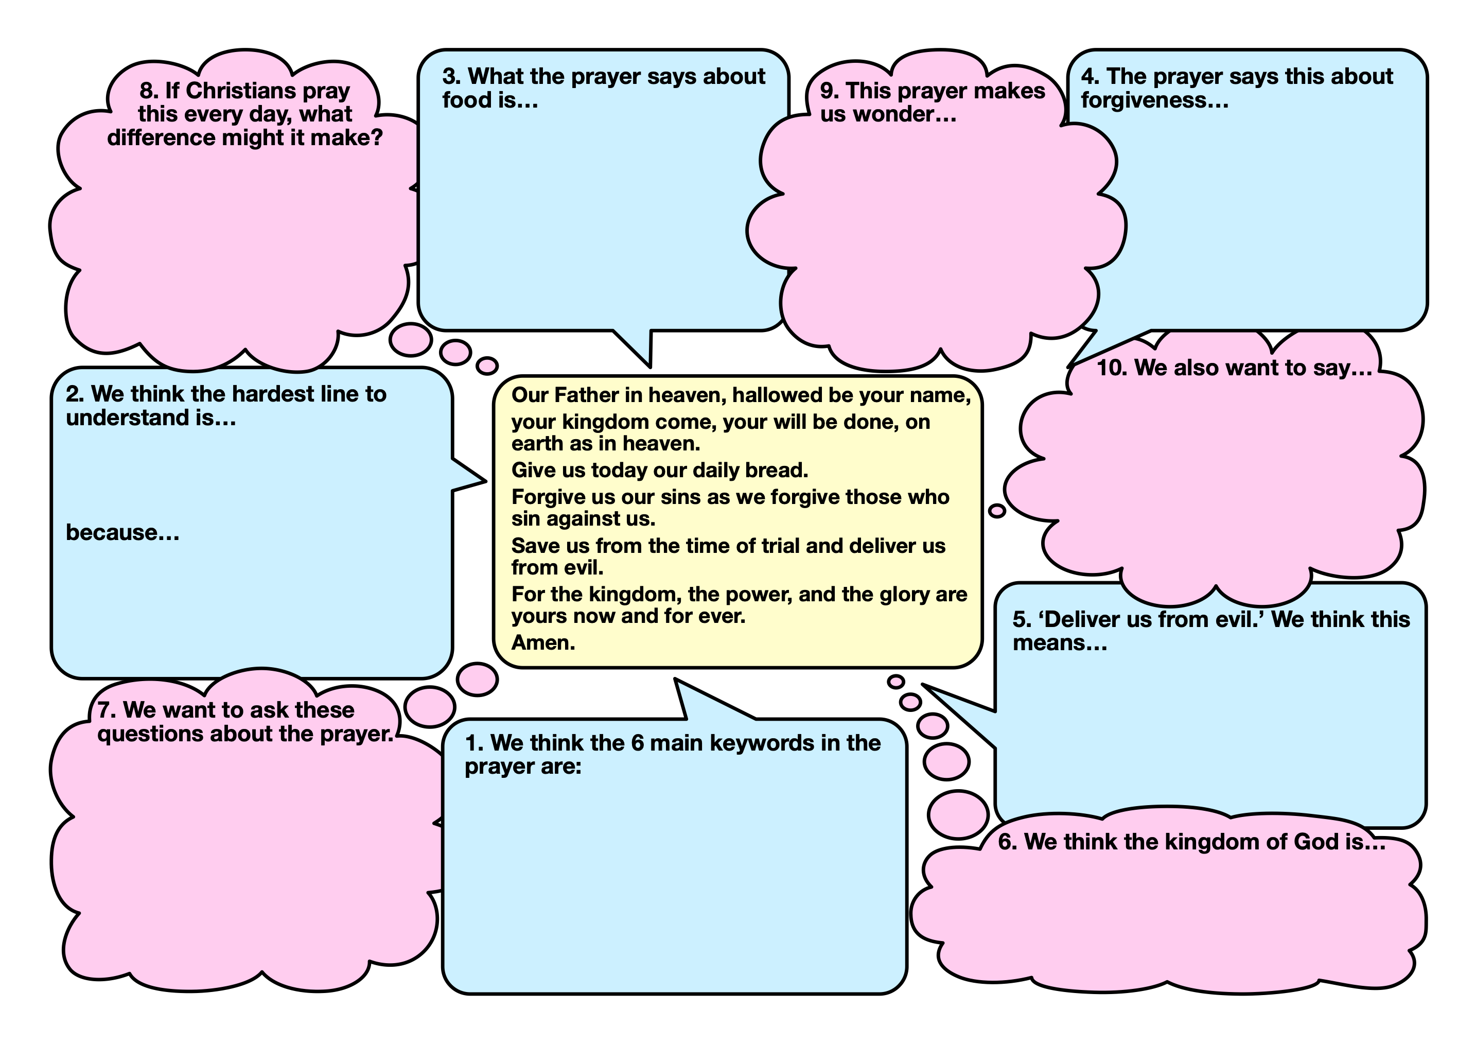
Thinking about praying
Fill in the thinking frame with a partner.
Notes:
This contribution to classroom RE / RVE / RME recognises the value of rich knowledge about prayer for pupils, and also encourages the deployment of that knowledge as pupils handle big questions and issues thoughtfully. This contributes to providing opportunities through the learning for spiritual development.

Slide 10
Thinking about praying:
Can you write a simple version of Jesus’
‘Lord’s Prayer’
One way of checking whether you understand a hard text is by trying to rewrite it for younger children.
Can you make a version of the Lord’s Prayer for 7 year olds? Work with a partner, using the framework sheet you completed for ideas?
Prayer Spaces in Schools: Good learning for all
See if other groups can help you to make sure you understand every word.
Notes:
This contribution to classroom RE / RVE / RME recognises the value of rich knowledge about prayer for pupils, and also encourages the deployment of that knowledge as pupils handle big questions and issues thoughtfully. This contributes to providing opportunities through the learning for spiritual development.

Slide 11
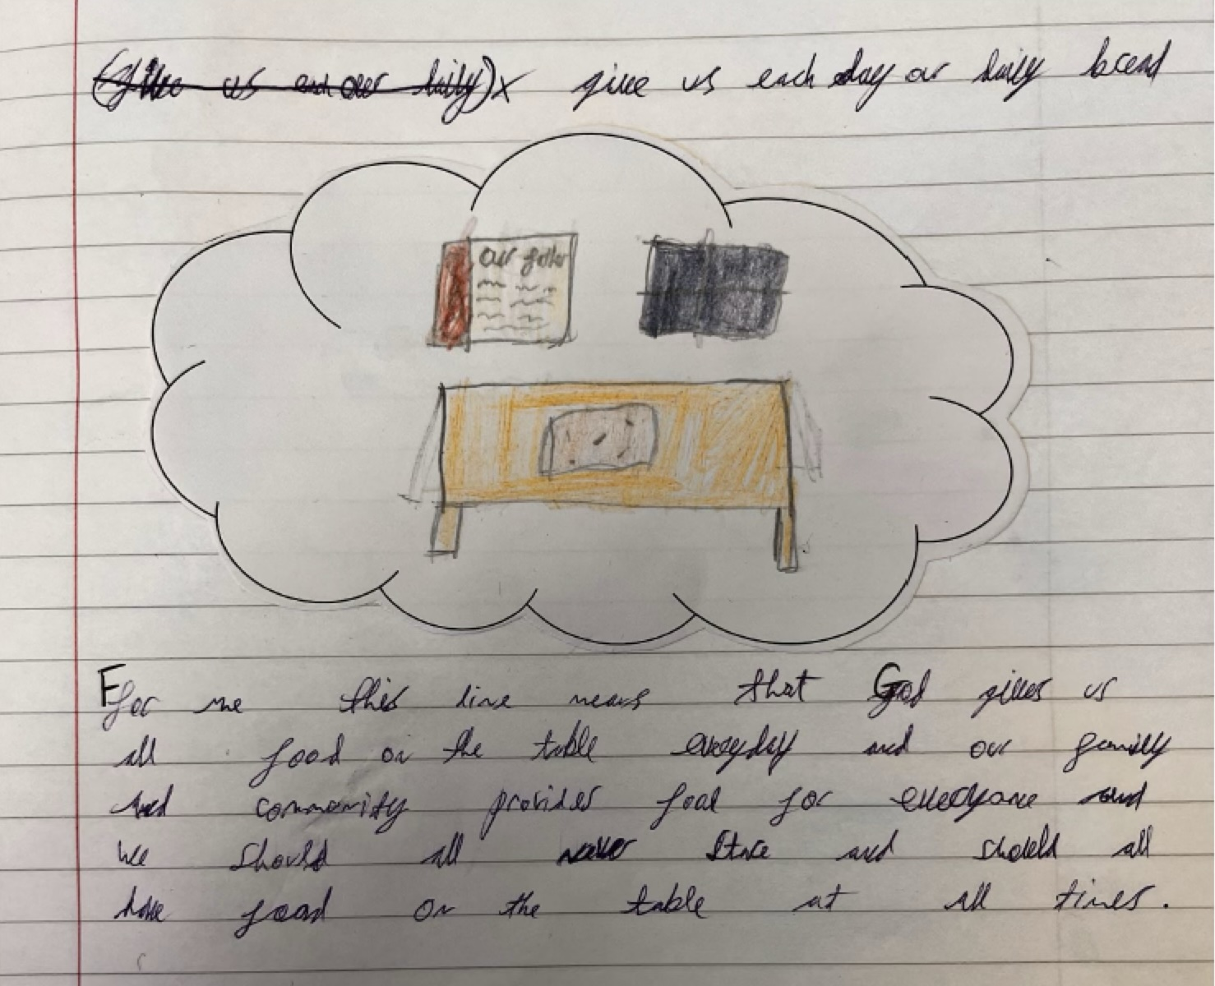
We asked children in Year 5 to think about the meanings of each line in the prayer. Here are some of their ideas.
Expressing your own viewpoints – can you do this?
Give us each day our daily bread
“For me this means that God gives us all food on the table everyday and our family and community provides food for everyone and we should all never starve and should all have food on the table at all times.”
Notes:
One aspect of these lessons (which can also be used as assembly outlines with simple adaptation) is that they give pupils frequent opportunities to clarify and express their own views and ideas about prayer.
We welcome the contested nature of this conversation: from different religions and worldviews there are many Varied perspectives from which to learn.

Slide 12
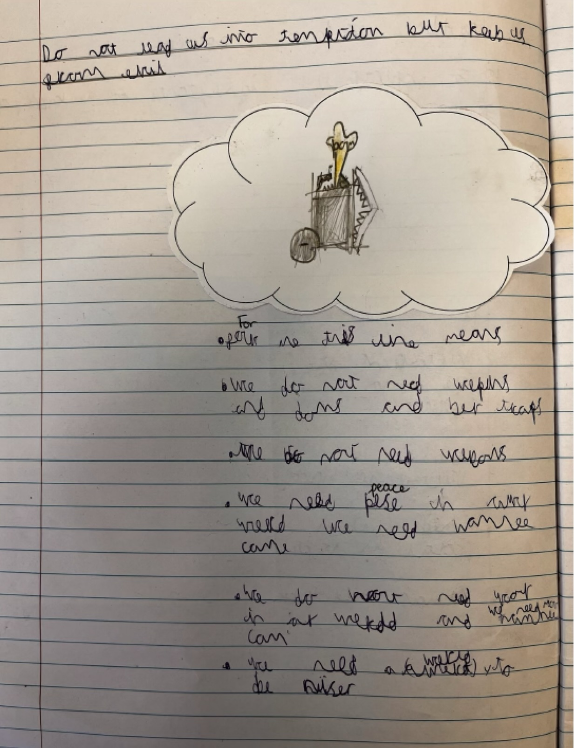
Do not lead us into temptation
but keep us away from evil
“For me this line means we do not need weapons and bombs and bear traps.
We do not need weapons.
We need peace in our world like need harmony come
We do not need war in our world
We need a world to be nicer.”
Prayer Spaces in Schools: Good learning for all

Slide 13
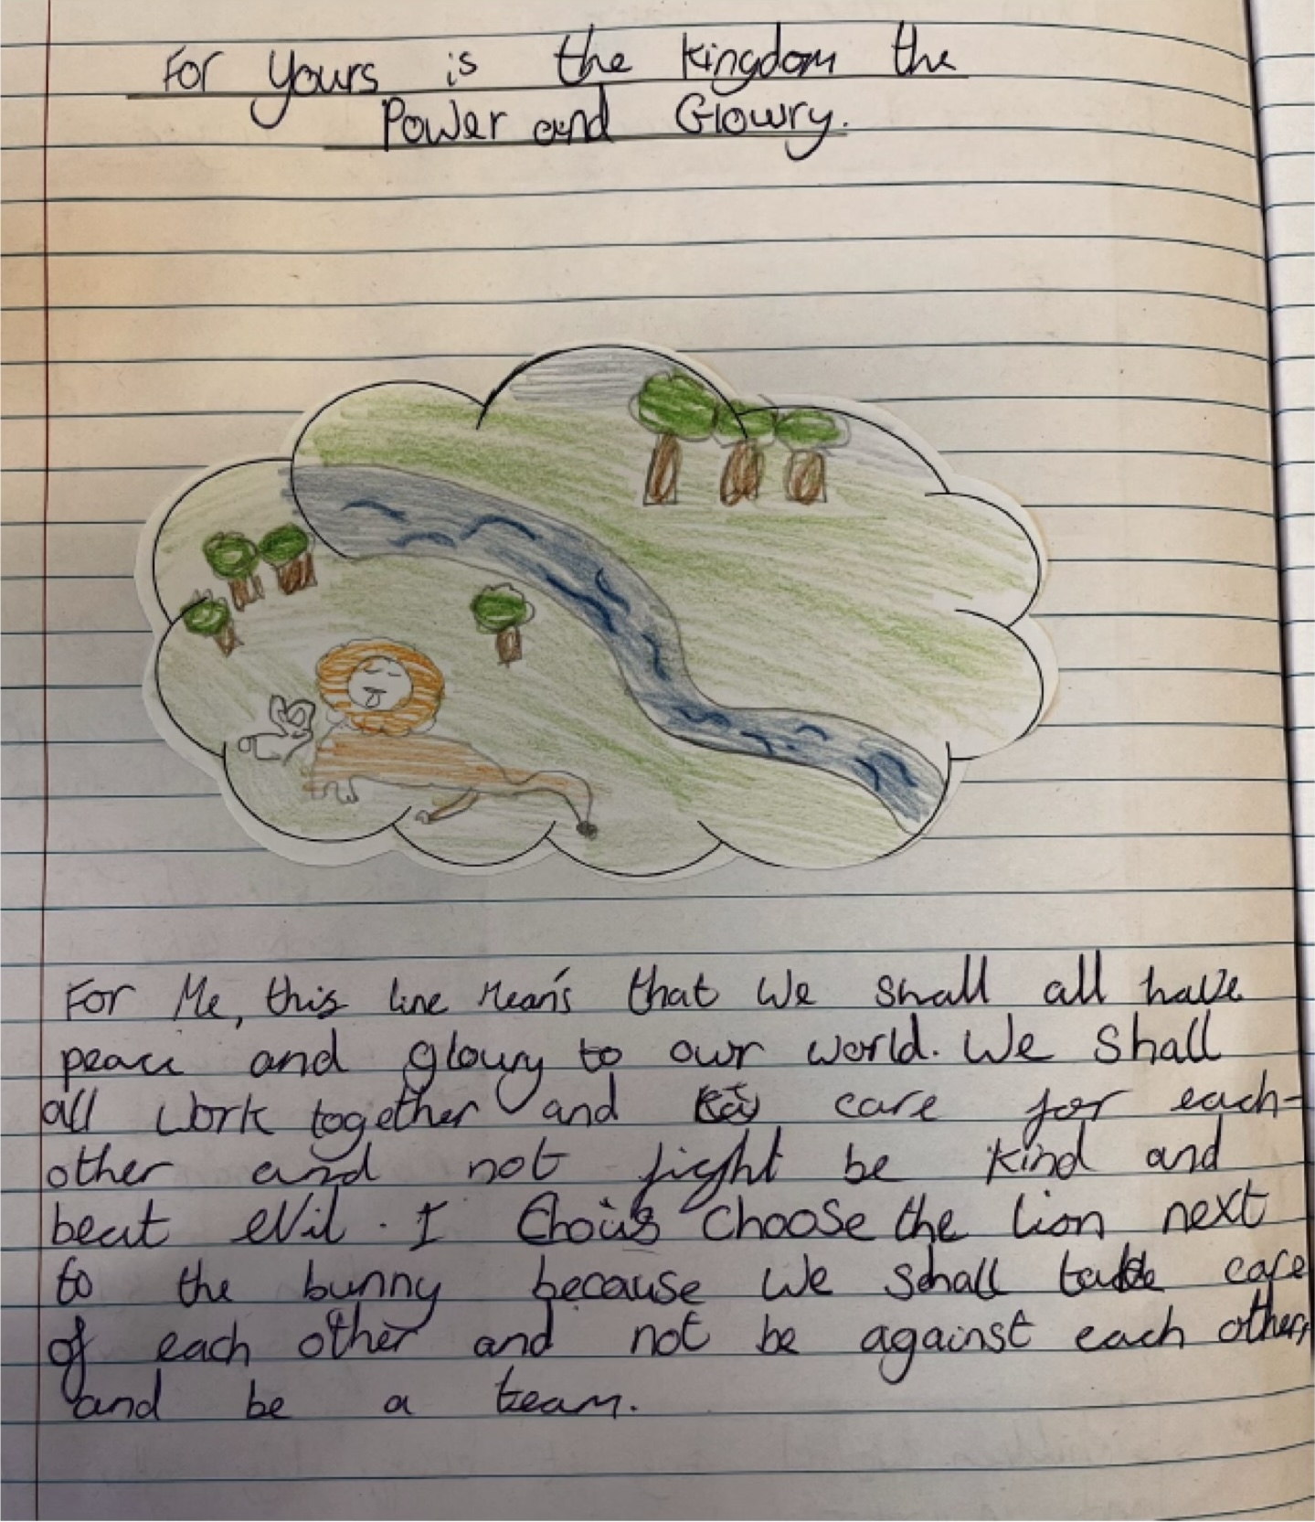
For yours is the kingdom the power and the glory
“To me this line means that we should all have peace and glory to our world. We shall work together and care for each other and not fight, be kind and beat evil. I chose the lion next to the bunny because we shall take care of each other and not be against each other, and be a team.”
Prayer Spaces in Schools: Good learning for all

Slide 14
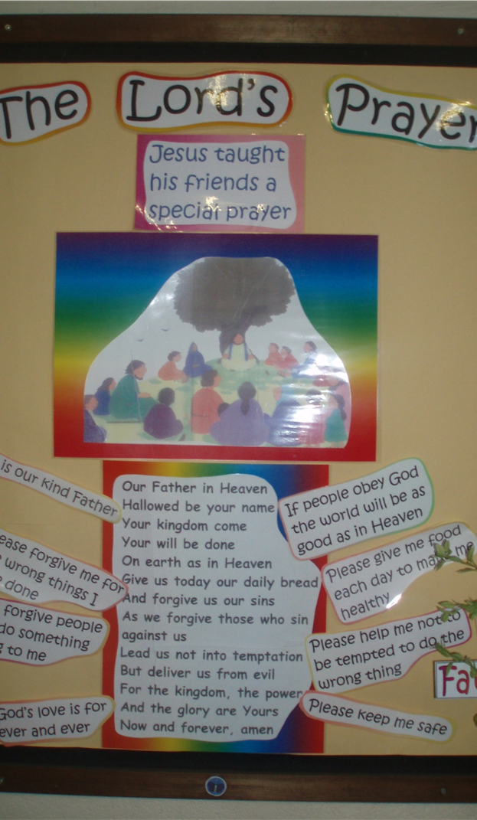
As we find out about the Lord’s Prayer, which Jesus taught to his followers, can you plan a display?
This could showcase all your questions, thoughts and ideas on a wall display which makes sense of your ideas and includes all your work from the Prayer Space at your school.
Do you think this example of a display helps make sense of the harder parts of the Lord’s Prayer?
Will yours be even better?
Please send a photo to lat@retoday.org.uk
“Our Father…”
Learn about the Lord’s Prayer
© RE Today, 2017.
Notes:
Watch the animation of the Lord’s Prayer at https://www.youtube.com/watch?v=d4R-WFkm41s There are lots of alternatives to this on YouTube – select one that your learners will appreciate.
What do learners like about the presentation, the words, the animation? Tell learners how this might be used in worship at a church, and talk about the language of this version- recap any words learners are learning to understand. Remind children that the Lord’s Prayer has been used for hundreds of years. It is also used all over the world by millions of people.
To enable the learners to make sense of the prayer in a creative way, ask them in small groups to plan their own presentation by choosing images and music to go with each phrase of the prayer. They might use an ICT based image bank, pictures cut from magazines, or their own artwork. This activity links to literacy (non-fiction texts) and to expressive arts
Talk about how the Lord’s Prayer is used. Can the children suggest what is meant by the phrase used by many Christians ‘the power of prayer’? It is to do with the idea in Christian belief that God listens to and hears all prayers, and that prayers can be answered

Slide 15
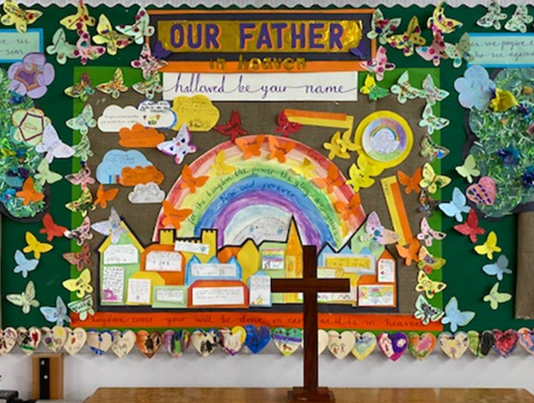
From Wilby Primary School in Northamptonshire
Could your class create a visual display about the meaning of the Lord’s Prayer?
Look at the picture on the next slide.
What is going on?

Slide 16
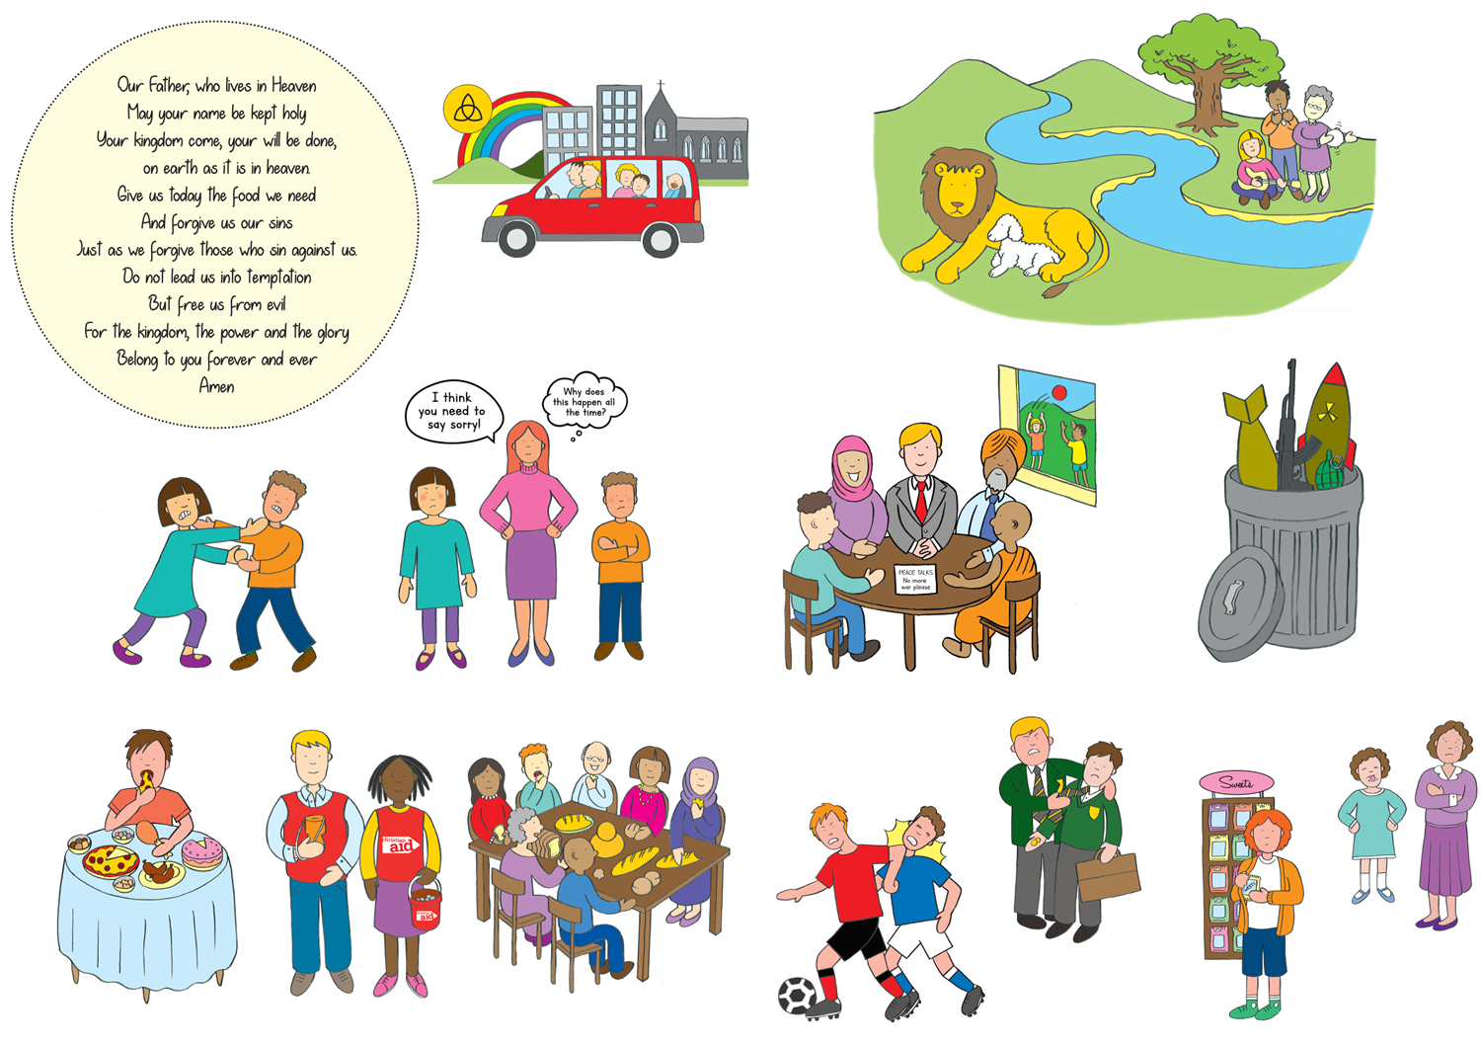
Do you understand what each line in Jesus’ famous ‘Lord’s Prayer’ means now?
Ask a question if you want to find out more.
All 13 of these little pictures gets a reference in the Lord’s Prayer.
Can you spot
them all?
Notes:
This Lord’s Prayer graphic shows every line in pictures. Can the pupils work out why the artist, the talented Sophie Hardwicke, has drawn each picture?
Copyright RE Today

Slide 17
Is the Lord’s Prayer connected to the
Prayer Space you visited?
The Lord’s Prayer shows these beliefs:
God is like a perfect parent
God is to be respected – worshipped!
If God ruled all our lives, earth would be like heaven
God wants all people to have enough food
God is a great forgiver – and we should be too
God is a great deliverer – and we all need that
God’s power of love lasts forever, so praying to God is a good plan.
Did your experience in the Prayer Space make you think about these ideas? What did you think?
What is God like?
How could a human respect or worship God?
How can we pray for a better world?
Did you think about being forgiven or delivered?
What are your thoughts about the idea that God is powerful and can help those who pray?
(you might just want to concentrate on giving deep answers to 2 or 3 of these Qs)
Notes:
One aspect of these lessons (which can also be used as assembly outlines with simple adaptation) is that they give pupils frequent opportunities to clarify and express their own views and ideas about prayer.
We welcome the contested nature of this conversation: from different religions and worldviews there are many varied perspectives from which to learn.

Slide 18
So what did we learn?
“I noticed three things about the Lord’s Prayer….”
“My ideas about forgiveness are…”
“’Give us our daily bread. This line made me think about people who don’t have enough food. I think we should…
“I think the Lord’s Prayer shows some beliefs about God, for example…”
Some people say the ‘Our Father...’ every day. My opinion about this is…
“I also want to say…”
Notes:
Use these prompts for final conversation in pairs, groups or whole class, or for writing if you need it. These provide OFSTED and inspection processes with excellent evidence of pupils’ understandings of spirituality, if that is what you need.
This lesson is very full, so do be selective in which parts you use, or spread it over two sessions.

