Slide 1





Prayer Spaces in Schools
Learning from a prayer space
KS2 Lesson 4 of 4
What does research tell us about praying?
Learning opportunities for 7-11s on themes about prayer and reflection.
Prayer Spaces in Schools create extraordinary opportunities for children and young people to think about prayer and to consider spirituality in open-minded experiential ways.
This lesson is one of a series written by Lat Blaylock of RE Today and provided free to schools to enable learners to use critical and reflective thinking skills to learn about spirituality, prayer and reflection.
is part of
Notes:
These lessons are written by Lat Blaylock, RE Consultant with RE Today www.retoday.org.uk
Aims of these lessons:
To provide excellent and respected classroom resources for teachers of RVE / RME / RE to use in lessons when a PRAYER SPACES visit is coming, taking place or has happened,
To enable teachers and PRAYER SPACES volunteers to deliver quality RVE / RME / RE about prayer which connects to the experiences of the PRAYER SPACES provision.
To enable pupils to think for themselves about prayer and its meanings, and access opportunities for spiritual, moral, social and cultural development.

Slide 2
Providing quality ‘state of the art’ RE / RVE / RME lessons ready to use for KS2 & KS3
Suitable for both teachers of RE / RVE / RME and Prayer Spaces volunteers to deliver.
Suitable for pre-Prayer Space and post Prayer Space uses.
About these resources.
Suitable for all pupils in all kinds of schools
Encouraging open hearted and critical thinking about prayer and reflection
Enhancing the experience of using a Prayer Space in school with good learning
Offering learners the chance to develop their own personal ideas about philosophical and social questions on the themes of prayer and reflection
Engaging, creative and absorbing learning.
We provide well prepared presentations, lesson plans and training webinars and examples.
Adaptive suggestions in lesson plans to help volunteers or fit in with teachers’ needs.
Introducing concepts and questions about Christian prayer. Providing resources to set high standards of RE / RVE / RME, deepening learning.
Also including assembly delivered options for school worship / religious observance
Integrated with common RE / RVE / RME units of work and ‘Understanding Christianity’ resources.
A lesson for KS2 and a lesson for KS3 in advance of the Prayer Space visit.
Suitable for all schools and all pupils offering creativity and critical engagement in the lessons.
Using active learning, creative multi-disciplinary methods, explained and resourced to be ‘ready to go’.
Three lessons each for KS2 and KS3, all free standing, that follow up the visit.
Notes:
Teachers and Youth Workers can use this lesson, which is part of a larger ‘Prayer Spaces in School’ learning package.
The lessons:
Can be taught - with preparation - ‘off the shelf’ using the 6 PPT sequences provided
Will be understood better by teachers and youth workers if you watch our training recorded webinars from Lat Blaylock of RE today
Include examples of pupils’ work, art, writing and responses
Are suitable for use across the UK, recognizing what is distinctive about RME / RVE / RE in each of the four nations
Reference law, guidance and inspection requirements for RE / SMSCD / School Worship
Use some PRAYER SPACES case studies

Slide 3
Prayer Spaces in Schools
Learning from a prayer space
What does research tell us about praying?
This is one lesson in a set which enables learners to respond to questions about prayer. This lesson looks at some research to get pupils thinking.
What do learners notice about surveys into how and why people pray?
Do British people pray more or less than people around the world?
What surprises us about data to do with praying?
What do people ‘get out’ of praying?
What different meanings are there the ‘prayer’?
Notes:
The topics addressed in these lessons include Biblical narrative and teaching, the Christian ‘Lord’s Prayer’, sociology of prayer, Christian experiences of prayer, creative prayer ideas, Christian theologies of prayer, Jesus and prayer, the phenomenon of ‘SBNR’ (spiritual but not religious) prayer, the experiences of answered prayer and unanswered prayer. Questions and diverse ideas are the focus: these lessons aim to open minds not to deliver one set of answers to these questions. The lessons are designed to compliment the opportunities for spiritual development that come from the experience of visiting and using a ‘Prayer Space’ in a school.

Slide 4
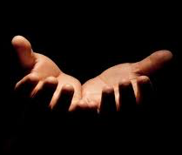
Thinking about praying
Over 1000 people in Britain were asked about praying.
Just over half said they prayed ‘sometimes’ or more often than that.
They were asked how prayer makes them feel, and they said lots of different things – have some guesses first.
What do you think they said?
Here are some of their answers.
In alphabet order:
Feeling…
challenged,
close to God,
guided,
happy,
hopeful,
humbled,
joyful,
loved,
peaceful,
released,
strong.
Pick three of these feelings and say to your partner:
When do you experience these emotions?
Are they important to you? (remember the feelings are in alphabet order here)
Notes:
This contribution to classroom RE / RVE / RME recognises the value of rich knowledge about prayer for pupils, and also encourages the deployment of that knowledge as pupils handle big questions and issues thoughtfully. This contributes to providing opportunities through the learning for spiritual development. The work uses a social studies lens, simply, and the survey results provide pupils with ‘here and now’ data about lived religion and spirituality in the UK today.
Pupils will learn percentages in Yr.5 and Yr.6 in Maths. Those in Yr.4 might access this work too, seeing a percentage as a 1/100th fraction – an idea they will cover in Maths.

Slide 5
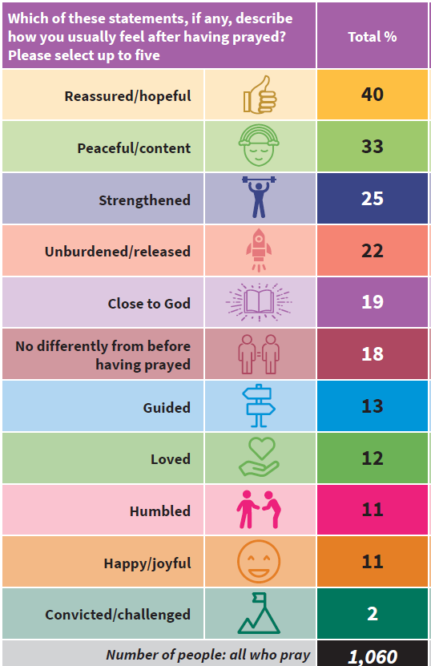
Thinking about praying
Now look at what the 1060 people in the survey said about the feelings prayer gave them.
The numbers are in percentages.
What do you notice?
Notes:
This contribution to classroom RE / RVE / RME recognises the value of rich knowledge about prayer for pupils, and also encourages the deployment of that knowledge as pupils handle big questions and issues thoughtfully. This contributes to providing opportunities through the learning for spiritual development. The work uses a social studies lens, simply, and the survey results provide pupils with ‘here and now’ data about lived religion and spirituality in the UK today.
Pupils will learn percentages in Yr.5 and Yr.6 in Maths. Those in Yr.4 might access this work too, seeing a percentage as a 1/100th fraction – an idea they will cover in Maths.

Slide 6

Finding out about prayer from research
Make some guesses in answer to these questions:
My guess of the percentage, the number out of 100, who pray every day in:
Brazil
India
Nigeria
Spain
UK
USA
A worldwide sample of people were asked: do you pray every day?
From these 6 countries, guess what percentage said yes: Brazil / India / Nigeria / Spain / UK / USA (the countries are in alphabet order in this list – can you spot them on a world map?).
Notes:
One aspect of these lessons (which can also be used as assembly outlines with simple adaptation) is that they use some data to make a real picture of prayer for learners. Use guesswork to generate curiosity – this is motivating. This can give pupils frequent opportunities to clarify and express their own views and ideas about prayer. We welcome the contested nature of this conversation: from different religions and worldviews there are many Varied perspectives from which to learn.

Slide 7
Do people in different countries pray in the same ways? Where is prayer most popular?
A worldwide sample of people were asked: do you pray every day?
From these 6 countries, guess what percentage said yes: Brazil / India / Nigeria / Spain / UK / USA ( the countries are in alphabet order in this list)
In the right order: Nigeria / India / Brazil / USA / Spain / UK
Make your guesses
Percentages: Nigeria 95% / India 75% / Brazil 61% / USA 55% / Spain 23% / UK 6%
Surprises: what did you find surprising or puzzling in the data? Can you explain it?
Notes:
One aspect of these lessons (which can also be used as assembly outlines with simple adaptation) is that they use some data to make a real picture of prayer for learners. Use guesswork to generate curiosity – this is motivating. This can give pupils frequent opportunities to clarify and express their own views and ideas about prayer. We welcome the contested nature of this conversation: from different religions and worldviews there are many Varied perspectives from which to learn.

Slide 8
Prayer in Britain
What percentage of British people say they pray at least sometimes?
What percentage pray once a month or more?
56% of British people say they pray sometimes.
Make your guesses
32% had prayed in the last month.
So over half pray sometimes.
And about a third prayed in the last month.
Surprised?
Notes:
One aspect of these lessons (which can also be used as assembly outlines with simple adaptation) is that they use some data to make a real picture of prayer for learners. Use guesswork to generate curiosity – this is motivating. This can give pupils frequent opportunities to clarify and express their own views and ideas about prayer. We welcome the contested nature of this conversation: from different religions and worldviews there are many Varied perspectives from which to learn.

Slide 9
Does God hear prayers?
What percentage of non-religious British people think that God hears their prayers?
What percentage of British Christians, and British Muslims think this?
19% of non-religious British people think God hears their prayers. About 1 out of 5.
Make your guesses
Among British Christians, that rises to 54% (Over half). Among British Muslims, it’s 83% (four out of five)
Surprised? How do you explain the figures?
Notes:
One aspect of these lessons (which can also be used as assembly outlines with simple adaptation) is that they use some data to make a real picture of prayer for learners. Use guesswork to generate curiosity – this is motivating. This can give pupils frequent opportunities to clarify and express their own views and ideas about prayer. We welcome the contested nature of this conversation: from different religions and worldviews there are many Varied perspectives from which to learn.

Slide 10
What do people pray for?
What do you think are the most common things that people in Britain pray for?
Can you think of three examples?
Commonest topics for prayer in Britain:
friends and family (69%),
people who are sick (54%)
and to give thanks (51%).
Make your guesses
Surprised? How do you explain the figures?
Do you think young people using the Prayer Space in your school would have prayed for friends, family, people who are sick and to give thanks? What else?
Notes:
One aspect of these lessons (which can also be used as assembly outlines with simple adaptation) is that they use some data to make a real picture of prayer for learners. Use guesswork to generate curiosity – this is motivating. This can give pupils frequent opportunities to clarify and express their own views and ideas about prayer. We welcome the contested nature of this conversation: from different religions and worldviews there are many Varied perspectives from which to learn.

Slide 11
What does the Bible offer to help us understand Christian prayer?
Here is an idea about prayer from Saint Paul, who wrote lots of the books of the New Testament. He says:
“Don’t be anxious about anything; rather, bring up all of your requests to God in your prayers… along with giving thanks. Then the peace of God that exceeds all understanding will keep your hearts and minds safe in Christ Jesus.” Philippians 4:6-7. CEV
Many Christians say that praying helps them with their worries, and gives them peace.
Where do you turn for help with your worries? And to find peace? Do you think praying is helpful for these things?
Where might you have found these ideas in the Prayer Space?
Did the Prayer Space give you any fresh ideas about this?
Notes:
These lessons enable pupils to learn a lot specifically about Christian prayer, and use Biblical quotations, examples and texts to enrich pupils’ understanding.

Slide 12
Choose 6 of these ten sentence starters and complete them with your own thoughts.
Writing about your learning
Lots of people feel hopeful, peaceful or stronger when they pray. I think…
Prayer makes me feel…
Most people in Nigeria (95%) and India (75%) pray every day. It’s surprising because…
Only one in 3 British people have prayed in the last month. What I think about this is…
Being non-religious doesn’t mean you don’t pray. About 1/5th of non-religious British people believe God hears their prayers. I think…
Does God hear our prayers? I believe…
Common topics for praying are friends and family, people who are ill and giving thanks. I guess these matter because…
I think the Prayer Space in our school was used to think about topics such as…
In the Bible, Saint Paul suggests you can be less worried and more peaceful if you pray. I think…
Praying: some people do it every day, other people never. What makes the difference? I’d say…
Notes:
There is a fill in sheet for this activity – emphasise that pupils are to choose 6 sentences, and do them slow and deep, rather than rushing through all ten. Linger longer, digging deeper!

Slide 13
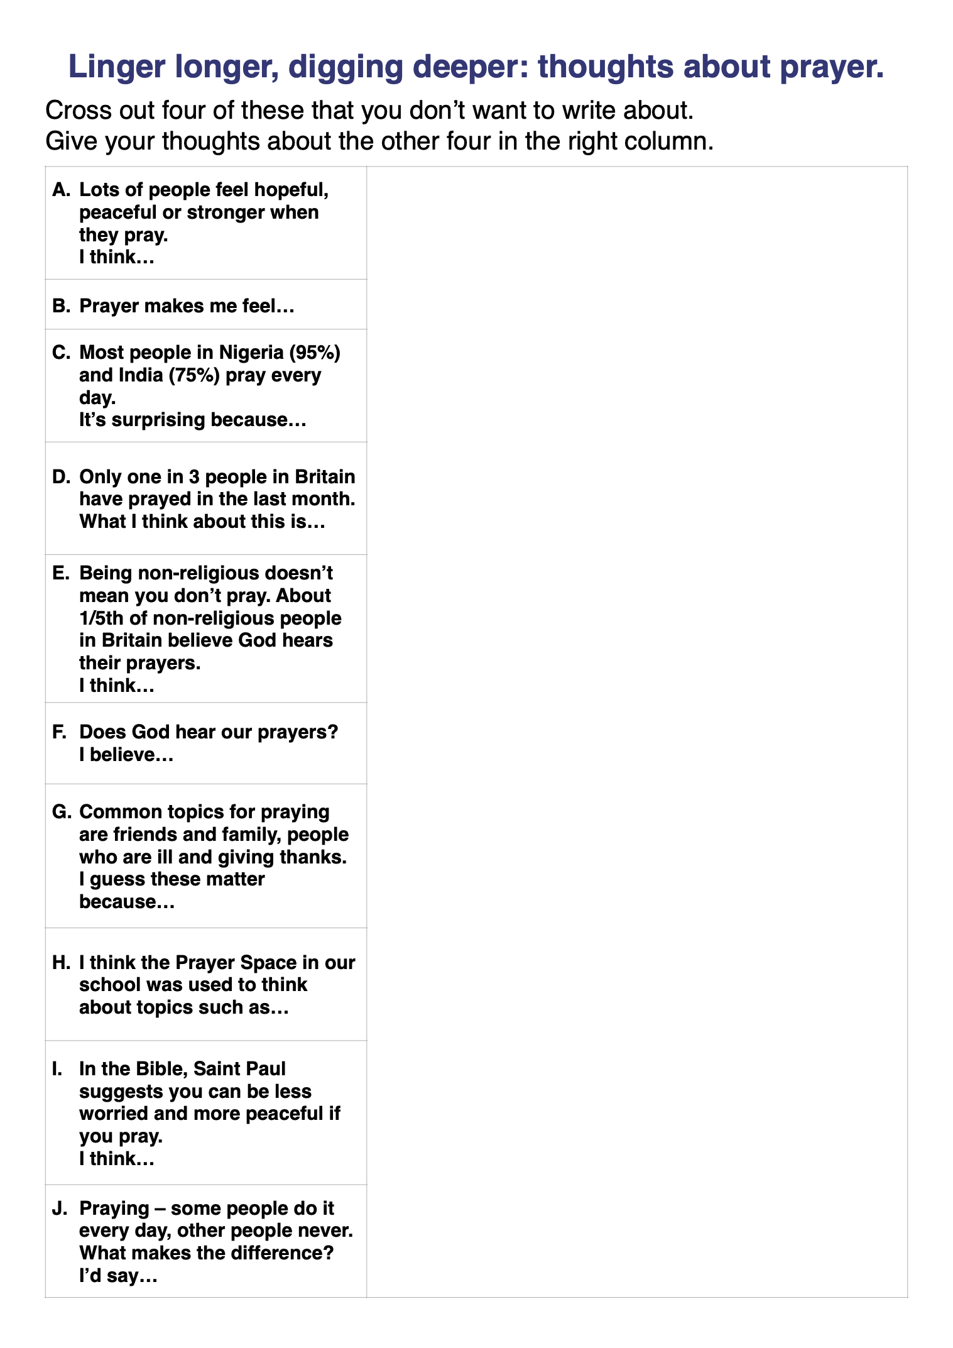
Fill in your own big ideas on the sheet, expressing your opinions about the learning we’re doing on prayer.
Read out your answers to others in a small group and listen to their ideas.
What do you notice?
Are everyone’s opinions different?
Notes:
This activity can give pupils frequent opportunities to clarify and express their own views and ideas about prayer – in ways that are well informed and based on some interesting data. We welcome the contested nature of this conversation: from different religions and worldviews there are many varied perspectives from which to learn.
The choice of tackling 6 from our ten prompts means pupils can decide for themselves to be more personal or more ‘objective’ in their replies. The discussion will maybe surprise you: we find pupils are often thinking profoundly on this topic.
Please send examples of interesting writing to lat@retoday.org.uk

