Slide 1





Prayer Spaces in Schools
Learning from a prayer space
KS3 Lesson 1 of 4
What is prayer?
Learning opportunities for 7-11s on themes about prayer and reflection.
Prayer Spaces in Schools create extraordinary opportunities for children and young people to think about prayer and to consider spirituality in open-minded experiential ways.
This lesson is one of a series written by Lat Blaylock of RE Today and provided free to schools to enable learners to use critical and reflective thinking skills to learn about spirituality, prayer and reflection.
is part of
Notes:
These lessons are written by Lat Blaylock, RE Consultant with RE Today www.retoday.org.uk
Aims of these lessons:
To provide excellent and respected classroom resources for teachers of RVE / RME / RE to use in lessons when a PRAYER SPACES visit is coming, taking place or has happened,
To enable teachers and PRAYER SPACES volunteers to deliver quality RVE / RME / RE about prayer which connects to the experiences of the PRAYER SPACES provision.
To enable pupils to think for themselves about prayer and its meanings, and access opportunities for spiritual, moral, social and cultural development.

Slide 2
Providing quality ‘state of the art’ RE / RVE / RME lessons ready to use for
KS2 & KS3
Suitable for both teachers of RE / RVE / RME and Prayer Spaces volunteers
to deliver.
Suitable for pre-Prayer Space and post Prayer Space uses.
About these resources.
Suitable for all pupils in all kinds of schools
Encouraging open hearted and critical thinking about prayer and reflection
Enhancing the experience of using a Prayer Space in school with good learning
Offering learners the chance to develop their own personal ideas about philosophical and social questions on the themes of prayer and reflection
Engaging, creative and absorbing learning.
We provide well prepared presentations, lesson plans and training webinars and examples.
Adaptive suggestions in lesson plans to help volunteers or fit in with teachers’ needs.
Introducing concepts and questions about Christian prayer. Providing resources to set high standards of RE / RVE / RME, deepening learning.
Also including assembly delivered options for school worship / religious observance
Integrated with common RE / RVE / RME units of work and ‘Understanding Christianity’ resources.
A lesson for KS2 and a lesson for KS3 in advance of the Prayer Space visit.
Suitable for all schools and all pupils offering creativity and critical engagement in the lessons.
Using active learning, creative multi-disciplinary methods, explained and resourced to be ‘ready to go’.
Three lessons each for KS2 and KS3, all free standing, that follow up the visit.
Notes:
Teachers and Youth Workers can use this lesson, which is part of a larger ‘Prayer Spaces in School’ learning package.
The lessons:
Can be taught - with preparation - ‘off the shelf’ using the 6 PPT sequences provided
Will be understood better by teachers and youth workers if you watch our training recorded webinars from Lat Blaylock of RE today
Include examples of pupils’ work, art, writing and responses
Are suitable for use across the UK, recognizing what is distinctive about RME / RVE / RE in each of the four nations
Reference law, guidance and inspection requirements for RE / SMSCD / School Worship
Use some PRAYER SPACES case studies

Slide 3
Prayer Spaces in Schools
Learning from a prayer space
Prayer and you; open minds
This is one lesson in a set which enables learners to respond to questions such as:
What is prayer? Meditation? Reflection?
Why are some prayers answered, and some unanswered?
Can prayer make a person feel happy? Calm? Thankful? Forgiven? How?
What can we find out about praying from social studies? Philosophy? Theology?
What do Christians say about prayer and Jesus, their own prayer practices
and the ways prayer ‘works’?
What do learners say about these big questions?
Notes:
The topics addressed in these lessons include Biblical narrative and teaching, the Christian ‘Lord’s Prayer’, sociology of prayer, Christian experiences of prayer, creative prayer ideas, Christian theologies of prayer, Jesus and prayer, the phenomenon of ‘SBNR’ (spiritual but not religious) prayer, the experiences of answered prayer and unanswered prayer.
Questions and diverse ideas are the focus: these lessons aim to open minds not to deliver one set of answers to these questions.
The lessons are designed to compliment the opportunities for spiritual development that come from the experience of visiting and using a ‘Prayer Space’ in a school.

Slide 4
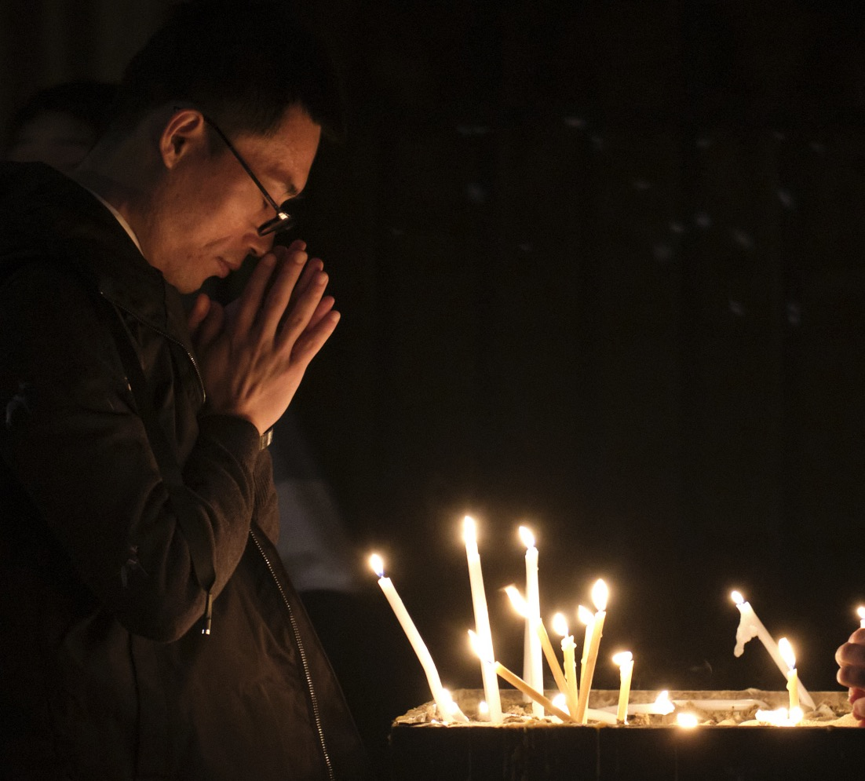
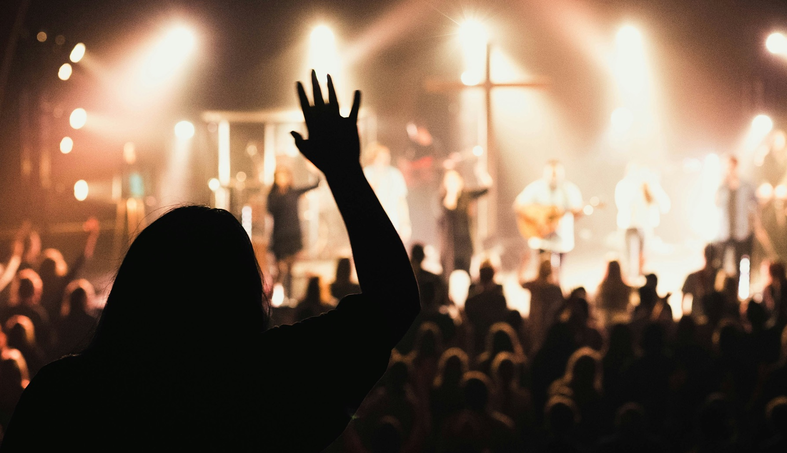
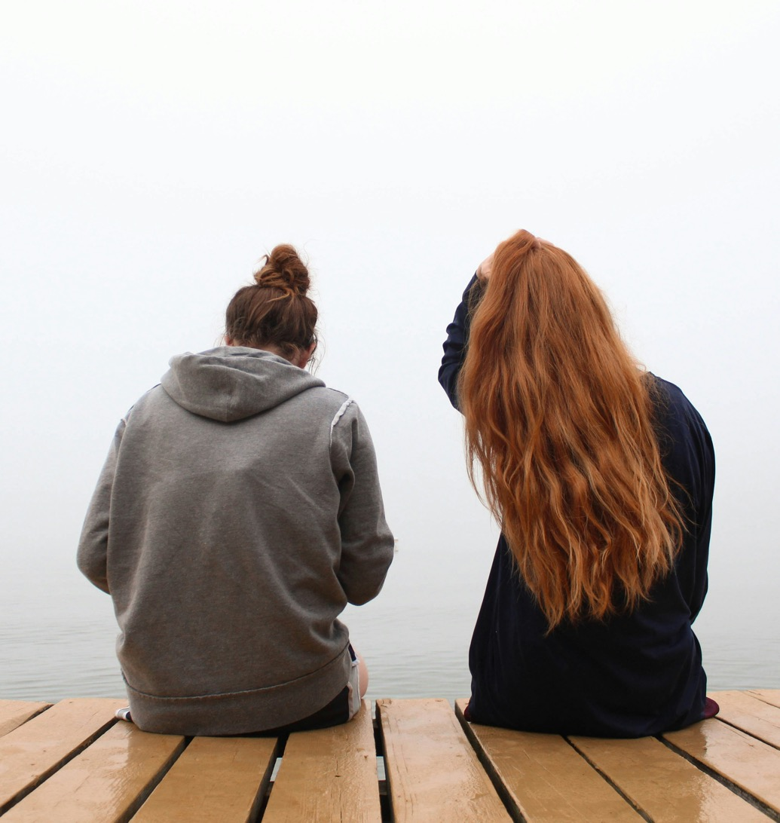


Thinking about praying
Notes:
This contribution to classroom RE / RVE / RME recognises the value of rich knowledge about prayer for pupils, and also encourages the deployment of that knowledge as pupils handle big questions and issues thoughtfully. This contributes to providing opportunities through the learning for spiritual development.
Stats from the Pew Research Centre.
https://www.pewresearch.org/religion/2018/06/13/how-religious-commitment-varies-by-country-among-people-of-all-ages/#:~:text=Compared%20with%20weekly%20worship%20attendance,and%20Latin%20America%20(62%25).

Slide 5
Thinking about praying
Far more people pray in the UK and in the world than those who go to holy buildings. In a worldwide survey, guess how many people pray every day…
It’s 49%. Surprised?
Some evidence suggests more young people pray than older people.
On the next slide: nine ideas from young people about prayer.
Which ones do you disagree with most?
Notes:
This contribution to classroom RE / RVE / RME recognises the value of rich knowledge about prayer for pupils, and also encourages the deployment of that knowledge as pupils handle big questions and issues thoughtfully. This contributes to providing opportunities through the learning for spiritual development.
Stats from the Pew Research Centre. https://www.pewresearch.org/religion/2018/06/13/how-religious-commitment-varies-by-country-among-people-of-all-ages/#:~:text=Compared%20with%20weekly%20worship%20attendance,and%20Latin%20America%20(62%25).

Slide 6
Expressing your own viewpoints
We asked lots of young learners to say WHAT THEY THINK ABOUT PRAYING. Read these examples out loud, and say: do you agree or disagree? Write your own 50 word opinions on praying.
Male, 13 – Christian. I think prayer is like a direct phone line to God but is never engaged. | Male, 12 – “I pray most nights before bedtime, as I feel it gives me a peace of mind to know that I am speaking to God and he is listening, but also we need to listen for answers from God and don't do all the talking. | Female, 16 – ”I pray and say the Lord’s Prayer etc - and it means nothing. I am just reciting words. When I am sad and lonely or extremely happy I sit and talk to myself telling God about how I feel and why - I think that is real prayer.
Male, 13 – “Prayer make me happier. When I leave church I feel mysteriously pleased with myself for helping with the offertory – I don’t know why. I come into church feeling tired and I come out feeling more alive. Silent prayer: good to do. At night it promises good dreams, in the morning, a good day. God is good.” | Female, 14 – “I think prayer is a way of meditation and connecting with a person's inner self which is important. I don't really agree with worship because you might dedicate your whole life to something that might turn out to be fake.” | Male, 13 – “I am not really a big prayer. If I am a litle down or feel a little lonely, I sometimes sit in my bed and talk to him because I feel that he is always listening to us all. He stops me feeling deserted and like I am alone in the world.”
Female, 12 – “I pray every night before I go to sleep. I find it's the least I can do for him after all that he has done for me.” | Female, 13 – “Prayer is when you stop and think about what you have done or where you are, and if you are scared, you talk to God, so you feel happier and not so alone.” | Female, 14 – “I believe that prayer strengthens people's belief in God. The more people pray the stronger God’s Spirit is with them. Prayer is a chance to say what you want individually to God and directly. It doesn't matter how many times you pray, it's up to you.”
If you were writing another statement about prayer to go with these, what would you write for yourself,
from your own viewpoint?
What do you disagree with in the first three quotes you have read?
Notes:
One aspect of these lessons (which can also be used as assembly outlines with simple adaptation) is that they give pupils frequent opportunities to clarify and express their own views and ideas about prayer. We welcome the contested nature of this conversation: from different religions and worldviews there are many varied perspectives from which to learn. The quotes come from this brilliant, searchable website – do use it in RE https://old.natre.org.uk/db/

Slide 7
Expressing your own viewpoints
We asked lots of young learners to say WHAT THEY THINK ABOUT PRAYING. Read these examples out loud, and say: do you agree or disagree? Write your own 50 word opinions on praying.
Male, 13 – Christian. I think prayer is like a direct phone line to God but is never engaged. | Male, 12 – “I pray most nights before bedtime, as I feel it gives me a peace of mind to know that I am speaking to God and he is listening, but also we need to listen for answers from God and don't do all the talking. | Female, 16 – ”I pray and say the Lord’s Prayer etc - and it means nothing. I am just reciting words. When I am sad and lonely or extremely happy I sit and talk to myself telling God about how I feel and why - I think that is real prayer.
Male, 13 – “Prayer make me happier. When I leave church I feel mysteriously pleased with myself for helping with the offertory – I don’t know why. I come into church feeling tired and I come out feeling more alive. Silent prayer: good to do. At night it promises good dreams, in the morning, a good day. God is good.” | Female, 14 – “I think prayer is a way of meditation and connecting with a person's inner self which is important. I don't really agree with worship because you might dedicate your whole life to something that might turn out to be fake.” | Male, 13 – “I am not really a big prayer. If I am a litle down or feel a little lonely, I sometimes sit in my bed and talk to him because I feel that he is always listening to us all. He stops me feeling deserted and like I am alone in the world.”
Female, 12 – “I pray every night before I go to sleep. I find it's the least I can do for him after all that he has done for me.” | Female, 13 – “Prayer is when you stop and think about what you have done or where you are, and if you are scared, you talk to God, so you feel happier and not so alone.” | Female, 14 – “I believe that prayer strengthens people's belief in God. The more people pray the stronger God’s Spirit is with them. Prayer is a chance to say what you want individually to God and directly. It doesn't matter how many times you pray, it's up to you.”
If you were writing another statement about prayer to go with these, what would you write for yourself,
from your own viewpoint?
Notes:
One aspect of these lessons (which can also be used as assembly outlines with simple adaptation) is that they give pupils frequent opportunities to clarify and express their own views and ideas about prayer. We welcome the contested nature of this conversation: from different religions and worldviews there are many varied perspectives from which to learn. The quotes come from this brilliant, searchable website – do use it in RE https://old.natre.org.uk/db/

Slide 8
Expressing your own viewpoints
We asked lots of young learners to say WHAT THEY THINK ABOUT PRAYING. Read these examples out loud, and say: do you agree or disagree? Write your own 50 word opinions on praying.
Male, 13 – Christian. I think prayer is like a direct phone line to God but is never engaged. | Male, 12 – “I pray most nights before bedtime, as I feel it gives me a peace of mind to know that I am speaking to God and he is listening, but also we need to listen for answers from God and don't do all the talking. | Female, 16 – ”I pray and say the Lord’s Prayer etc - and it means nothing. I am just reciting words. When I am sad and lonely or extremely happy I sit and talk to myself telling God about how I feel and why - I think that is real prayer.
Male, 13 – “Prayer make me happier. When I leave church I feel mysteriously pleased with myself for helping with the offertory – I don’t know why. I come into church feeling tired and I come out feeling more alive. Silent prayer: good to do. At night it promises good dreams, in the morning, a good day. God is good.” | Female, 14 – “I think prayer is a way of meditation and connecting with a person's inner self which is important. I don't really agree with worship because you might dedicate your whole life to something that might turn out to be fake.” | Male, 13 – “I am not really a big prayer. If I am a litle down or feel a little lonely, I sometimes sit in my bed and talk to him because I feel that he is always listening to us all. He stops me feeling deserted and like I am alone in the world.”
Female, 12 – “I pray every night before I go to sleep. I find it's the least I can do for him after all that he has done for me.” | Female, 13 – “Prayer is when you stop and think about what you have done or where you are, and if you are scared, you talk to God, so you feel happier and not so alone.” | Female, 14 – “I believe that prayer strengthens people's belief in God. The more people pray the stronger God’s Spirit is with them. Prayer is a chance to say what you want individually to God and directly. It doesn't matter how many times you pray, it's up to you.”
Notes:
One aspect of these lessons (which can also be used as assembly outlines with simple adaptation) is that they give pupils frequent opportunities to clarify and express their own views and ideas about prayer. We welcome the contested nature of this conversation: from different religions and worldviews there are many varied perspectives from which to learn. The quotes come from this brilliant, searchable website – do use it in RE https://old.natre.org.uk/db/

Slide 9
Learning creatively: prayer-art
We asked some children to show us their beliefs about prayer in a work of art. You are going to see four of these.
The children have written about their prayers as well.
Give them a score out of ten for their art, and their writing.
Which one is best?
We are asking the question: What is prayer? Some people answer by saying something like ‘hands together, eyes closed, Our Father…’ But others say prayer is many things – reflecting, sitting silently, listening for God, wishing, saying sorry…
What do you think?
What do people pray about? Their problems and wishes? Their hopes and fears? Those they love, themselves or the whole human race?
When you visit the prayer space, your ideas about praying may be challenged.
Take an open mind with you.
Notes:
We work from the view that there is a close frontier between spiritual learning and creativity: the experience of using a prayer space often feels highly creative, and prompts creativity for pupils.

Slide 10
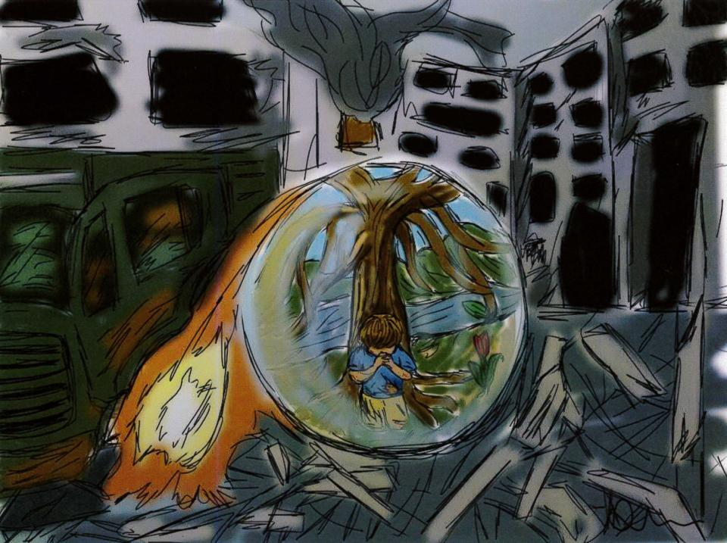
Adey, 14
Prayer Bubble
“My Religious Studies art work on prayer is a picture drawn on an app on my iPad. It is about the theoretical bubble you become in, when you pray. It is about how prayer makes you feel protected and in your own little world. The picture is showing a small boy praying in a war scene / zone and how he feels protected when he prays. Does God hear? That is a question that faith can answer positively, and doubt wonders about.”
What do you think?
Notes:
Pupil art like this often communicates very powerfully to other learners – examples come from the NATRE ‘Spirited Arts’ competition and gallery.
https://www.natre.org.uk/about-natre/projects/spirited-arts/spirited-arts-gallery/2023/
Do get your pupils to enter.
Teachers could challenge pupils: do they think prayer is like a ‘safety bubble’ as Adey suggests?

Slide 11
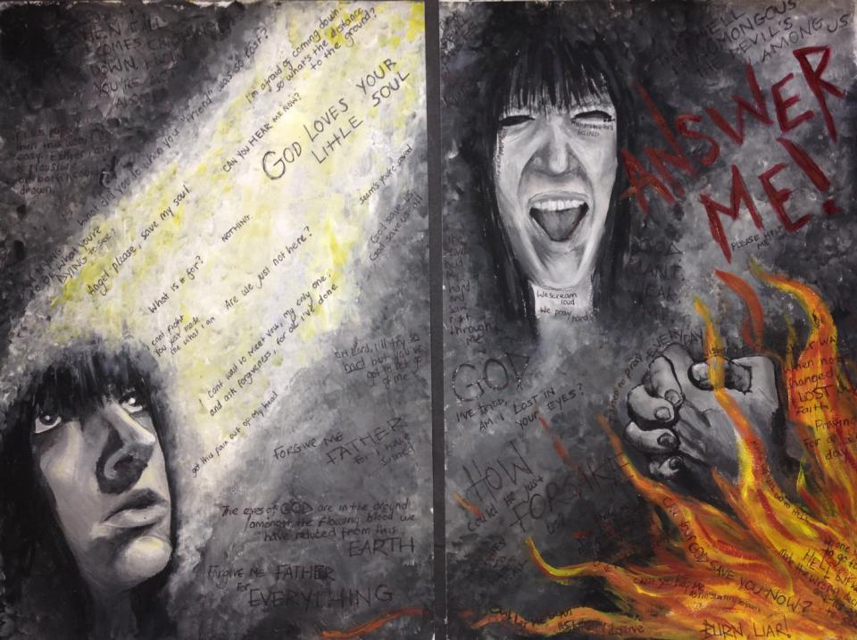
Notes:
Pupil art like this often communicates very powerfully to other learners – examples come from the NATRE ‘Spirited Arts’ competition and gallery.
https://www.natre.org.uk/about-natre/projects/spirited-arts/spirited-arts-gallery/2023/
Do get your pupils to enter.
Teachers could challenge pupils: do they understand what Jake means by ‘battling the duality’

Slide 12
Jake,16
“This painting is called ‘Agnostic’ and it is about someone who doesn’t know whether to believe in God or not and is battling the duality of Atheist and Christian within themselves.
The page on the right is of an Atheist(ish) view and contains lyrics of my favourite bands arguing if there is a God and mainly, if there is, does he care? It also tries to portray corruption and temptation of the Devil whist reaching out for salvation from a man that could be false. I used lyrics such as, “I used to pray every day, wishing for a better way. When nothing changed, I lost my faith, praying for a better day” (Witness the Addiction by Suicide Silence) to try and show this. The right page is ultimately about lack or loss of faith. Maybe God isn’t listening.
What do you think?
Notes:
Pupil art like this often communicates very powerfully to other learners – examples come from the NATRE ‘Spirited Arts’ competition and gallery.
https://www.natre.org.uk/about-natre/projects/spirited-arts/spirited-arts-gallery/2023/
Do get your pupils to enter.
Teachers could challenge pupils: do they understand what Jake means by ‘battling the duality’

Slide 13
Jake,16 [part 2]
“The page on the left is a more Christian view. It symbolises a deep want / need for a belief in God. I represented prayer as a way of releasing worries and questions. Again, I used lyrics of my favourite bands such as, “When it all comes crashing down, know you’re not alone” (Dream Run by Parkway Drive). I tried to show a trust and support with God. These lyrics I deliberately put in the light as it was the purest part of the page.
In the grey areas and on both sides of the ring binder I put more agnostic lyrics to show doubt and confusion such as, “If I was perfect, then this would be easy. Either road is plausible, on both I could drown” (Crossroads by Avenged Sevenfold).
In conclusion - there is no conclusion to this piece. As a whole it shows one unanswered question and the attack of arguments that come with that question, “Is there a God? Does God care?”
What do you think?
Notes:
Pupil art like this often communicates very powerfully to other learners – examples come from the NATRE ‘Spirited Arts’ competition and gallery.
https://www.natre.org.uk/about-natre/projects/spirited-arts/spirited-arts-gallery/2023/
Do get your pupils to enter.
Teachers could challenge pupils: do they understand what Jake means by ‘battling the duality’

Slide 14
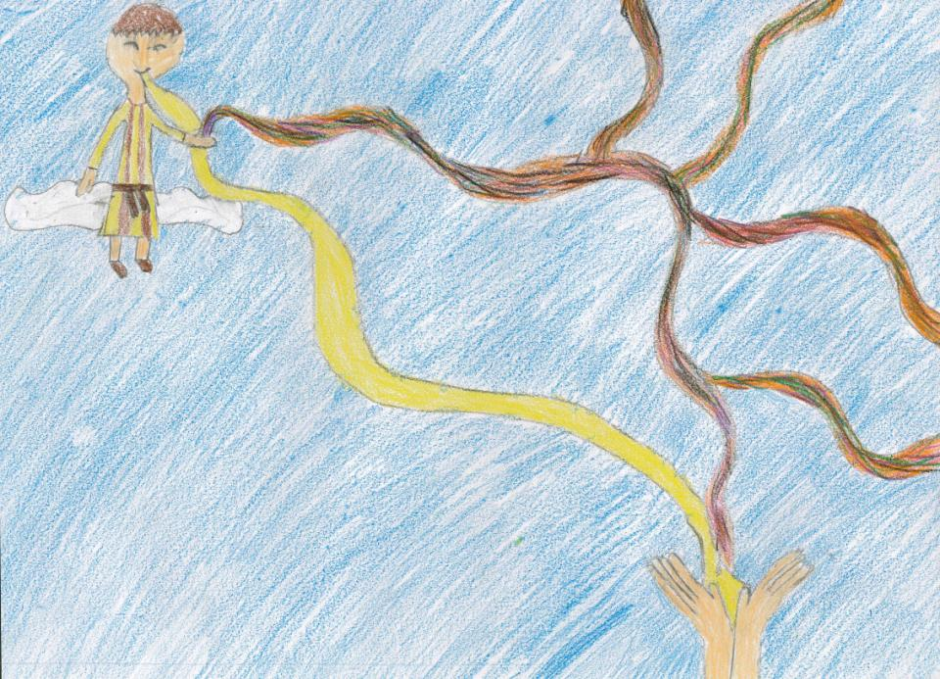
Jessica, 10
The first prayer
“I have drawn a picture of when you say your first prayer to God for forgiveness. I have drawn when your tangled life goes up to God and he catches it and renews you and you get a new, better life. What I like best about my work is that it really explains the first prayer. When I was making this, my main thoughts were how happy God must be when people decide to join Him. My inspiration for this work came from when I became a Christian.”
Do you think God is happy when we pray?
Why or why not?
Notes:
Pupil art like this often communicates very powerfully to other learners – examples come from the NATRE ‘Spirited Arts’ competition and gallery.
https://www.natre.org.uk/about-natre/projects/spirited-arts/spirited-arts-gallery/2023/
Do get your pupils to enter.
Challenge pupils to really hear what Jessica is saying: this is a really profound piece of work from a young learner on the topic of conversion or encounter with God.

Slide 15
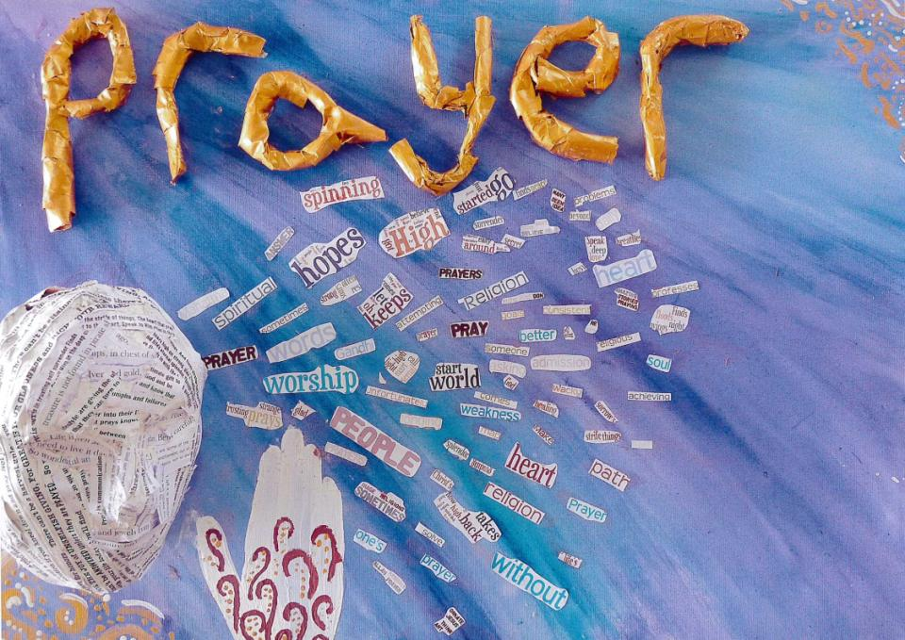
Group work – these 15 years old called their work:
“The face of Prayer”
We have based our piece of art on a quotation from C.S. Lewis. We believe that prayer is about sharing our thoughts. Prayer should make a difference to us and to our lives.
C. S . Lewis said: “I pray because I can’t help myself. I pray because I’m helpless. I pray because the need flows out of me all the time, waking and sleeping. It doesn’t change God, it changes me.”
C. S. Lewis, the creator of Narnia
Coming out of the persons mouth are words that a person may say during prayer, asking for help, asking ‘Why?’ Words that say why a person may pray - for hope, or in weakness.”
Notes:
Additional text from the pupils who made this: “We came up with the words when as a group we spoke about what we thought of when we thought about prayer and what prayer might mean to us, we also thought about whether we have ever had to pray or anyone we know that has and what they prayed for. We also included actions to make changes in our lives. The 3D face has also got words on but these are examples of prayer songs and poems. Our person is praying in the most common method of prayer with both palms touching and their fingertips pointing upward towards the sky. We used a head to show how we feel we communicate via our thoughts and words. As in the quotation the words are flowing out of the person into the air around them. The eyes cannot be seen indicating that prayer can occur at any time. This is reflected in the quotation.
We choose the colour gold for the lettering in our title because gold shows a sign of value and trust in God through prayer, gold is also a very auspicious colour in many religions. We chose a mixture of blues and purples for our backgrounds as they are calming colours and when you pray it is soothing and calming as it is just you communicating directly to God.

Slide 16
Which of these four did you like best? Why?
Which ideas do you agree with about prayer?
Which do you disagree with?
If you made an artwork to show your ideas about prayer, what would you picture?
Your ‘theology of prayer’ is your answers to questions about why people pray, whether God hears, and how God answers.
What’s yours?
Notes:
Teacher: develop the discussion about this slide by asking pupils to talk in twos, then vote, then discuss around the class. You may be surprised how well they respond to the ideas of other students here. Pupil art like this often communicates very powerfully to other learners – examples come from the NATRE ‘Spirited Arts’ competition and gallery.
https://www.natre.org.uk/about-natre/projects/spirited-arts/spirited-arts-gallery/2023/
Do get your pupils to enter.

Slide 17
What does the Bible offer to help us understand Christian prayer?
What do you know about prayer in the teaching of the bible?
Can you collect five facts round the class? Ten facts?
Christians learn about prayer from what Jesus said, and from what the Bible teaches them. Here are two quotes from the Bible;
In Matthew’s Gospel, chapter 6, Jesus talks to his followers about private prayer: “When you pray, go into your room, close the door and pray to your Father, who is in heaven. Then your Father, who sees what is done in secret, will reward you.”
What do you think?
Saint Paul writes, in his letter to Christians at Thessalonica: “Rejoice always, pray continually, give thanks in all circumstances! For this is God’s will for you in Christ Jesus.”
What do you think it means?
Notes:
These lessons enable pupils to learn a lot specifically about Christian prayer, and use Biblical quotations, examples and texts to enrich pupils’ understanding.

Slide 18
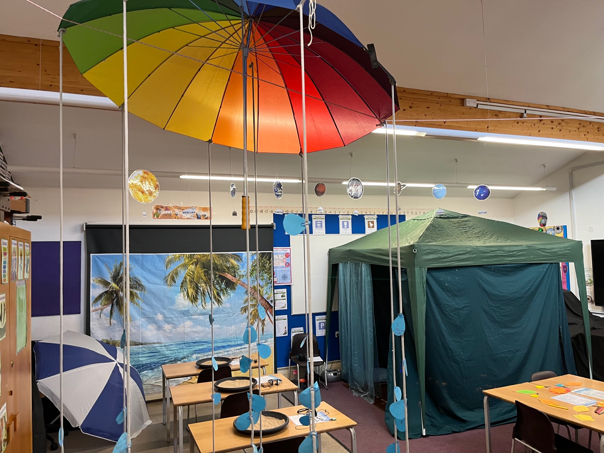
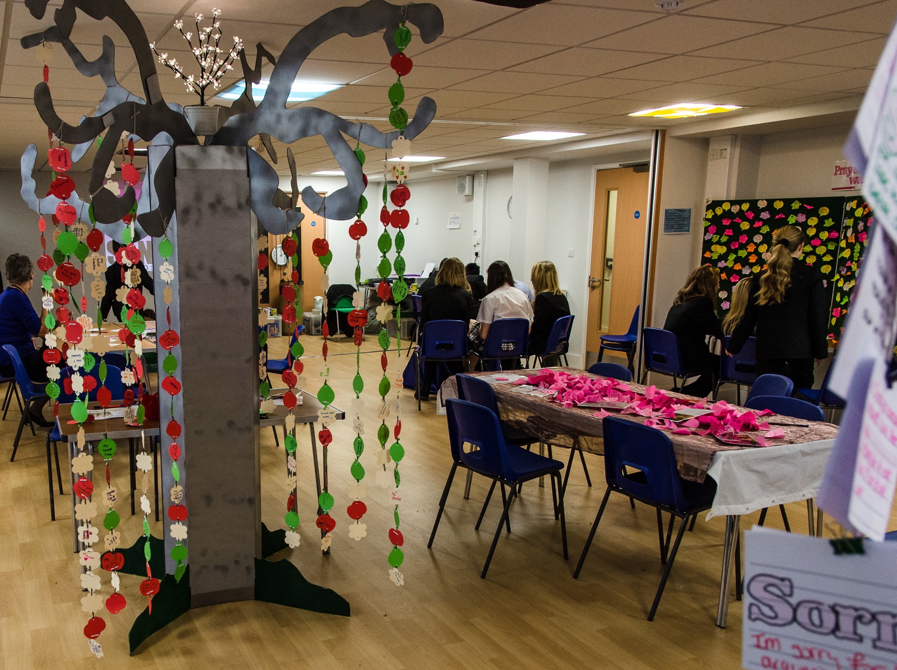
What is a ‘Prayer Space’?
It will surprise you.
It’s much easier to experience a prayer space than to tell you what it is.
Notes:
For teachers and lesson leaders: Prayer Spaces are hugely varied. They use a broad understanding of prayer. Activities in a Prayer Space in School may enable pupils to reflect deeply or profoundly on themselves, their relationships, their place on the earth and their connection with ‘the big beyond’ – God, as many say.
These spaces use activities which engage with happiness and sorrow, success and failure, strength and weakness, faith and doubt. The activities are often and by turns responsive, provocative, creative ,imaginative, focused on the human spirit. They make space for the spiritual.
No two prayer spaces are the same, and each individual’s experience of the Space will be unique.
These Spaces are never coercive – we don’t think there is any such thing as ‘forced prayer’. Instead, the Prayer Spaces open up new horizons of imagination, possibility and faith.

Slide 19
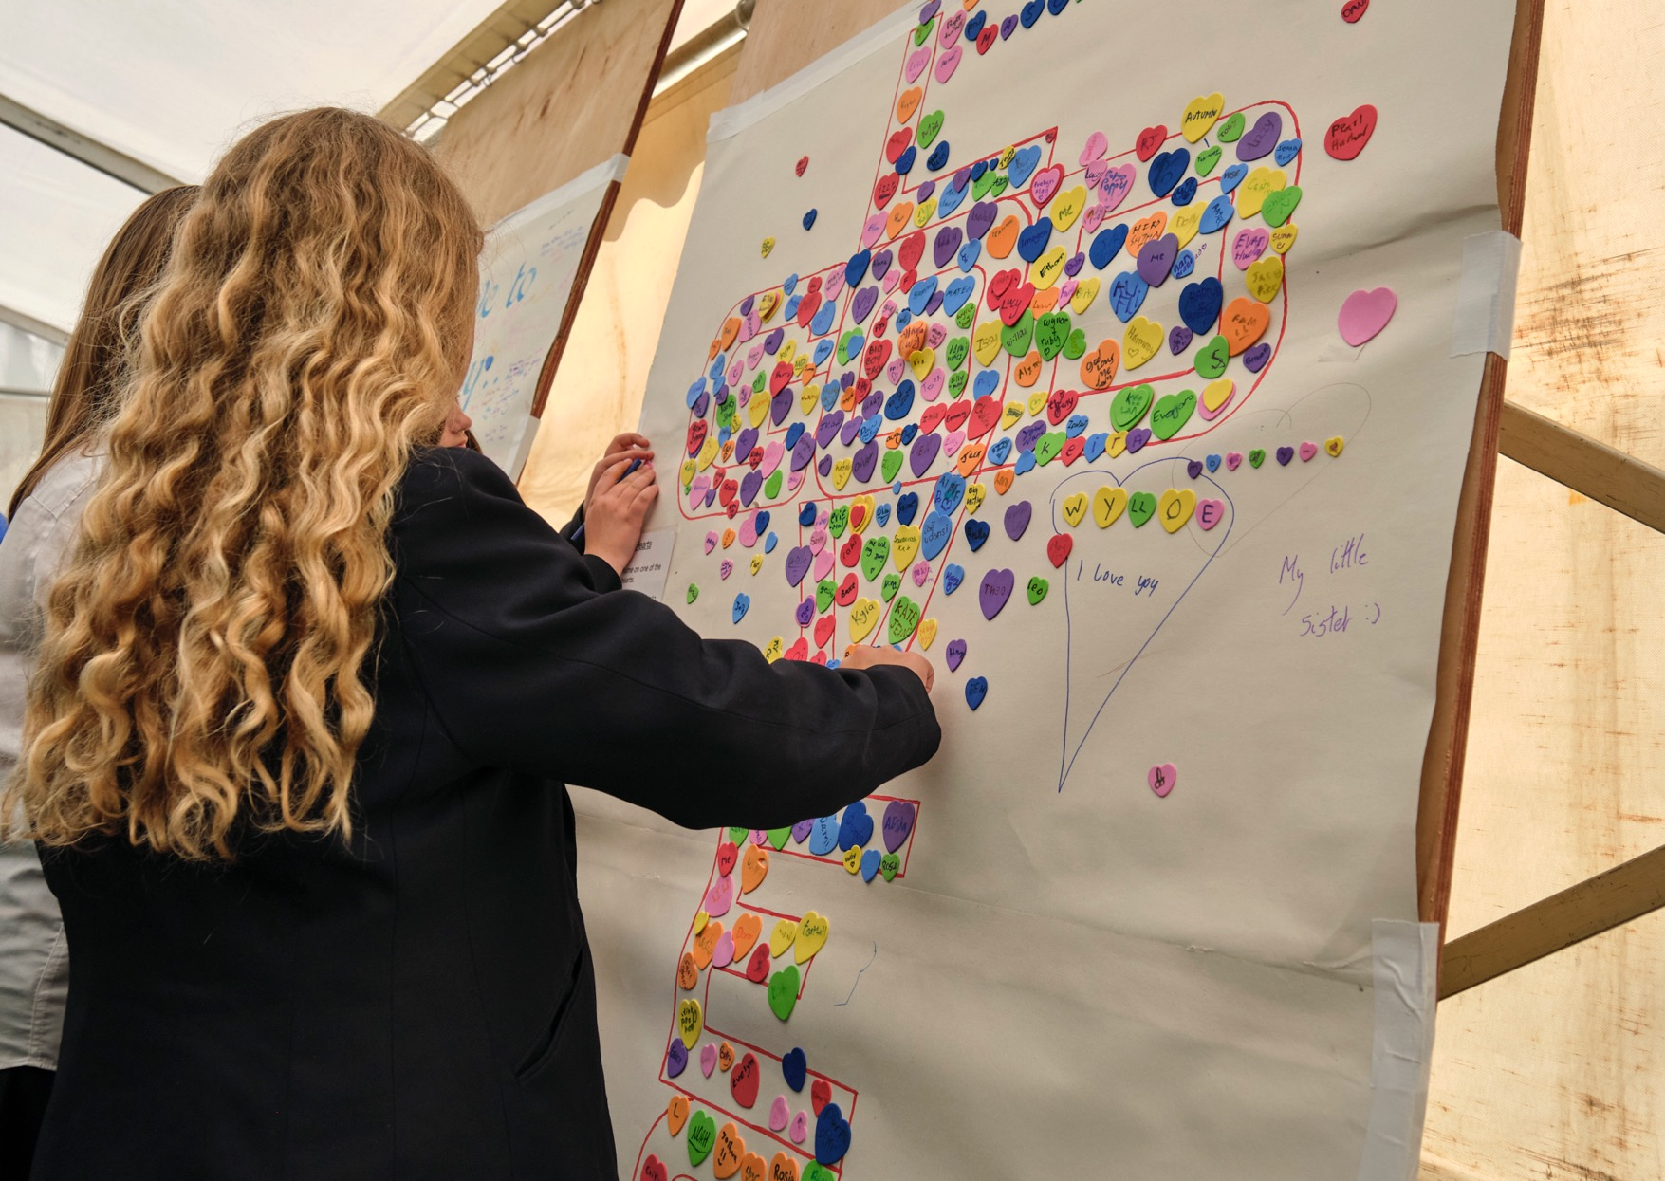
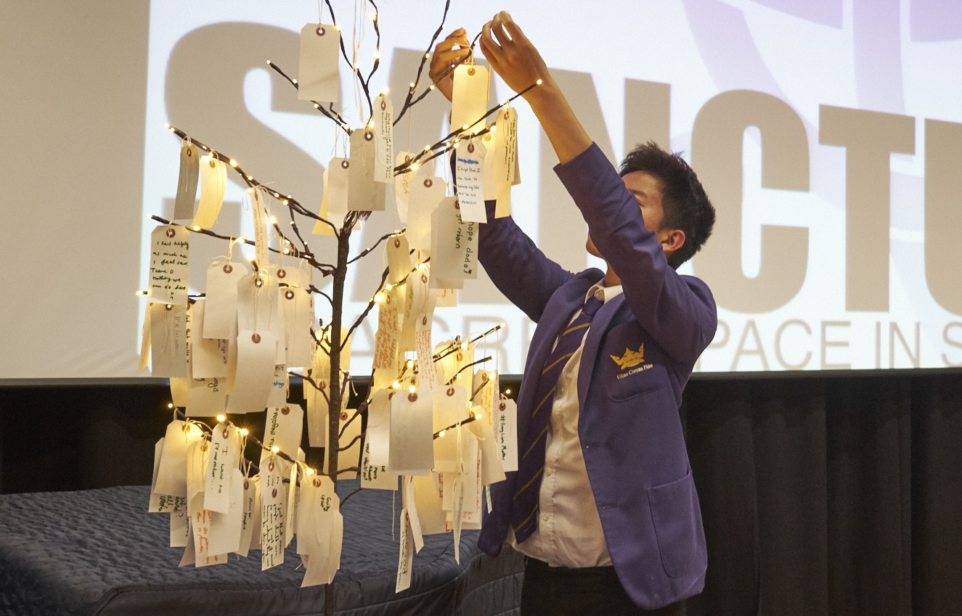
What is a ‘Prayer Space’?
You don’t have to be religious to like this.
It’s a chance to think really deeply or to feel really fully.
You can ponder some big issues and questions, or find calm, or peace. Lots more too.
Notes:
For teachers and lesson leaders: Prayer Spaces are hugely varied. They use a broad understanding of prayer. Activities in a Prayer Space in School may enable pupils to reflect deeply or profoundly on themselves, their relationships, their place on the earth and their connection with ‘the big beyond’ – God, as many say.
These spaces use activities which engage with happiness and sorrow, success and failure, strength and weakness, faith and doubt. The activities are often and by turns responsive, provocative, creative ,imaginative, focused on the human spirit. They make space for the spiritual.
No two prayer spaces are the same, and each individual’s experience of the Space will be unique.
These Spaces are never coercive – we don’t think there is any such thing as ‘forced prayer’. Instead, the Prayer Spaces open up new horizons of imagination, possibility and faith.

Slide 20
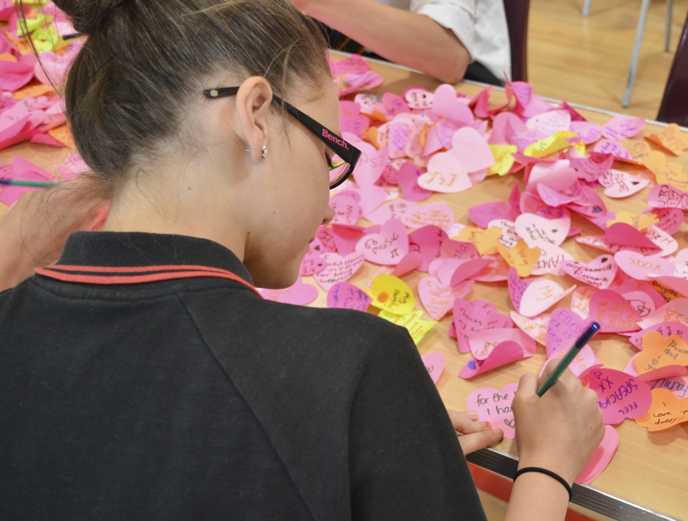
What is a ‘Prayer Activity’?
A prayer space has a range of simple activities that help you to reflect or pray. Each one gives you something to consider, a way to reflect and an opportunity to respond with your own thoughts, feelings or prayer.
This activity is called
‘Thankful’.
It invites us to think about the things we’re thankful for and then write them on a post-it note heart.
For some people, taking time to be thankful is part of the way they talk to God in prayer.
Notes:
The instructions for this prayer activity say:
What makes your life good? What are you thankful for right now?
Write on a post-it note one thing that makes you thankful and add it to the others here.

Slide 21
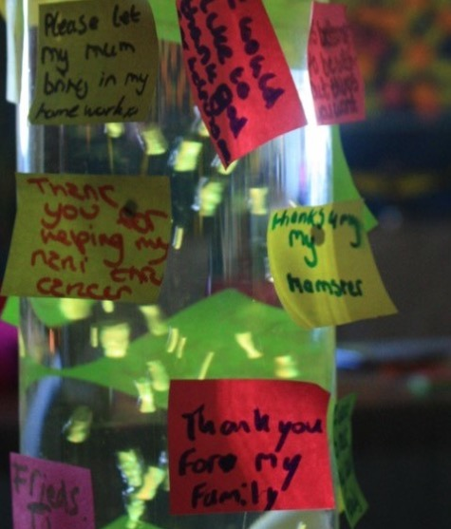
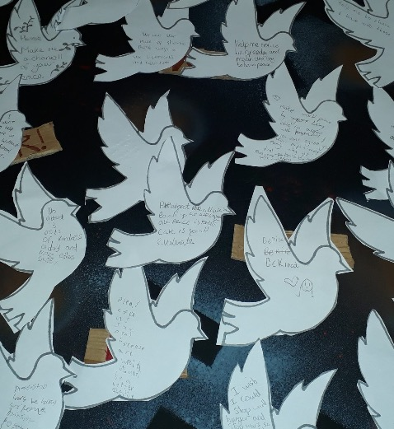
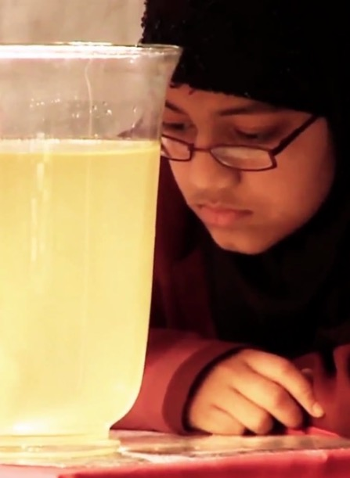
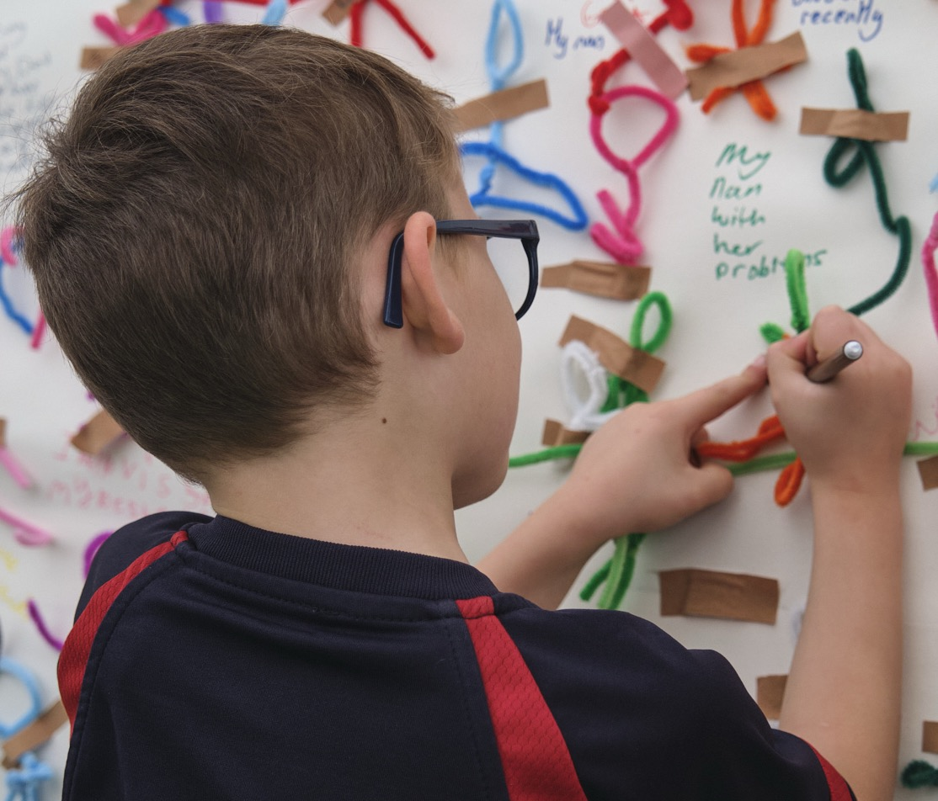
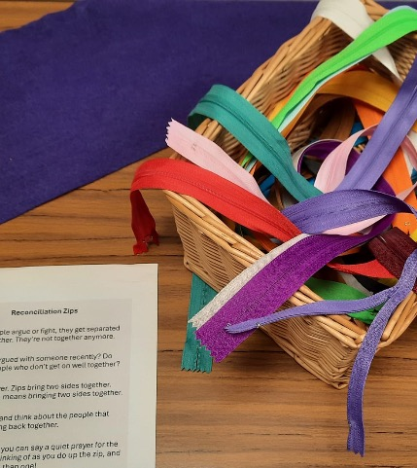
Notes:
Teaching may need the focus on welcome and open hearts and minds because sometimes pupils (perhaps rightly) wary of religion in school: they wonder if someone is trying to force them to think one way.
These lessons are about getting young students to think for themselves, not to accept anyone else’s dogma. Of course, there’s an important argument about ‘whose dogma’ our contemporary culture places centrally: for some, it is the possibility of religion being taken seriously and appreciated that our culture denies. Others see this the other way round.
The point here is to show pupils both sides of these questions and invite increasingly informed responses.

Slide 22
When you visit the Prayer Space in your school…
Expect it to be a bit different from everyday school
Take an open minded attitude
It’s a free and welcoming experience – no one will force you to do anything
Be ready to use your imagination
Don’t worry: it is inclusive and everyone is welcome, if you believe in prayer and pray lots, or if you’ve never done that and don’t believe in prayer, there will be some interesting things to think about
Talk, talk, talk: it’s great when pupils using prayer spaces to speak up about their feelings, their ideas and their experience
Silence, silence, silence: what happens in the prayer space might be personal, emotional, spiritual. Keep it private if you want to – and take the silence as a gift. We probably need a bit more calm and quietness in our lives…
Notes:
This slide tries to offer pupils a reassuring description of the ways the Prayer Space might work for them. Teachers will do well to familiarise themselves with the particular activities and ideas in the Prayer Space at their school and refer to them with pupils.
The website has hundreds of examples of prayer activities and stories from many kinds of school, but each Prayer Space is unique.

