Slide 1





Prayer Spaces in Schools
Learning from a prayer space
KS3 Lesson 2 of 4 What is prayer?
Learning opportunities for 7-11s on themes about prayer and reflection.
Prayer Spaces in Schools create extraordinary opportunities for children and young people to think about prayer and to consider spirituality in open-minded experiential ways.
This lesson is one of a series written by Lat Blaylock of RE Today and provided free to schools to enable learners to use critical and reflective thinking skills to learn about spirituality, prayer and reflection.
is part of
Notes:
These lessons are written by Lat Blaylock, RE Consultant with RE Today www.retoday.org.uk
Aims of these lessons:
To provide excellent and respected classroom resources for teachers of RVE / RME / RE to use in lessons when a PRAYER SPACES visit is coming, taking place or has happened,
To enable teachers and PRAYER SPACES volunteers to deliver quality RVE / RME / RE about prayer which connects to the experiences of the PRAYER SPACES provision.
To enable pupils to think for themselves about prayer and its meanings, and access opportunities for spiritual, moral, social and cultural development.

Slide 2
Providing quality ‘state of the art’ RE / RVE / RME lessons ready to use for KS2 & KS3
Suitable for both teachers of RE / RVE / RME and Prayer Spaces volunteers to deliver.
Suitable for pre-Prayer Space and post Prayer Space uses.
About these resources.
Suitable for all pupils in all kinds of schools
Encouraging open hearted and critical thinking about prayer and reflection
Enhancing the experience of using a Prayer Space in school with good learning
Offering learners the chance to develop their own personal ideas about philosophical and social questions on the themes of prayer and reflection
Engaging, creative and absorbing learning.
We provide well prepared presentations, lesson plans and training webinars and examples.
Adaptive suggestions in lesson plans to help volunteers or fit in with teachers’ needs.
Introducing concepts and questions about Christian prayer. Providing resources to set high standards of RE / RVE / RME, deepening learning.
Also including assembly delivered options for school worship / religious observance
Integrated with common RE / RVE / RME units of work and ‘Understanding Christianity’ resources.
A lesson for KS2 and a lesson for KS3 in advance of the Prayer Space visit.
Suitable for all schools and all pupils offering creativity and critical engagement in the lessons.
Using active learning, creative multi-disciplinary methods, explained and resourced to be ‘ready to go’.
Three lessons each for KS2 and KS3, all free standing, that follow up the visit.
Notes:
Teachers and Youth Workers can use this lesson, which is part of a larger ‘Prayer Spaces in School’ learning package.
The lessons:
Can be taught - with preparation - ‘off the shelf’ using the 6 PPT sequences provided
Will be understood better by teachers and youth workers if you watch our training recorded webinars from Lat Blaylock of RE today LINK:
Include examples of pupils’ work, art, writing and responses
Are suitable for use across the UK, recognizing what is distinctive about RME / RVE / RE in each of the four nations
Reference law, guidance and inspection requirements for RE / SMSCD / School Worship
Use some PRAYER SPACES case studies

Slide 3
Prayer Spaces in Schools
Learning from a prayer space
Examining spirituality: meaning and making sense
This is one lesson in a set which enables learners to respond to big questions.
Here, there are 5 activities:
Learn about a description of spirituality that is human, but not tied to one religion
Select 6 words from a list of 40 that describe your spiritual sense.
Create an image map of your spiritual ‘identikit’.
Imagine how some people might pray – imagework
Create your own ‘Spiritual Spotify’ tracklist, selecting the music that is spiritual for you.
This lesson is very full, so do be selective in which parts you use, or spread it over two sessions.
Notes:
The 5 aspects of this lesson can be done in an hour in a fast paced lesson – but if you prefer, take them more slowly and space them over 2 lessons. Or choose only three that suit your students.
The topics addressed in these lessons include Biblical narrative and teaching, the Christian ‘Lord’s Prayer’, sociology of prayer, Christian experiences of prayer, creative prayer ideas, Christian theologies of prayer, Jesus and prayer, the phenomenon of ‘SBNR’ (spiritual but not religious) prayer, the experiences of answered prayer and unanswered prayer.
Questions and diverse ideas are the focus: these lessons aim to open minds not to deliver one set of answers to these questions.
The lessons are designed to compliment the opportunities for spiritual development that come from the experience of visiting and using a ‘Prayer Space’ in a school.

Slide 4
A human and humane model of spirituality
Spiritual growth is about…
Notes:
There is a vast literature and a continuing conversation about the nature of spirituality. The work of Dr Rebecca Nye, University of Cambridge, is useful in plural settings like school. Founded in research, her exposition of spirituality is child-centred, alert to Christianity and many other faiths and clear.
If you are interested to go further into the topic, two books are recommended: Children's Spirituality: What it is and Why it Matters (Sure Foundations) 2009, The Spirit of the Child: Revised Edition, DLT, 2006, by David Hay and Rebecca Nye.

Slide 5
A human and humane model of spirituality
Relating to myself – my inner life
What are my deepest ideas? My identity? What shapes my sense of who I am?
Spiritual growth is about…
Notes:
There is a vast literature and a continuing conversation about the nature of spirituality. The work of Dr Rebecca Nye, University of Cambridge, is useful in plural settings like school. Founded in research, her exposition of spirituality is child-centred, alert to Christianity and many other faiths and clear.
If you are interested to go further into the topic, two books are recommended: Children's Spirituality: What it is and Why it Matters (Sure Foundations) 2009, The Spirit of the Child: Revised Edition, DLT, 2006, by David Hay and Rebecca Nye.

Slide 6
A human and humane model of spirituality
Relating to myself – my inner life
What are my deepest ideas? My identity? What shapes my sense of who I am?
Who do I love, and how can I show love? What makes relationships work well?
Spiritual growth is about…
Relating to others – living in love and community
Notes:
There is a vast literature and a continuing conversation about the nature of spirituality. The work of Dr Rebecca Nye, University of Cambridge, is useful in plural settings like school. Founded in research, her exposition of spirituality is child-centred, alert to Christianity and many other faiths and clear.
If you are interested to go further into the topic, two books are recommended: Children's Spirituality: What it is and Why it Matters (Sure Foundations) 2009, The Spirit of the Child: Revised Edition, DLT, 2006, by David Hay and Rebecca Nye.

Slide 7
A human and humane model of spirituality
Relating to myself – my inner life
What are my deepest ideas? My identity? What shapes my sense of who I am?
Who do I love, and how can I show love? What makes relationships work well?
Spiritual growth is about…
Relating to others – living in love and community
Relating to the earth – connecting with nature and the planet
How do I see and care for the world of nature?
Notes:
There is a vast literature and a continuing conversation about the nature of spirituality. The work of Dr Rebecca Nye, University of Cambridge, is useful in plural settings like school. Founded in research, her exposition of spirituality is child-centred, alert to Christianity and many other faiths and clear.
If you are interested to go further into the topic, two books are recommended: Children's Spirituality: What it is and Why it Matters (Sure Foundations) 2009, The Spirit of the Child: Revised Edition, DLT, 2006, by David Hay and Rebecca Nye.

Slide 8
A human and humane model of spirituality
Relating to myself – my inner life
What are my deepest ideas? My identity? What shapes my sense of who I am?
Who do I love, and how can I show love? What makes relationships work well?
Relating to the ultimate – the ‘Big Beyond’ - as some say, ‘God’
Spiritual growth is about…
Relating to others – living in love and community
Relating to the earth – connecting with nature and the planet
What beliefs about the biggest questions shape me? Thoughts about God?
How do I see and care for the world of nature?
Notes:
There is a vast literature and a continuing conversation about the nature of spirituality. The work of Dr Rebecca Nye, University of Cambridge, is useful in plural settings like school. Founded in research, her exposition of spirituality is child-centred, alert to Christianity and many other faiths and clear.
If you are interested to go further into the topic, two books are recommended: Children's Spirituality: What it is and Why it Matters (Sure Foundations) 2009, The Spirit of the Child: Revised Edition, DLT, 2006, by David Hay and Rebecca Nye.

Slide 9
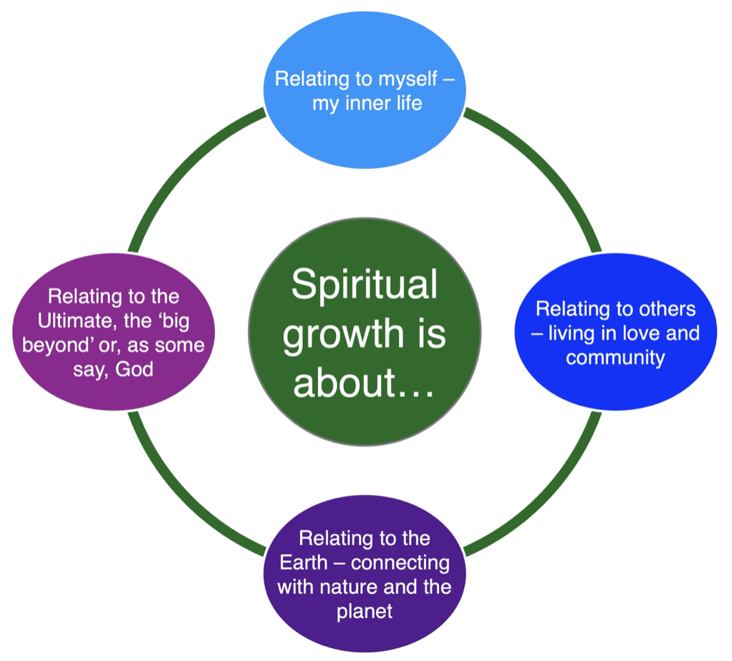
A human and humane model of spirituality
These four parts of spiritual life are simple in a way: it’s about how you relate ‘in, out, down and up’
Demonstrate this with four arm actions:
In, put your hands to your chest.
Out, throw your arms out wide.
Down, open your palms to the earth.
Up, push the sky upwards
Notes:
There is a vast literature and a continuing conversation about the nature of spirituality. The work of Dr Rebecca Nye, University of Cambridge, is useful in plural settings like school. Founded in research, her exposition of spirituality is child-centred, alert to Christianity and many other faiths and clear.
If you are interested to go further into the topic, two books are recommended: Children's Spirituality: What it is and Why it Matters (Sure Foundations) 2009, The Spirit of the Child: Revised Edition, DLT, 2006, by David Hay and Rebecca Nye.

Slide 10
Prayer Spaces: a spiritual experience?
In the Prayer Space, you get to choose different activities and ways of reflecting or praying.
Notice how each activity in the prayer space connects with one or more of the aspects of spirituality we’ve just seen.
– Some of these are about you – your inner life.
– Some are about your relationships – your friends, family, and other people you love, or struggle to love!
– Some activities are about the Earth, the natural world, and difficult events that happen.
– And some will make you think of ideas about what we might call ‘the big beyond’ - God, for some people.
Think of one activity in the prayer space. Which spiritual relationship does it most relate to?
Prayer Spaces in Schools: Good learning for all
Notes:
For teachers and lesson leaders: Prayer Spaces are hugely varied. They use a broad understanding of prayer. Activities in a Prayer Space in School may enable pupils to reflect deeply or profoundly on themselves, their relationships, their place on the earth and their connection with ‘the big beyond’ – God, as many say. These spaces use activities which engage with happiness and sorrow, success and failure, strength and weakness, faith and doubt. The activities are often and by turns responsive, provocative, creative ,imaginative, focused on the human spirit. They make space for the spiritual.
No two prayer spaces are the same, and each individual’s experience of the Space will be unique. These Spaces are never coercive – we don’t think there is any such thing as ‘forced prayer’.
Instead, the Prayer Spaces open up new horizons of imagination, possibility and faith.

Slide 11
Prayer Spaces: a spiritual experience?
Every person has experiences in life which are hard to talk about: they are the deep things of life, tricky to put into words.
Many people believe prayer can help – what do you think?
These experiences might be to do with hope or fear. The future, or the past. Where you come from, or where you believe you are going. What you know for sure, and what you are completely uncertain about.
All this big stuff is, in some ways, spiritual. The Prayer Space gives you a chance to explore what really matters.
Notes:
Discussion at this point can connect prayer to the idea of the spiritual – is prayer a spiritual activity? Why do many more people pray than go to church, mosque, etc?

Slide 12
Thinking about your spiritual side
Prayer Spaces in Schools provide opportunities for many thousands of young people to consider their spirituality.
The word can be offputting: it has many shades of meaning.
Some people don’t use the word to describe themselves at all, but many more like the idea of being spiritual, whether they are religious or not.
Notes:
This contribution to classroom RE / RVE / RME recognises the value of rich knowledge about prayer for pupils, and also encourages the deployment of that knowledge as pupils handle big questions and issues thoughtfully.
This contributes to providing opportunities through the learning for spiritual development.

Slide 13
Thinking about your spiritual side
The next slide gives you 39 words which are often associated with spirituality.
Can you choose six from this list – or add some of your own – that you would like to recognise in yourself?
(There are 3.8 million different ways of doing this.)
Take your chosen list of six, and share it with another person.
Take it in turns to listen to the other person’s description of what their spirituality includes from their six words.
After this there’s another activity where you can develop your ideas.
Notes:
This contribution to classroom RE / RVE / RME recognises the value of rich knowledge about prayer for pupils, and also encourages the deployment of that knowledge as pupils handle big questions and issues thoughtfully.
This contributes to providing opportunities through the learning for spiritual development.

Slide 14
39+ ideas about what spirituality means. Which 6 would apply to you? ‘For me, being spiritual includes being…’
Holy | Loving | Devoted | Calm | Peaceful
Harmonious | Earthy | Joyful | Patient | Good
Sensual | Natural | Connected | Self-aware | Gentle
Wise | Aware | Empathic | Open to the Sacred | Relational
Kind | Intuitive | Authentic | God-like | Prayerful
Numinous | Open-hearted | Forgiving | Detached | God-honouring
Worshipful | Obedient | Hopeful | In the moment | Courageous
Dreamer | Friendly | Mysterious | Yearning | ????

Slide 15

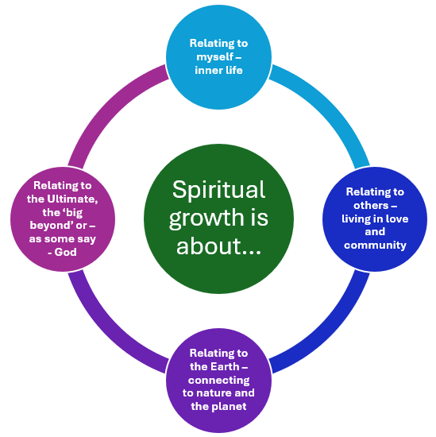





Add logos, symbols, emojis or other images to the page to produce an identikit spiritual you.
Expressing your own viewpoints
Take a page with the spirituality diagram in its centre.
Design your own.
Fit the 6 words you chose for your ‘spiritual identikit’ inside the circle.
Dreamer
Aware
Loving
Open to the sacred
Hopeful
Peaceful
Here’s an example.
Notes:
One aspect of these lessons (which can also be used as assembly outlines with simple adaptation) is that they give pupils frequent opportunities to clarify and express their own views and ideas about prayer. We welcome the contested nature of this conversation: from different religions and worldviews there are many Varied perspectives from which to learn.
The logos in this slide come from the Noun Project and are free to use. Other pix from Prayer Spaces could be used. Here are the links to them.
Dream: https://thenounproject.com/icon/dream-5757100/
Aware: https://thenounproject.com/icon/aware-5810536/
Sacred: https://thenounproject.com/icon/holy-5242745/
Hope: https://thenounproject.com/icon/hope-4878877/
Peace: https://thenounproject.com/icon/peace-dove-6747640/
Love: https://thenounproject.com/icon/love-7436717/

Slide 16
Learning creatively: imagining some prayers
I asked my class: ‘anyone do a prayer they would like to tell us about this week?’ An unlikely lad put his hand up. ‘I was rude, and I got sent out of Maths again, to stand outside the head teacher’s study’ he told us.
‘I prayed ‘Please God, don’t let him come out.’
I asked: ‘Did he come out? Was your prayer answered?’
‘No, he didn’t come out. But it wasn’t an answer. I’m an atheist…’
The next activity is for anyone – believer or atheist or in between. It asks you to imagine what people might pray.
You will get a picture to look at and then think:
what would someone in the picture pray?
Notes:
We work from the view that there is a close frontier between spiritual learning and creativity: the experience of using a prayer space often feels highly creative, and prompts creativity for pupils.
This activity invites learners to think about what aperson might pray, from an image. It’s very flexible – and pupils seem to like it.

Slide 17
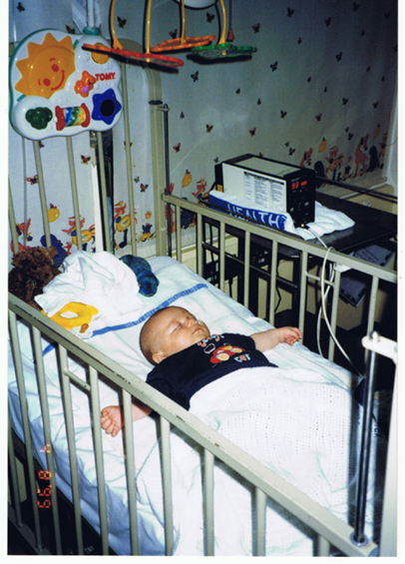
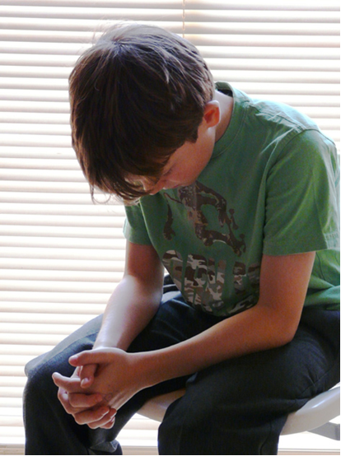
Who prays what and when?
What might the boy be praying? Imagine the story.
Maybe… “God, my little cousin is so tiny, and she’s not very well. Please give her strength to grow. And please give our whole family love and peace while we try to look after her….”
Notes:
This surprisingly powerful imaginative activity doesn’t assume everyone prays, and gives students alternatives: tell them ‘the difference between praying and wishing might be that if you pray, you believe someone – God - is listening. But wishing is similar because it expresses what we long for in our hearts.
Teachers will need a selection of photos, postcards or images which show people of different ages and from all over the world, some suffering or in pain, some in need, some looking peaceful or hopeful, maybe some at worship. The wider the selection the better. Ask learners to choose a picture and write their imagined prayer for a person in the picture.

Slide 18
Who prays what and when?
Select a picture from those your teacher provides.
Notes:
This surprisingly powerful imaginative activity doesn’t assume everyone prays, and gives students alternatives: tell them ‘the difference between praying and wishing might be that if you pray, you believe someone – God - is listening. But wishing is similar because it expresses what we long for in our hearts.
Teachers will need a selection of photos, postcards or images which show people of different ages and from all over the world, some suffering or in pain, some in need, some looking peaceful or hopeful, maybe some at worship. The wider the selection the better. Ask learners to choose a picture and write their imagined prayer for a person in the picture.

Slide 19

‘being in the flow’ ‘feeling at my most alive’
“I play the sax. I feel most alive when I’m playing in our band, and everything is going so well, the crowd are united, the music seems to take on a life of its own. It is amazing.”
“My favourite thing is playing sport, and my best sport is cricket. Just occasionally as a batter, I get in a kind of mood where I feel everything is going brilliantly. I feel I can’t go wrong. In the flow like this, I have scored two quick half centuries this year. It’s like being out of myself – brilliant.”
“Last summer, my friends and I were doing an award scheme and we climbed Scafell Pike – on a dull day. As we came to the top, the sun came out of the clouds. Everyone went still and quiet. We just took the moment from the mountain. It was unforgettable.”
“One of my saddest days was – strange this - also one of my best. It was when my gran died. She was 92, and it was actually very peaceful, and all the family were there. The thing I’ll never forget was a sense of being at one with each other, full of love. I hope she felt it too. I think she did.”
Some people who are not religious still pray – it is a sign, maybe, that you can be spiritual but not religious.
Spirituality: to deepen your understanding consider: when do people feel most alive? Here are four answers.
What would yours be?
Notes:
These four examples, adapted from teenage accounts and anonymised, cover several of the ways in which young people find it interesting to connect to spirituality. Add some more from the students you teach to make this local and classroom close.

Slide 20
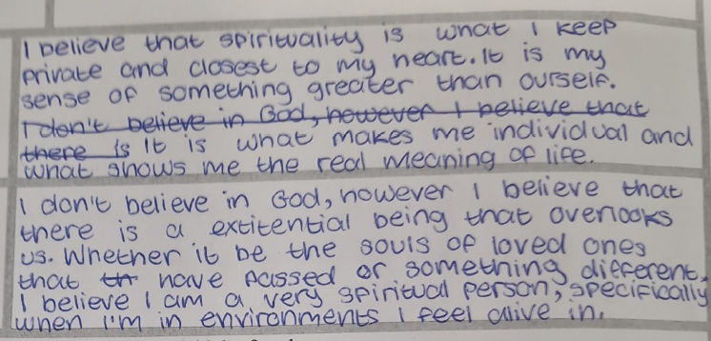
Broad views of prayer and spirituality
Sam is 14:
Notes:
Prayer is a controversial topic, and in writing these lessons we are pleased to present some activities that ask pupils to use their critical thinking skills. Ideas and materials form different religions and from atheist and agnostic perspectives enrich the learning, which has mind-opening intentions.

Slide 21

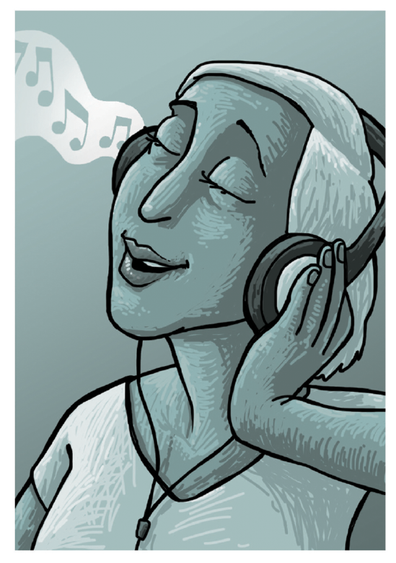
Spiritual – but not religious.
How is music spiritual?
The music that moves me!
Make a list of 5 pieces of music you find moving.
You can choose one love song, but select four that are not ‘love me hug me squeeze me’ set to a tune.
For each one, say what it is that the song speaks about that you find inspiring.
Call this list your ‘spiritual spotify’ Different for everyone but maybe about the values you hold dear. Did you choose a song of love, peace, joy, calm, excitement, fearlessness, overcoming hard times, friendship, worship, justice, hope, forgiveness, weeping, kindness? What else?
Share your list in a group of 4 friends.
Notes:
Dynamic worldview learning:
religion, philosophy, belief, ethics, society, spirituality
14-16 Religious Education for All
A fresh approach to an issue many schools face
Characteristics of the approach:
Vibrant RE for all
Issue-led
Focus on critical thinking
Focus on creativity
Rich in knowledge of religions and worldviews
Suitable for teachers with other specialisms to tackle
Alert to current OFSTED concerns
Enrichment of learning is the model
Alert to British Values, community cohesion, anti-racist education
Global, National, Local
Can be internally certificated for participants and those who are awarded merit for a piece of work (like EPQ for 14-16s)
A worthwhile experience of RE in itself

Slide 22

My spiritual Spotify:
1.
2.
3.
4.
5.
Notes:
This slide can be printed off for students to record the task. Please send interesting examples to me lat@retoday.org.uk
Music is often identified by 14-18s as the key way they ‘get in touch with their spiritual side’ It’s unsurprising that most religious communities use music to develop spiritual atmospheres. The (atheistic) ‘Sunday Assembly’ has singing together as a part of its programmes too.

Slide 23
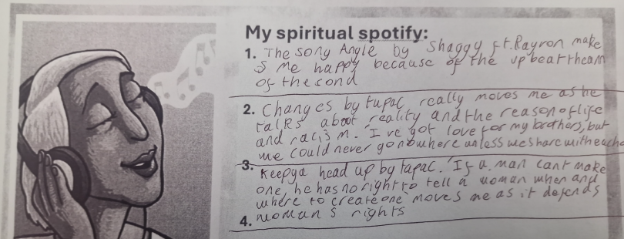
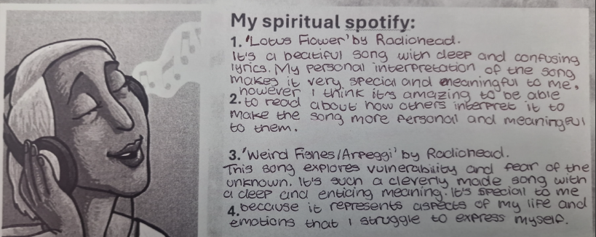
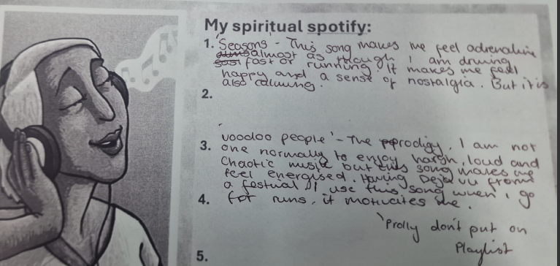
These three students, all 14, have very different ‘spiritual’ Spotify lists.
What’s yours and why?
Notes:
‘Spiritual Spotify’ is an activity designed to use the fact that our music – and pretty much everyone has some music that moves them – is a signal of our spirituality.
As individual as your fingerprint, ever changing, affective, our music makes the spiritual audible.
Teachers and Prayer Space facilitators may like to share their own ‘5 Spiritual Spotify’ tracks with students.

Slide 24
What does the Bible offer to help us understand Christian prayer?
Jesus said:
“When you pray, go into your room.
Close the door and pray to your Father, who is unseen.
Then your Father, who sees what is done in secret,
Will reward you.”
Christianity teaches that prayer cannot be bought or sold. It is a private matter between you and God.
Many Christians feel that the activity of prayer gives them a warmed heart. They meet with God when they pray. They may be given calm, guidance, peace or a challenge. Prayers for God’s help may be answered.
Discuss / write: what do you think?
Notes:
These lessons enable pupils to learn a lot specifically about Christian prayer, and use Biblical quotations, examples and texts to enrich pupils’ understanding.
This slide is a simple one, offering a point of reflection for students. Teachers might invite comments, or just supervise a silence for thinking, or both.
The quotation is from Matthew 6v6, from the New International Version, a part of the Sermon on the Mount.

Slide 25
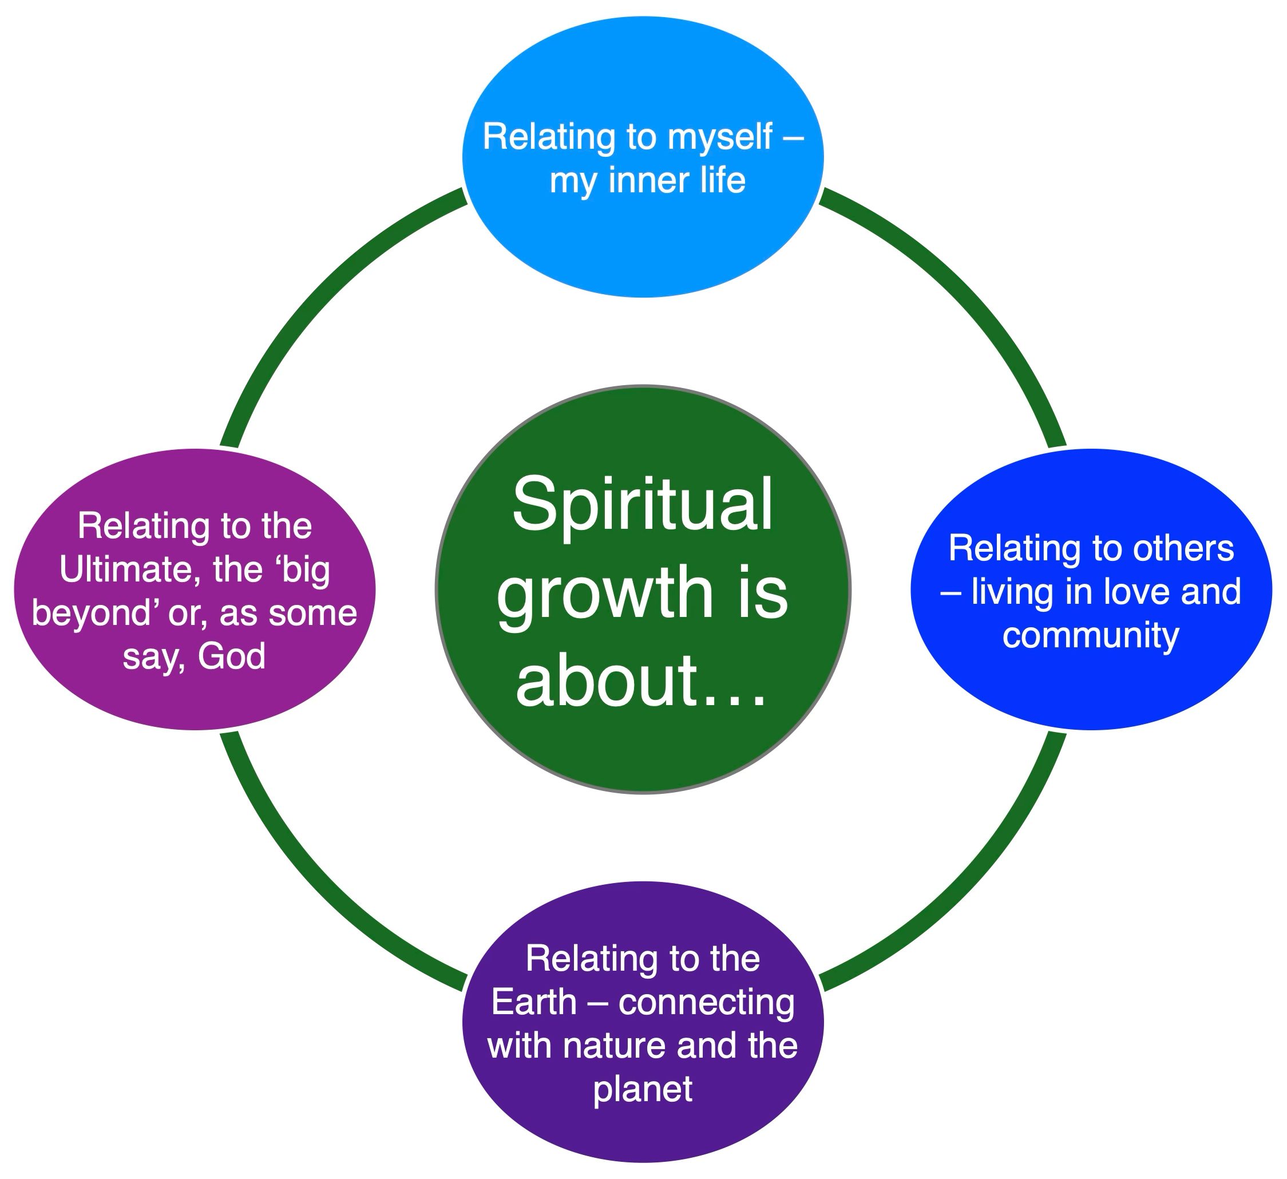
A human and humane model of spirituality
Remember:
Spirituality is defined in different ways by different people.
This description is specially made for any human – not just Christians, Muslims, Hindus or Buddhists.
Being ‘spiritual but not religious’ is a common and growing way of identifying in the UK.
Notes:
There is a vast literature and a continuing conversation about the nature of spirituality. The work of Dr Rebecca Nye, University of Cambridge, is useful in plural settings like school. Founded in research, her exposition of spirituality is child-centred, alert to Christianity and many other faiths and clear.
If you are interested to go further into the topic, two books are recommended: Children's Spirituality: What it is and Why it Matters (Sure Foundations) 2009, The Spirit of the Child: Revised Edition, DLT, 2006, by David Hay and Rebecca Nye.

Slide 26
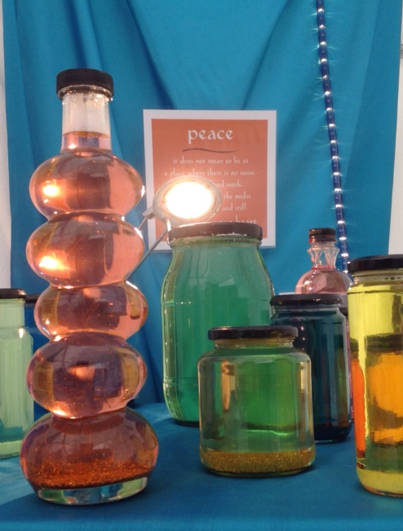
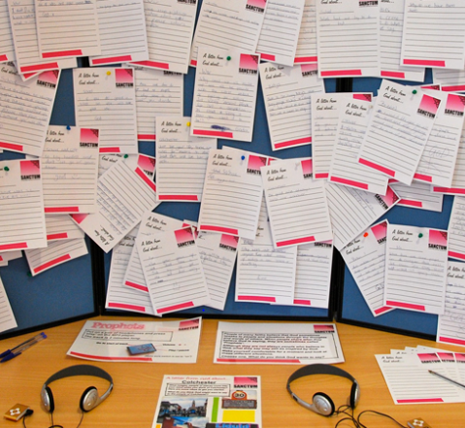
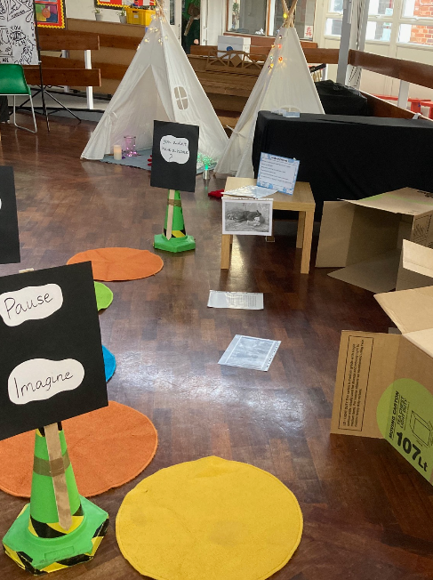
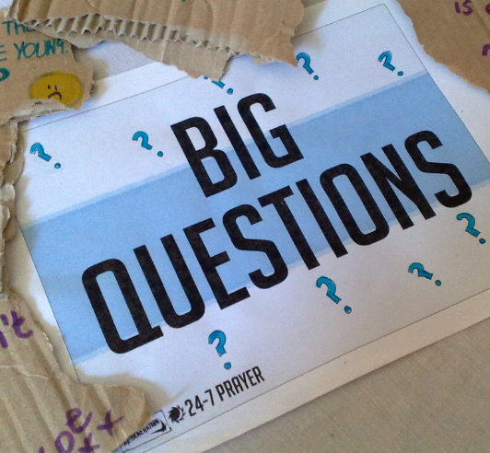
Prayer Spaces: A spiritual experience?
Some people find themselves put off religion if others seem to be forcing it upon them.
Prayer Spaces are meant to be open spaces. Nobody involved is trying to force anyone else to think in a particular way. There’s no compulsion in prayer – it has to be chosen to be real.
Anyone who coerces others about beliefs should ask themselves some questions.
But, what do you think? How has the prayer space affected you?
Prayer Spaces in Schools: Good learning for all
Notes:
For teachers and lesson leaders: Prayer Spaces are hugely varied. They use a broad understanding of prayer. Activities in a Prayer Space in School may enable pupils to reflect deeply or profoundly on themselves, their relationships, their place on the earth and their connection with ‘the big beyond’ – God, as many say. These spaces use activities which engage with happiness and sorrow, success and failure, strength and weakness, faith and doubt. The activities are often and by turns responsive, provocative, creative ,imaginative, focused on the human spirit. They make space for the spiritual.
No two prayer spaces are the same, and each individual’s experience of the Space will be unique. These Spaces are never coercive – we don’t think there is any such thing as ‘forced prayer’. Instead, the Prayer Spaces open up new horizons of imagination, possibility and faith.

Slide 27
Reflecting on my time in the Prayer Space
Relating to myself – my inner life
Take a moment to answer these questions for yourself;
Try to remember moments in the prayer space when you connected with each of these four aspects of spirituality.
What do you think was the most spiritual thing about the prayer space? What was the least spiritual thing?
If a person who prays came into the space, how would you introduce it to them?
Relating to others – living in love and community
Relating to the earth – connecting with nature and the planet
Relating to the ultimate – the ‘Big Beyond’ - as some say, ‘God’
In pairs, share your answer to just one of these questions.
Notes:
For teachers and lesson leaders: Activities in a Prayer Space may enable pupils to reflect deeply or profoundly on themselves, their relationships, their place on the earth and their connection with ‘the big beyond’ – God, as many say. These spaces use activities which engage with happiness and sorrow, success and failure, strength and weakness, faith and doubt. The activities are often and by turns responsive, provocative, creative, imaginative, focused on the human spirit. They make space for the spiritual. No two prayer spaces are the same, and each individual’s experience of the Space will be unique. These Spaces are never coercive – we don’t think there is any such thing as ‘forced prayer’. Instead, the Prayer Spaces open up new horizons of imagination, possibility and faith.
These personal evaluative questions can be the subject of discussion only, but if you get written responses as well, the Prayer Space team will be VERY interested to see them – maybe give pupils post-it sticky notes to record their thoughts.
Having explored ideas about spirituality this exercise invites learners to apply this understanding to their own experience of the prayer space. Sharing answers helps to clarify our own thoughts and can encourage wider understanding and mutual respect where opinions differ. Discussing just one question gives space for some answers to stay private and encourages interaction around ‘best’ responses.

