Slide 1





Prayer Spaces in Schools
Learning from a prayer space
KS3 Lesson 3 of 4 What is prayer?
Learning opportunities for 7-11s on themes about prayer and reflection.
Prayer Spaces in Schools create extraordinary opportunities for children and young people to think about prayer and to consider spirituality in open-minded experiential ways.
This lesson is one of a series written by Lat Blaylock of RE Today and provided free to schools to enable learners to use critical and reflective thinking skills to learn about spirituality, prayer and reflection.
is part of
Notes:
These lessons are written by Lat Blaylock, RE Consultant with RE Today www.retoday.org.uk
Aims of these lessons:
To provide excellent and respected classroom resources for teachers of RVE / RME / RE to use in lessons when a PRAYER SPACES visit is coming, taking place or has happened,
To enable teachers and PRAYER SPACES volunteers to deliver quality RVE / RME / RE about prayer which connects to the experiences of the PRAYER SPACES provision.
To enable pupils to think for themselves about prayer and its meanings, and access opportunities for spiritual, moral, social and cultural development.

Slide 2
Providing quality ‘state of the art’ RE / RVE / RME lessons ready to use for KS2 & KS3
Suitable for both teachers of RE / RVE / RME and Prayer Spaces volunteers to deliver.
Suitable for pre-Prayer Space and post Prayer Space uses.
About these resources.
Suitable for all pupils in all kinds of schools
Encouraging open hearted and critical thinking about prayer and reflection
Enhancing the experience of using a Prayer Space in school with good learning
Offering learners the chance to develop their own personal ideas about philosophical and social questions on the themes of prayer and reflection
Engaging, creative and absorbing learning.
We provide well prepared presentations, lesson plans and training webinars and examples.
Adaptive suggestions in lesson plans to help volunteers or fit in with teachers’ needs.
Introducing concepts and questions about Christian prayer. Providing resources to set high standards of RE / RVE / RME, deepening learning.
Also including assembly delivered options for school worship / religious observance
Integrated with common RE / RVE / RME units of work and ‘Understanding Christianity’ resources.
A lesson for KS2 and a lesson for KS3 in advance of the Prayer Space visit.
Suitable for all schools and all pupils offering creativity and critical engagement in the lessons.
Using active learning, creative multi-disciplinary methods, explained and resourced to be ‘ready to go’.
Three lessons each for KS2 and KS3, all free standing, that follow up the visit.
Notes:
Teachers and Youth Workers can use this lesson, which is part of a larger ‘Prayer Spaces in School’ learning package.
The lessons:
Can be taught - with preparation - ‘off the shelf’ using the 6 PPT sequences provided
Will be understood better by teachers and youth workers if you watch our training recorded webinars from Lat Blaylock of RE today
Include examples of pupils’ work, art, writing and responses
Are suitable for use across the UK, recognizing what is distinctive about RME / RVE / RE in each of the four nations
Reference law, guidance and inspection requirements for RE / SMSCD / School Worship
Use some PRAYER SPACES case studies

Slide 3
Prayer Spaces in Schools
Learning from a prayer space
Investigating prayer with social science methods
This is one lesson in a set which enables learners to respond to questions such as:
What do surveys of public views tell us about prayer in Britain and globally?
Can prayer make a person feel happy? Calm? Thankful? Forgiven? Close to God? How?
What can we find out about praying from social studies? Philosophy? Theology?
What do learners say about the big questions of prayer, philosophy and truth?
Notes:
The topics addressed in these lessons include Biblical narrative and teaching, the Christian ‘Lord’s Prayer’, sociology of prayer, Christian experiences of prayer, creative prayer ideas, Christian theologies of prayer, Jesus and prayer, the phenomenon of ‘SBNR’ (spiritual but not religious) prayer, the experiences of answered prayer and unanswered prayer. Questions and diverse ideas are the focus: these lessons aim to open minds not to deliver one set of answers to these questions. The lessons are designed to compliment the opportunities for spiritual development that come from the experience of visiting and using a ‘Prayer Space’ in a school.

Slide 4
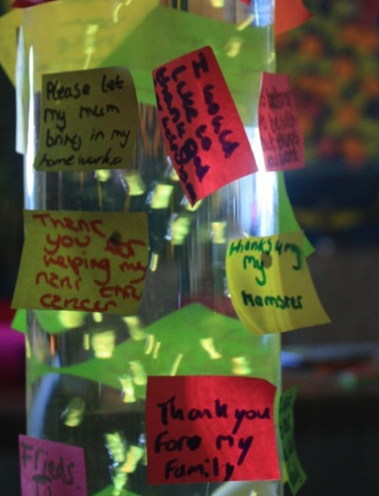
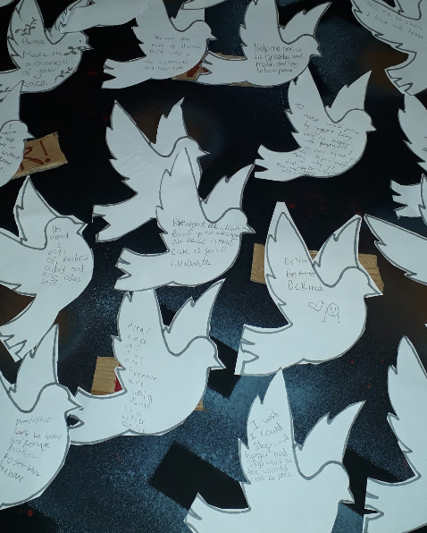
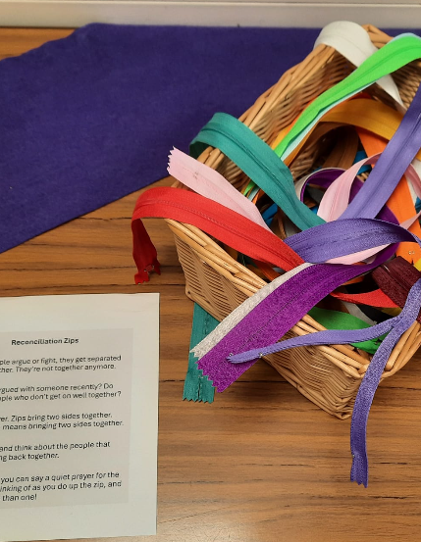
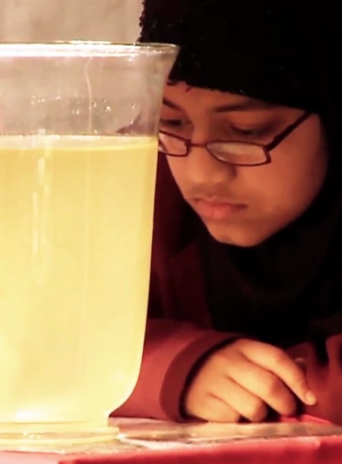
Prayer Spaces engage with many spiritual values. Think of peace, joy, forgiveness or resilience. Prayer Spaces give you spiritual space to respond for yourself.
Prayer Spaces intend to be inclusive. Anyone can join in. These are free, welcoming, safe spaces.
A person who is Muslim or Christian, Agnostic or Atheist can use a Prayer Space from their own position with integrity. Designed by Christian educators, with inclusive intentions.
Prayer Spaces in Schools: Good learning for all
Notes:
Teaching may need the focus on welcome and open hearts and minds because sometimes pupils (perhaps rightly) wary of religion in school: they wonder if someone is trying to force them to think one way. These lessons are about getting young students to think for themselves, not to accept anyone else’s dogma. Of course, there’s an important argument about ‘whose dogma’ our contemporary culture places centrally: for some, it is the possibility of religion being taken seriously and appreciated that our culture denies. Others see this the other way round. The point here is to show pupils both sides of these questions and invite increasingly informed responses.

Slide 5
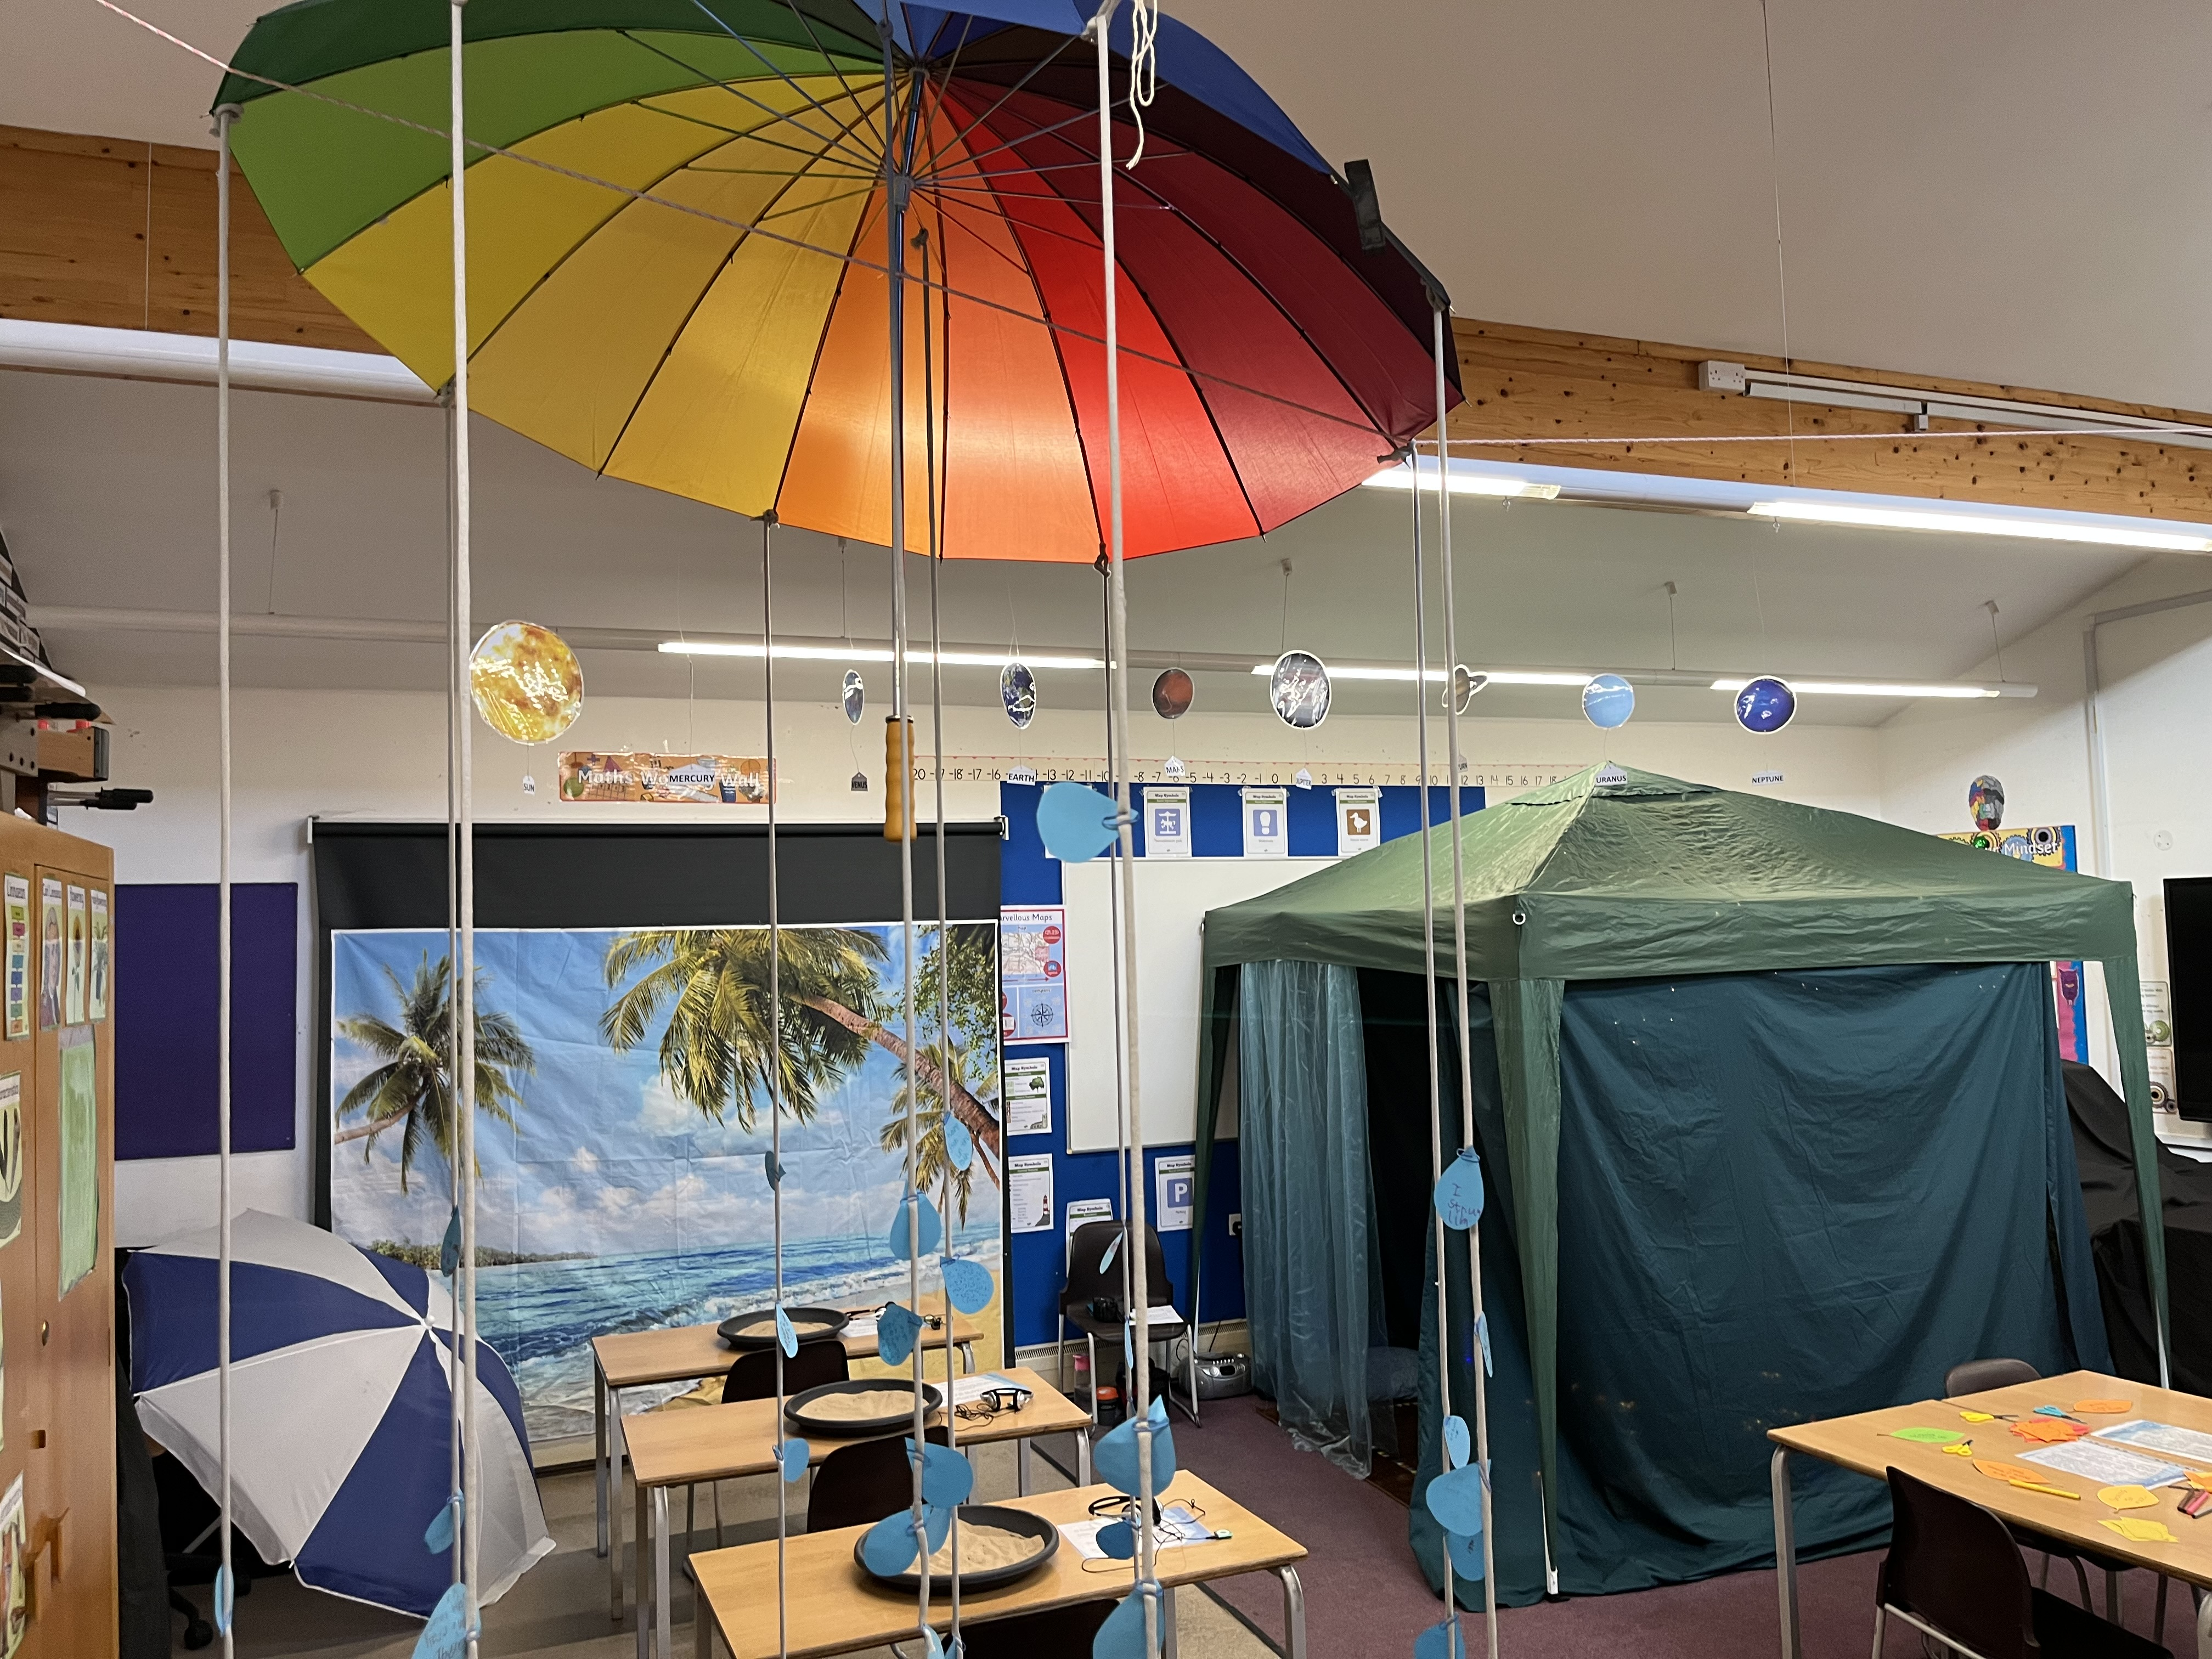
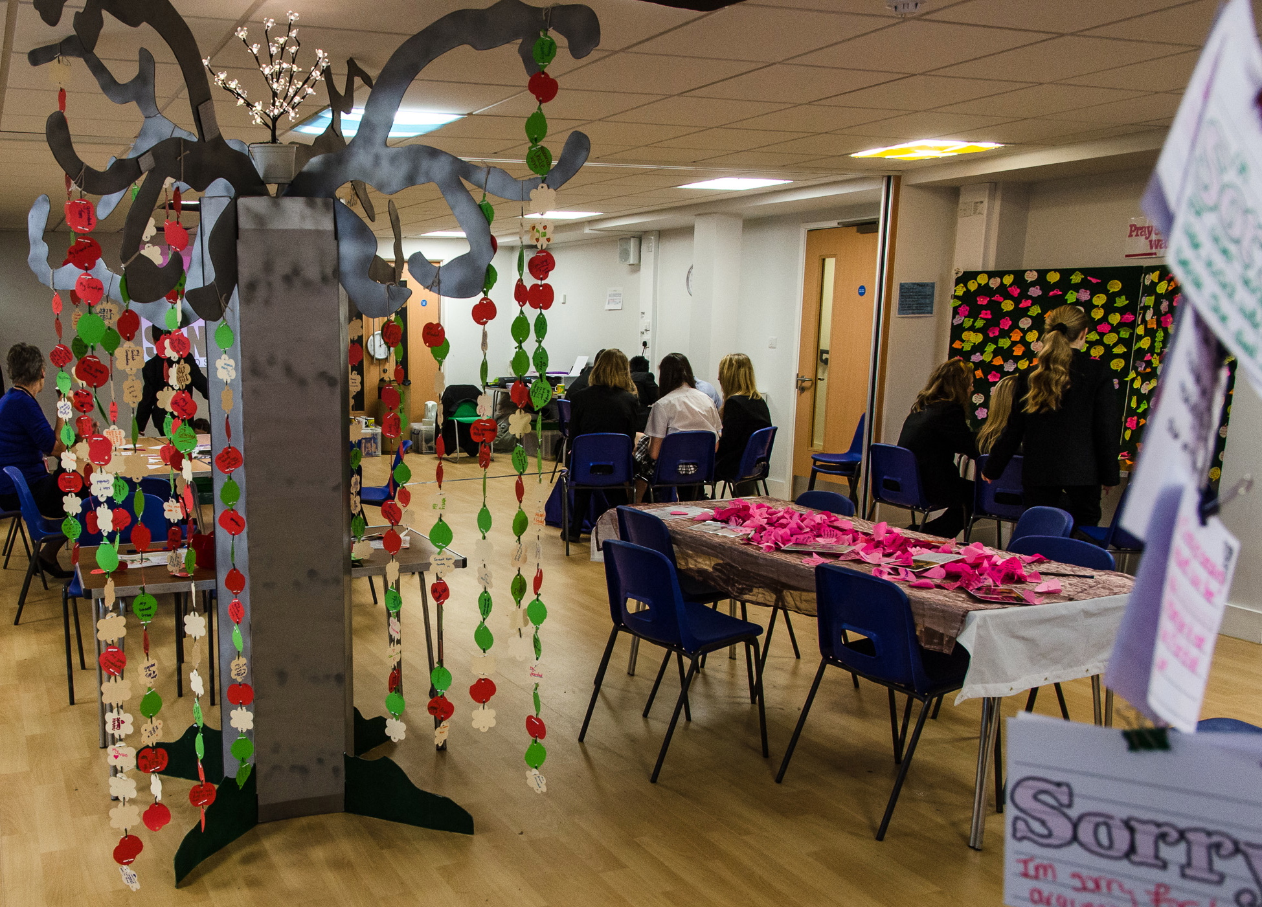
My experience of a ‘Prayer Space’
You don’t have to be religious to like this.
It’s a chance to think really deeply or to feel really fully.
You can ponder some big issues and questions, or find calm, or peace. Lots more too.
Notes:
For teachers and lesson leaders: Prayer Spaces are hugely varied. They use a broad understanding of prayer. Activities in a Prayer Space in School may enable pupils to reflect deeply or profoundly on themselves, their relationships, their place on the earth and their connection with ‘the big beyond’ – God, as many say. These spaces use activities which engage with happiness and sorrow, success and failure, strength and weakness, faith and doubt. The activities are often and by turns responsive, provocative, creative ,imaginative, focused on the human spirit. They make space for the spiritual. No two prayer spaces are the same, and each individual’s experience of the Space will be unique. These Spaces are never coercive – we don’t think there is any such thing as ‘forced prayer’. Instead, the Prayer Spaces open up new horizons of imagination, possibility and faith.

Slide 6
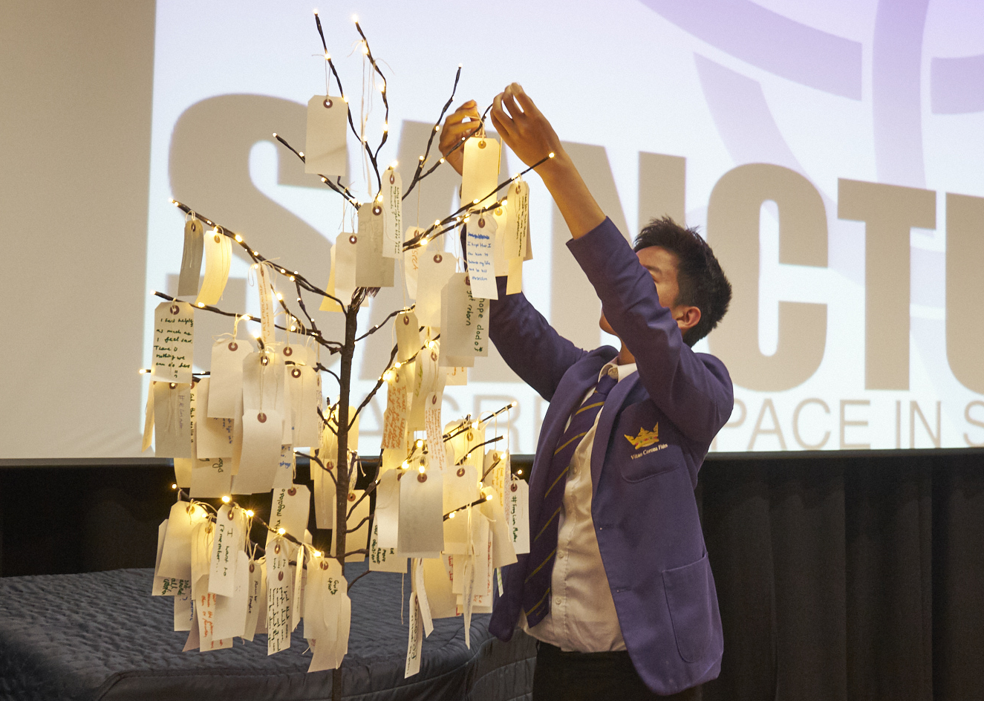
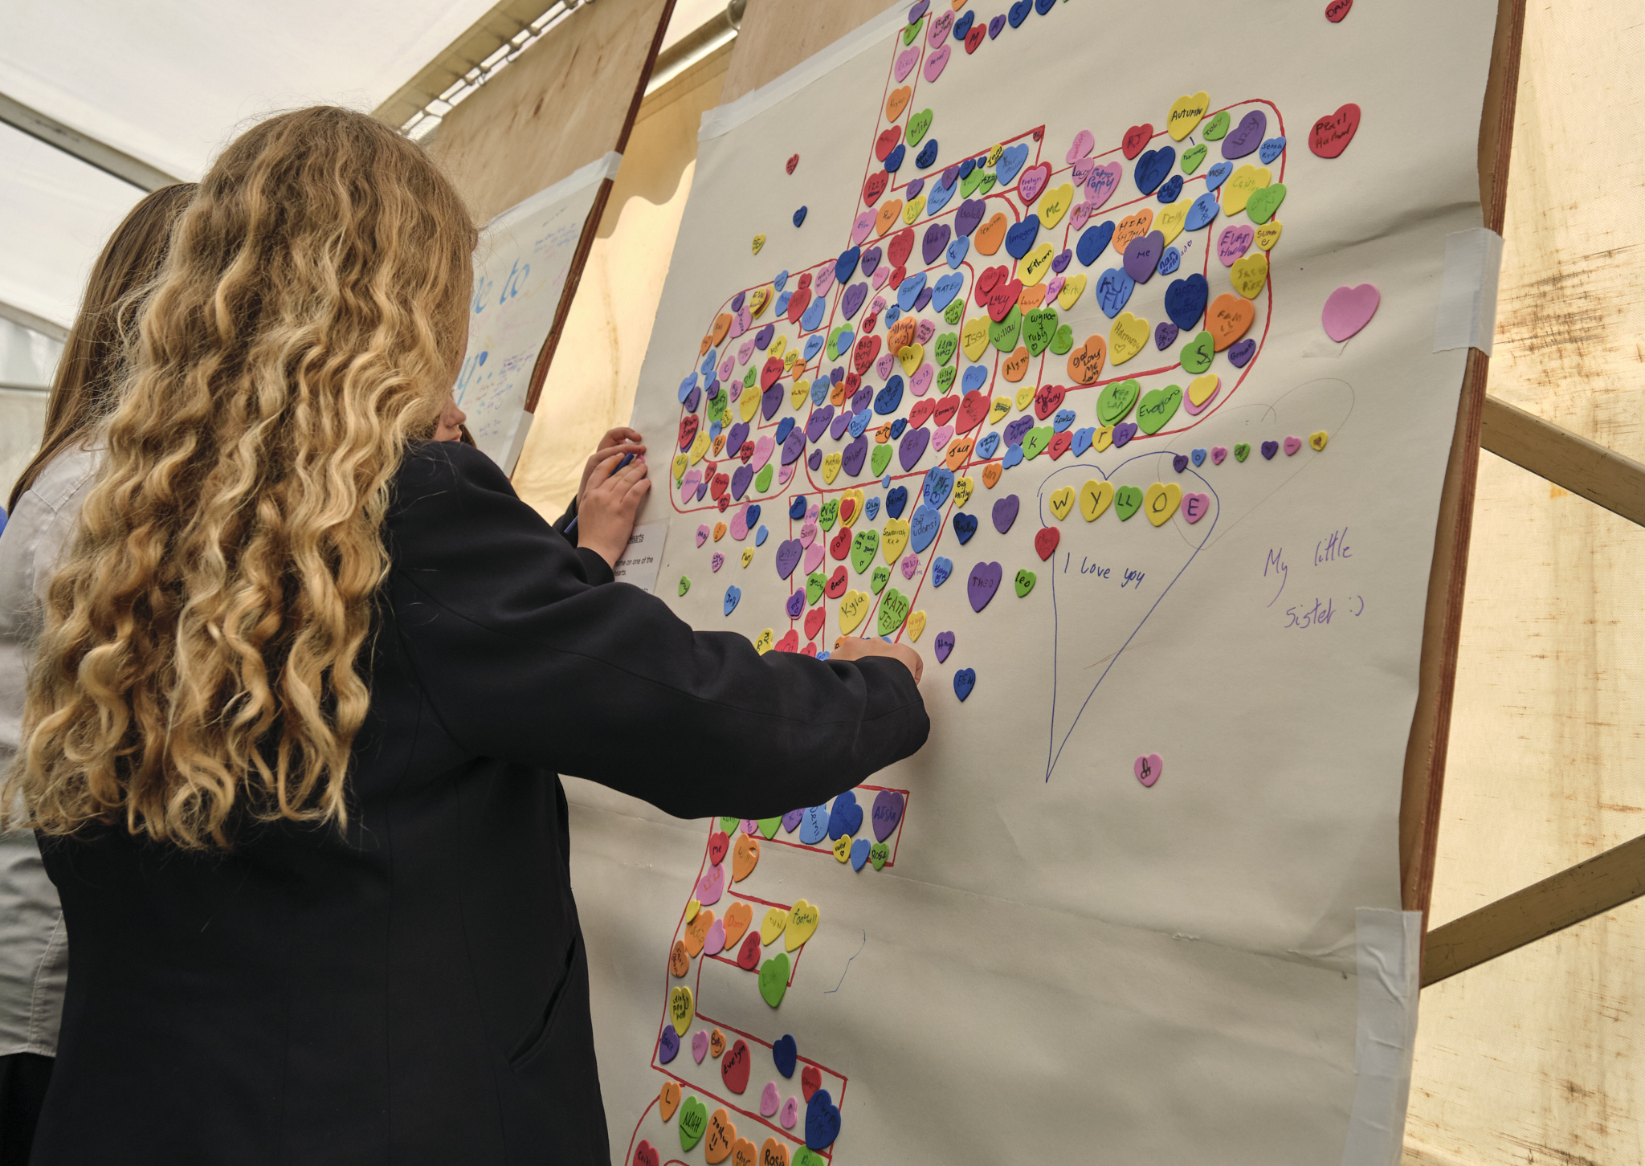
My experience of a ‘Prayer Space’
Choose three words that describe your own experience of the Prayer Space.
What activity or experience had the most impact on you?
Notes:
For teachers and lesson leaders: Prayer Spaces are hugely varied. They use a broad understanding of prayer. Activities in a Prayer Space in School may enable pupils to reflect deeply or profoundly on themselves, their relationships, their place on the earth and their connection with ‘the big beyond’ – God, as many say. These spaces use activities which engage with happiness and sorrow, success and failure, strength and weakness, faith and doubt. The activities are often and by turns responsive, provocative, creative ,imaginative, focused on the human spirit. They make space for the spiritual.
No two prayer spaces are the same, and each individual’s experience of the Space will be unique. These Spaces are never coercive – we don’t think there is any such thing as ‘forced prayer’.
Instead, the Prayer Spaces open up new horizons of imagination, possibility and faith.

Slide 7
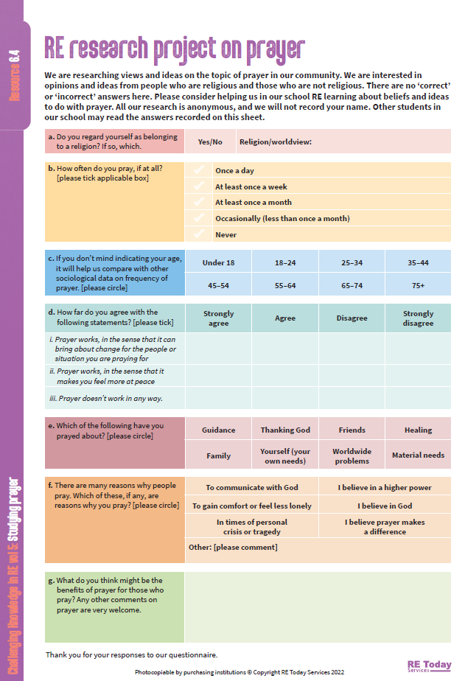
Learning by research
This is a prayer questionnaire.
If each person in a class of 30 asks three grown ups to answer the questions (not your teachers, please!) then we will have 90 questionnaires.
Use your RE homework time to ask three adults, older family members, friends, neighbours, whoever you see, to tell you their ideas about praying. You, or they, can record the answers on the sheet.
Notes:
We like it when pupils get the chance to investigate and find out about religion and belief or themselves. This questionnaire promotes broad mined and open hearted engagement with the topic of prayer, and all views are welcome. You might need to give the questionnaires out a week in advance of the lesson.
Prepare your classes carefully for the research task – teach them why it is anonymous, and what their attitude to respondents should be: all replies welcome, be grateful, record exactly what people say.

Slide 8
Learning by research
Back in class, share the questionnaires, and count up the results (you could pass them round 6 classroom groups, each group looking at the answer to one of the 6 questions). Charts? Graphs? Summaries of comments? Yes please.
As a whole class, put together a research report: ‘Prayer in our Community’
Answer the questions: What did our data show about our community? What was surprising? Is our community typical of the wider UK or the wider world?
Notes:
We like it when pupils get the chance to investigate and find out about religion and belief or themselves. This questionnaire promotes broad mined and open hearted engagement with the topic of prayer, and all views are welcome. You might need to give the questionnaires out a week in advance of the lesson.
Prepare your classes carefully for the research task – teach them why it is anonymous, and what their attitude to respondents should be: all replies welcome, be grateful, record exactly what people say.

Slide 9
Learning about prayer from research – guesswork!
Make some guesses in answer to these questions:
A worldwide sample of people were asked: do you pray every day? From these 6 countries, guess what percentage said yes: Brazil / India / Nigeria / Spain / UK / USA (alphabet order in this list)
What percentage of British people say they pray at least sometimes? What percentage pray once a month or more?
What percentage of non-religious British people think that God hears their prayers? (and what percentage of British Christians, and British Muslims think this?)
What do you think are the most common things that people in Britain pray for? Can you think of three examples?
A1: In the right order: Nigeria / India / Brazil / USA / Spain / UK
A2: Nigeria 95% / India 75% / Brazil 61% / USA 55% / Spain 23% / UK 6%
B: 56% of Brits say they pray sometimes. 32% had prayed in the last month.
C: 19% of non-religious Brits think God hears their prayers. Among British Christians, that rises to 54%. Among British Muslims, it’s 83%
D: Commonest topics for prayer in Britain: friends and family (69%), people who are sick (54%) and to give thanks (51%).
Surprises: what did you find surprising or puzzling in the data? Can you explain it?
Notes:
We like it when pupils get the chance to investigate and find out about religion and belief or themselves. This activity uses global data from the respected Pew Research Foundation to help pupils see how religious practice varies globally.
https://www.pewresearch.org/religion/2018/06/13/how-religious-commitment-varies-by-country-among-people-of-all-ages/
We also collect and reference data on prayer here:
https://www.natre.org.uk/resources/termly-mailing/bqic-secondary-challenging-knowledge-in-re/studying-prayer/6-data-on-prayer-a-sociological-approach/
What do people pray for? Data from:
https://www.churchofengland.org/media/press-releases/younger-people-more-likely-pray-older-generations-survey-finds

Slide 10
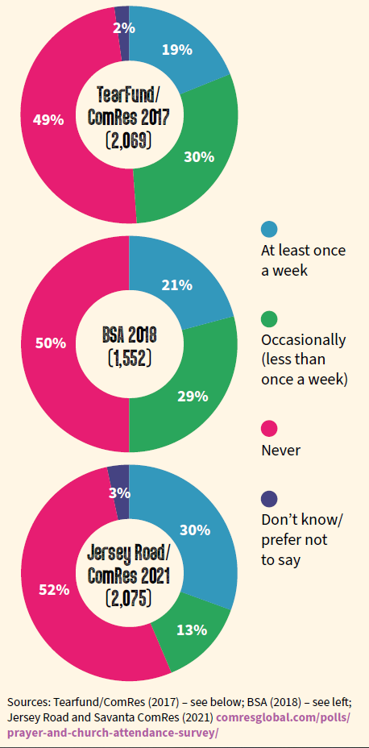
Three surveys asked British people about prayer. The results varied a bit.
At least once a week
Occasionally (less than once a week)
Never
Don’t know / prefer not to say
In each survey, how many people said they never prayed?
What’s the highest figure for weekly prayer between the three surveys? And the lowest?
People who pray occasionally or often add up to 43%, 46% or 49%. Why do you think people pray? What do you think they might pray for?
Notes:
Statistics are hard to interpret here, there could de different interpretations. But encourage pupils to think for themselves about making sense of the data and suggesting reasons and explanations.
Sources: TearFund/ComRes (2017); BSA (2018); Jersey Road and Savanta ComRes (2021)
https://savanta.com/knowledge-centre/poll/prayer-and-church-attendance-survey/

Slide 11
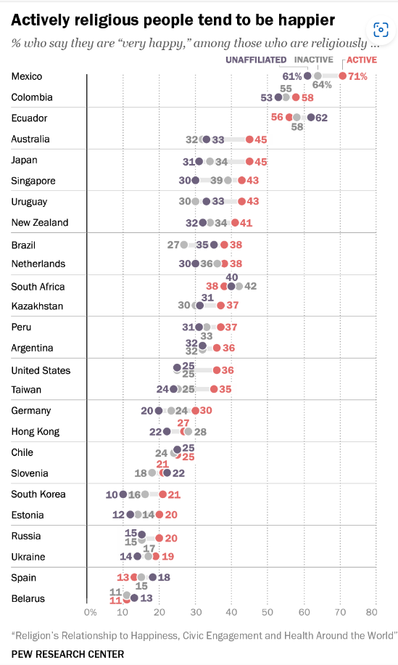
Does prayer work?
A global survey. Take a look at this data sheet.
First of all work out what it says about how happy people are in different countries.
Then notice that in each country, the data splits the religious from the non-religious and splits the religious into two groups – actively religious, or inactive in their religion. Being ‘actively religious’ includes being a person who prays in an intentional way.
Who is happier?
Why?
Do people want to be happy? It’s very rare to say no. This research shows that actively praying makes people happier.
Notes:
Source.
Key Findings From the Global Religious Futures Project | Pew Research Center

Slide 12
Does prayer work?
What is wise – and what is unwise – about this idea: ‘being actively religious makes you happier.”
Relational consciousness is Dr Rebecca Nye’s description of what spiritual life is about. It is about how good you are at being aware of how you relate to; – yourself – others – the Earth – and ‘the big beyond’ or ‘God’
Do you think in the future we are likely to need prayer as a part of what makes humans happy?
Notes:
Source.
Key Findings From the Global Religious Futures Project | Pew Research Center

Slide 13
Does prayer work?
If you wanted to find out about prayer through a survey of British people what questions could you ask?
Jot down three questions with a partner.
Then share ideas round the class.
Notes:
This contribution to classroom RE / RVE / RME recognises the value of rich knowledge about prayer for pupils, and also encourages the deployment of that knowledge as pupils handle big questions and issues thoughtfully. This contributes to providing opportunities through the learning for spiritual development.
This particular lesson uses survey data and sociological learning methods for pupils.

Slide 14
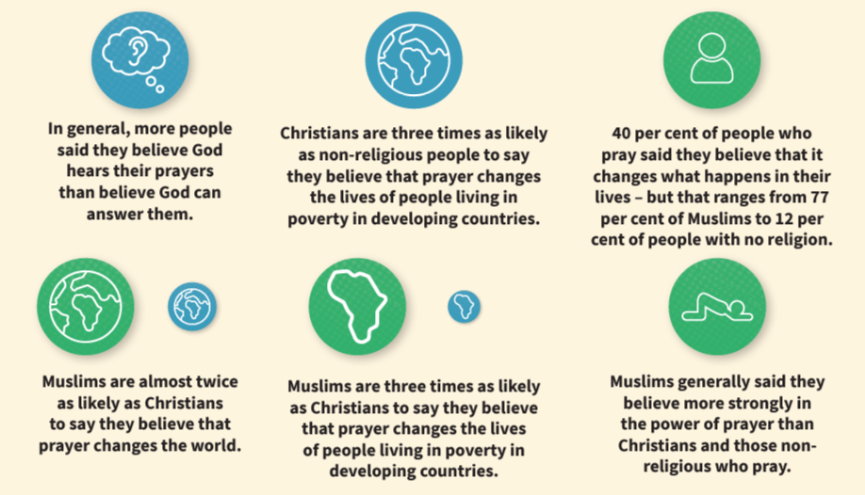
Does prayer work?
In 2017 TearFund and Savanta ComRes did a survey of 2,069 adults (18+) in Britain. Of these, 1,060 (51%) said they prayed at least sometimes. Those 1,060 were asked how strongly they agreed with a series of statements about the effect of prayer.
Some British data
TEAR Fund is a Christian aid agency, working with some of the poorest people in the world. They wanted to know about prayer, so they did a survey.
What strikes you about the info here?
The next slide shows more detail.
Notes:
This contribution to classroom RE / RVE / RME recognises the value of rich knowledge about prayer for pupils, and also encourages the deployment of that knowledge as pupils handle big questions and issues thoughtfully. This contributes to providing opportunities through the learning for spiritual development. This particular lesson uses survey data and sociological learning methods for pupils.

Slide 15
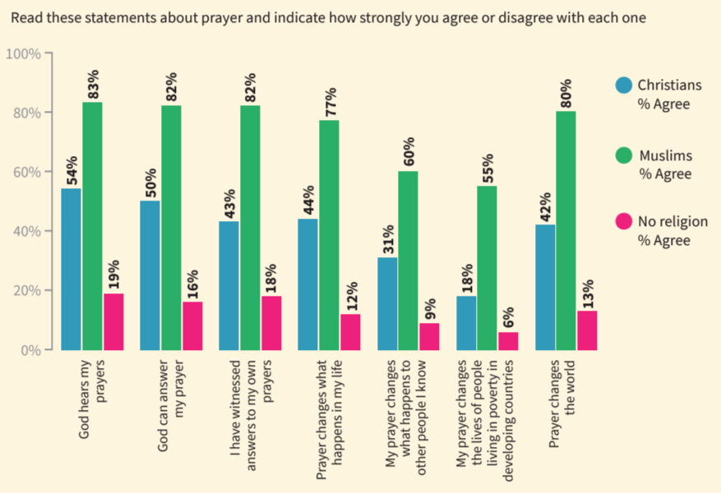
Does prayer work?
Look at the data carefully so that you can answer these questions:
Percentage of Muslims who believe God answers prayers
Percentage of non-religious who think prayer can change the world
Percentage of Christians who have witnessed answers to their own prayers
What is surprising in this data table?

Slide 16
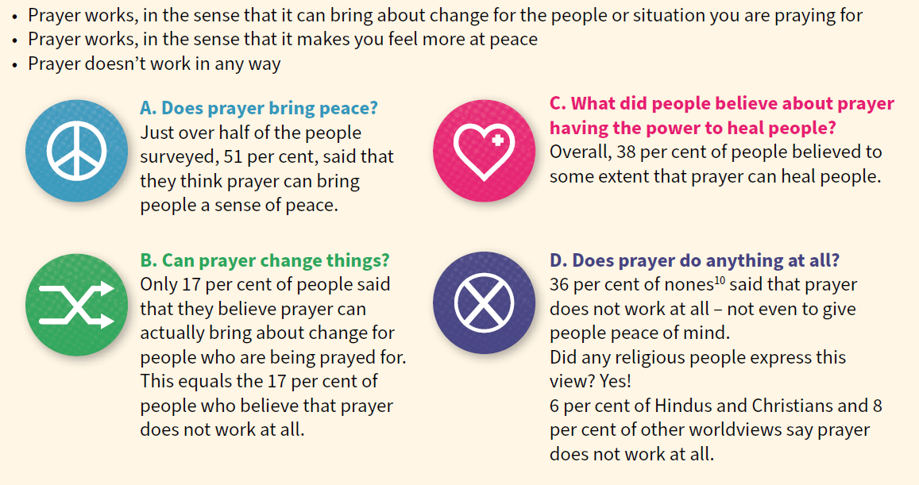
People were asked which statement came closest to their views of prayer:
Look at the data carefully so that you can answer these questions:
Percentage who believe prayer can bring peace?
Percentage who think prayer can have healing power?
Percentage who think prayer doesn’t work?
Private question: Which of these 4 connects to your experience of the Prayer Space?
What is surprising in this data table?

Slide 17
Expressing your own viewpoints (your ideas will be shared in the class)
Big ideas about prayer | Your reaction: Number and comments. 1-6 1=Agree strongly / agree / agree a bit / disagree a bit / disagree / 6=disagree strongly
“Prayer is a waste of breath. It is pointless.”
“I don’t pray much myself, but if other people feel the benefit, then why worry? If it works for you, then good luck.”
“The best way to find out if prayer works: try it for a month. Pray daily and unselfishly for something good. Did it happen?”
“God is good, and hears all our prayers. Wisely, God sometimes gives us what we pray for and sometimes not.”
“Prayer is a puzzle and a mystery. Sometimes it seems to work, sometimes it falls flat. God knows why (literally)”
“I think the biggest difference prayer makes is to me – helping me accept life as it is, be calm, have trust and live with love.”
Notes:
One aspect of these lessons (which can also be used as assembly outlines with simple adaptation) is that they give pupils frequent opportunities to clarify and express their own views and ideas about prayer. We welcome the contested nature of this conversation: from different religions and worldviews there are many varied perspectives from which to learn.
This table is available as a worksheet too, and can be the basis of research if there are 30+ sheets filled in by different learners. Maybe older learners can run this research for younger pupils.

Slide 18
Broad views of prayer and spirituality: discuss
In this lesson you have looked at some statistical surveys of attitudes to prayer in the UK and from around the world. What will you remember from this?
Statistics don’t tell us about meanings, but rather about populations. Why do some people pray every day, and find it worthwhile, but others not at all, and don’t care?
There is some evidence (not proof of course) that praying each day makes people calmer, happier and more resilient. How do you explain findings like these?
Christian theologies of prayer suggest at least 5 ways prayer ‘works’: ‘God hears our prayers, God’s presence can be experienced when we pray. God in Jesus asks his followers to be persistent in prayer. Praying opens up our lives to spiritual possibilities. God works through prayer.' What do you think of each of these five ideas?
Notes:
Prayer is a controversial topic, and in writing these lessons we are pleased to present some activities that ask pupils to use their critical thinking skills. Ideas and materials form different religions and from atheist and agnostic perspectives enrich the learning, which has mind-opening intentions. The four points on the slide will likely elicit discussion points in groups or whole class conversation.
Writing could follow – invite students to write about the two they find most interesting. Depth is more important than breadth.

Slide 19
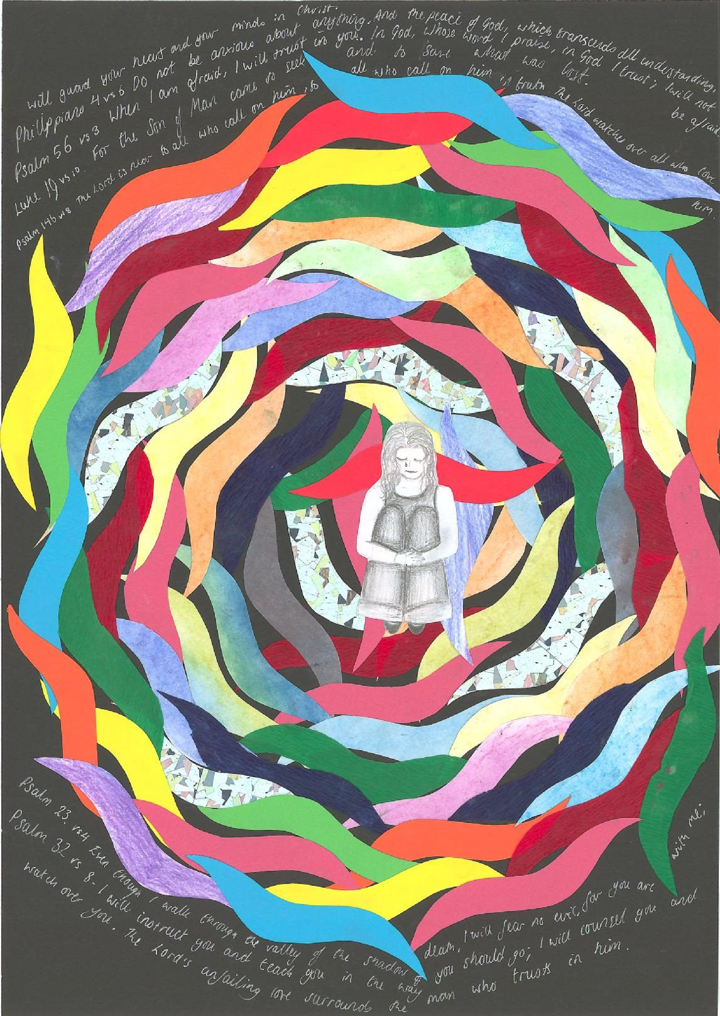
Reflecting on spiritual responses Jenni, 14
“My art work about prayer uses Bible texts about our spiritual lives: ‘do not be anxious about anything, but pray, and God will give you peace.’ Similar teaching comes from Psalms and the New Testament.
The young person is the centre of my picture, surrounded by flame-shapes. They are a symbol of God’s Spirit. When she prays, all kinds of good energy is released around her and flows into her life, and the lives of those she prays for. I believe prayer is an invisible - but powerful - force on Earth.”

Slide 20
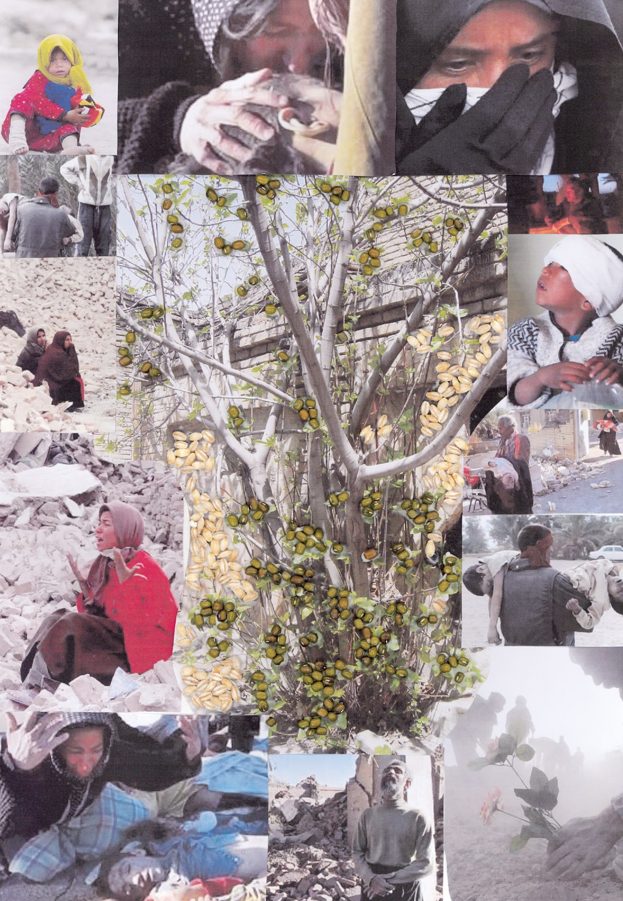
Reflecting on spiritual responses Maral, 14
Here’s a picture of a fig tree. My grandmother loved figs and when she died 20 years ago a fig tree simultaneously grew out of the bricks in her garden, without anyone planting a seed or watering it. This, in my family, is considered as a ‘small miracle’, an act of God, something which shows God remembers us.
However, I wanted to contradict this. I surrounded the fig tree or the ‘small miracle’ with pictures of people suffering, all of them are from the Bam earthquake in Iran, the country which I am from. With those pictures I wanted to ask ‘Where is God for them?’
The art work is a contradiction. If God exists for ‘small miracle’ such as the simultaneous growth of the fig tree in my grandmother’s garden, how come God does not exist for those innocent people who are suffering greatly? My poster says: ‘Where is God?’

Slide 21

Which of these two art works did you like best and why?
Which of the art works says something you agree with?
If you could ask Jenny or Maral questions, what would you ask?
If you created a work of art to express your own visions, experience or thoughts about prayer, what would you make?
Maybe sketch it out?
Prayer Spaces in Schools: Good learning for all
Notes:
Enter any art work from this activity in the Spirited Arts competition run by NATRE.

Slide 22
What did you learn? What did you think?
Which statistics about prayer do you remember?
From research in your own class / community, what did you discover?
Does answers prayer make a good argument for the belief that God is real?
Can we learn more about prayer from social studies surveys, or from expressive arts? What does each of these ways of knowing offer?
End of the lesson: what new questions have come up for you? Any new ideas?
Notes:
Questions for written work or for discussion.

