Slide 1





Prayer Spaces in Schools
Learning from a prayer space
KS3 Lesson 4 of 4 What is prayer?
Learning opportunities for 7-11s on themes about prayer and reflection.
Prayer Spaces in Schools create extraordinary opportunities for children and young people to think about prayer and to consider spirituality in open-minded experiential ways.
This lesson is one of a series written by Lat Blaylock of RE Today and provided free to schools to enable learners to use critical and reflective thinking skills to learn about spirituality, prayer and reflection.
is part of
Notes:
These lessons are written by Lat Blaylock, RE Consultant with RE Today www.retoday.org.uk
Aims of these lessons:
To provide excellent and respected classroom resources for teachers of RVE / RME / RE to use in lessons when a PRAYER SPACES visit is coming, taking place or has happened,
To enable teachers and PRAYER SPACES volunteers to deliver quality RVE / RME / RE about prayer which connects to the experiences of the PRAYER SPACES provision.
To enable pupils to think for themselves about prayer and its meanings, and access opportunities for spiritual, moral, social and cultural development.

Slide 2
Providing quality ‘state of the art’ RE / RVE / RME lessons ready to use for KS2 & KS3
Suitable for both teachers of RE / RVE / RME and Prayer Spaces volunteers to deliver.
Suitable for pre-Prayer Space and post Prayer Space uses.
About these resources.
Suitable for all pupils in all kinds of schools
Encouraging open hearted and critical thinking about prayer and reflection
Enhancing the experience of using a Prayer Space in school with good learning
Offering learners the chance to develop their own personal ideas about philosophical and social questions on the themes of prayer and reflection
Engaging, creative and absorbing learning.
We provide well prepared presentations, lesson plans and training webinars and examples.
Adaptive suggestions in lesson plans to help volunteers or fit in with teachers’ needs.
Introducing concepts and questions about Christian prayer. Providing resources to set high standards of RE / RVE / RME, deepening learning.
Also including assembly delivered options for school worship / religious observance
Integrated with common RE / RVE / RME units of work and ‘Understanding Christianity’ resources.
A lesson for KS2 and a lesson for KS3 in advance of the Prayer Space visit.
Suitable for all schools and all pupils offering creativity and critical engagement in the lessons.
Using active learning, creative multi-disciplinary methods, explained and resourced to be ‘ready to go’.
Three lessons each for KS2 and KS3, all free standing, that follow up the visit.
Notes:
Teachers and Youth Workers can use this lesson, which is part of a larger ‘Prayer Spaces in School’ learning package.
The lessons:
Can be taught - with preparation - ‘off the shelf’ using the 6 PPT sequences provided
Will be understood better by teachers and youth workers if you watch our training recorded webinars from Lat Blaylock of RE today
Include examples of pupils’ work, art, writing and responses
Are suitable for use across the UK, recognizing what is distinctive about RME / RVE / RE in each of the four nations
Reference law, guidance and inspection requirements for RE / SMSCD / School Worship
Use some PRAYER SPACES case studies

Slide 3
Prayer Spaces in Schools
Learning from a prayer space
A serious discussion
of some big issues about prayer
This is one lesson in a set which enables learners to respond to questions such as:
What is prayer?
Can prayer make a person feel happy? Calm? Thankful? Forgiven? Close to God? How?
What can we find out about praying from listening to ideas from people who pray a lot and those who say prayer is a waste of time?
What did Jesus teach his followers about the best attitudes to pray with? What do learners say about these big questions?
What do learners think about questions such as: does God answer prayers? Can prayer change our lives?
Notes:
The topics addressed in these lessons include Biblical narrative and teaching, the Christian ‘Lord’s Prayer’, sociology of prayer, Christian experiences of prayer, creative prayer ideas, Christian theologies of prayer, Jesus and prayer, the phenomenon of ‘SBNR’ (spiritual but not religious) prayer, the experiences of answered prayer and unanswered prayer.
Questions and diverse ideas are the focus: these lessons aim to open minds not to deliver one set of answers to these questions.
The lessons are designed to compliment the opportunities for spiritual development that come from the experience of visiting and using a ‘Prayer Space’ in a school.

Slide 4

Thinking about praying
Wheels within wheels
Two circles of chairs, an inside circle facing outward, and an outside circle facing inward.
People facing each other discuss the question on the screen.
Every two minutes the people in the outside circle move round one seat clockwise.
They then get a new partner – and a new discussion topic.
Notes:
Wheels within wheels Topic: Prayer To run this lesson, you need a space where two circles of chairs can be laid out, an inside circle facing outward, and an outside circle facing inward. Like at a speed dating event, the people in the outside circle move round one seat clockwise every two minutes. They then get a new partner – and a new discussion topic. If you have 30 in the class, then you need 15 ‘inside circle’ chairs and 15 ‘outside circle’
As the ‘circle’ moves round, the teacher can ask for interesting and deep ideas that have been discussed by partners to be shared with the whole class.
Afterwards, a write-up activity (homework?) is surprisingly good at drawing out deep thinking from the class.
The photo on the next slide shows the activity in action at a big pupil conference where 80 pupils were involved. It is a bit if a job to set it up, but works really well at getting high discussion participation rates.

Slide 5
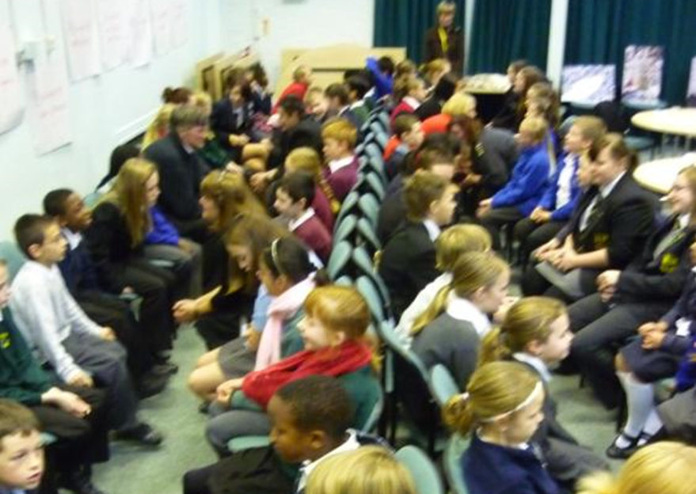
A
“Prayer, basically, doesn’t work.
Either God is not listening (or does not exist?)
Or God is not persuaded to do anything because we ask it.
I don’t believe in prayer.”
Notes:
Wheels within wheels Topic: Prayer (also called “speed dating”) To run this lesson, you need a space where two circles of chairs can be laid out, an inside circle facing outward, and an outside circle facing inward. Like at a speed dating event, the people in the outside circle move round one seat clockwise every two minutes. They then get a new partner – and a new discussion topic. If you have 30 in the class, then you need 15 ‘inside circle’ chairs and 15 ‘outside circle’
As the ‘circle’ moves round, the teacher can ask for interesting and deep ideas that have been discussed by partners to be shared with the whole class.
Afterwards, a write-up activity (homework?) is surprisingly good at drawing out deep thinking from the class.
The photo on the next slide shows the activity in action at a big pupil conference where 80 pupils were involved. It is a bit if a job to set it up, but works really well at getting high discussion participation rates.

Slide 6
B
“Prayer is not magic, but it is a spiritual practice with some power.
You can use prayer to make a difference.
I do believe it is not a waste of time and effort.”
Notes:
Ask pupils to move on one chair in the outside circle each time, and settle them before you move the slide. Then read out the quote slowly, clearly, twice. Then let them all talk!

Slide 7

C
“The main point of prayer is not to get God to do what you want.
It’s to find out what God wants you to do.
And then get the strength and love in your heart to try and do it.”
Notes:
In the feedback to the whole group, welcome all opinions with thanks but very little other teacher comment. You might occasionally correct a fact or direct an opinion towards reasonableness and away from ignorance. Expect different beliefs to emerge – that’s the point.

Slide 8
D
“Some prayers are answered. This shows God is good.
Some prayers are not. This is maybe because God is wise and does not give us everything we want.
God’s like your parents: they know better, sometimes, than to give you every Mars Bar you ask for.
Same with God.”
Notes:
The quotes are available for pupils’ own writing and reflection on capture sheet that goes with these resources.

Slide 9
E
“Prayer is quite manipulative.
If a nurse, for example, says to a patient ‘Would you like me to pray for you?’ then the patient may feel very uncomfortable. This sort of thing should be banned.
Christians who are nurses should be more professional (there have been recent cases of this in the news).”
Notes:
I’ve deliberately balanced to quote set with some positives and negatives about prayer: no one will agree with all the quotes. This uses controversy and diversity for learning, a key principle in good RE.
Lesson facilitators need not be concerned about the range of views: this is a strength of the discussion methods here. It encourages all pupils to ‘be real’ and say what their own perspective might be with clarity and an open heart and mind.

Slide 10
F
“Praying for someone else is a kind and generous thing to do – like giving them a gift of your time and care.
It is good to pray for people (even if there is no God to listen).”
Notes:
This sentence focuses on one argument about the ‘utility’ of prayer as intention, and opens up the idea that prayer is ‘useful’ in various different ways.

Slide 11
G
“Prayer is a psychological tool.
Never mind if ‘God is listening’ or not: prayer makes people happier, and gives calmness and comfort to those who pray.
If it has these effects, why knock it?”
Notes:
The sentences have got a little more difficult and complex as the activity progresses.
Some explanation may help pupils, but there is nothing here too hard for most 11 year olds.

Slide 12
Expressing your own viewpoints (1) (possible homework)
After you have been a part of the ‘wheels within wheels’ discussion, write about it.
Use these three prompts:
The discussion we had in class today was…
I noticed that not everyone shares my views, for example…
I put my own views into words clearly, for example…
Notes:
One aspect of these lessons (which can also be used as assembly outlines with simple adaptation) is that they give pupils frequent opportunities to clarify and express their own views and ideas about prayer.
We welcome the contested nature of this conversation: from different religions and worldviews there are many varied perspectives from which to learn.

Slide 13
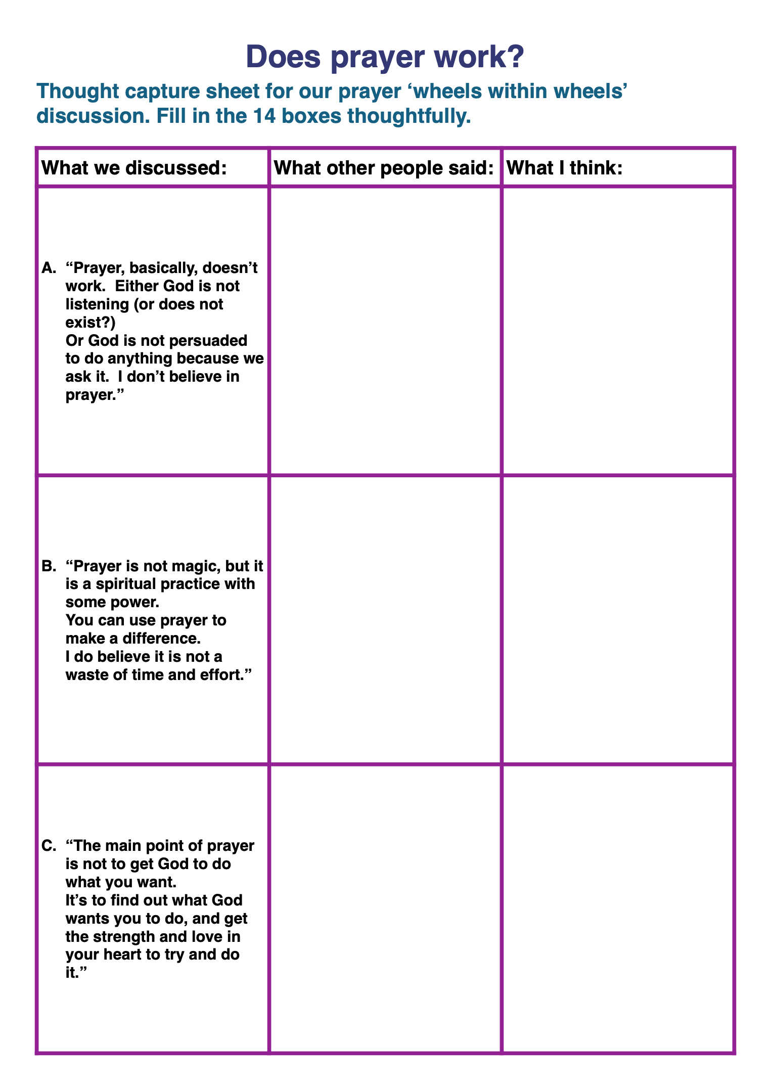
Expressing your own viewpoints (2) (possible homework)
After you have been a part of the ‘wheels within wheels’ discussion, write about it.
Use the additional thought capture sheet – here’s the first page of it – and record what you learned from others in your discussions and your own developed ideas.
Share your sheet in a small group. Be detailed and deep! Respect the differences of view that you will certainly discover!
Notes:
One aspect of these lessons (which can also be used as assembly outlines with simple adaptation) is that they give pupils frequent opportunities to clarify and express their own views and ideas about prayer. We welcome the contested nature of this conversation: from different religions and worldviews there are many Varied perspectives from which to learn.
The lesson could finish here, but if you have time, the extensions and further activities below are worth pursuing, perhaps especially in Year 9 or above.

Slide 14
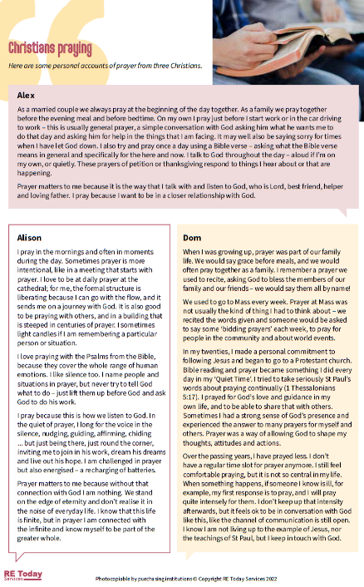
Investigating prayer with social science methods
Three Christians write about their experiences of prayer
Read what Alex, Alison and Dom say about their prayers.
What value and significance does each one find in prayer?
If you wrote a piece answering similar questions yourself, what would yours say?
Notes:
https://www.natre.org.uk/resources/5-1-what-is-prayer-for-christians-ckre-vol-5-pp-12-13/
This resource sheet can be printed from the PPT, or accessed via the Prayer Spaces Lessons weblink
The topics addressed in these lessons include Biblical narrative and teaching, the Christian ‘Lord’s Prayer’, sociology of prayer, Christian experiences of prayer, creative prayer ideas, Christian theologies of prayer, Jesus and prayer, the phenomenon of ‘SBNR’ (spiritual but not religious) prayer, the experiences of answered prayer and unanswered prayer.
Questions and diverse ideas are the focus: these lessons aim to open minds not to deliver one set of answers to these questions.
The lessons are designed to compliment the opportunities for spiritual development that come from the experience of visiting and using a ‘Prayer Space’ in a school.

Slide 15
What does the Bible offer to help us understand Christian prayer? A parable by Jesus.
Read it carefully.
The Parable of the Pharisee and the tax collector
Jesus told this parable to certain people who had convinced themselves that they were righteous and who looked on everyone else with disgust:
“Two people went up to the temple to pray. One was a Pharisee and the other a tax collector. The Pharisee stood and prayed about himself with these words, ‘God, I thank you that I’m not like everyone else—crooks, evildoers, adulterers—or even like this tax collector. I fast twice a week. I give a tenth of everything I receive.’ But the tax collector stood at a distance. He wouldn’t even lift his eyes to look toward heaven. Rather, he struck his chest and said, ‘God, show mercy to me, a sinner.’
I tell you, this person went down to his home justified rather than the Pharisee. All who lift themselves up will be brought low, and those who make themselves low will be lifted up.”
Luke 18:9-14, Common English Bible
Notes:
These lessons enable pupils to learn a lot specifically about Christian prayer, and use Biblical quotations, examples and texts to enrich pupils’ understanding. You might want to move this part of the lesson up higher and do it first. This is a third part to the lesson, but could be used first or second depending on the teaching sequence you need.
There is a good section on BBC GCSE RS Bitesize about the meanings of this parable:
https://www.bbc.co.uk/bitesize/guides/zkw2vk7/revision/3

Slide 16
What does the Bible offer to help us understand Christian prayer? A parable by Jesus.
Discuss:
Both these people prayed. But Jesus doesn’t commend them both. Are some kinds of prayer no use?
What was it about the tax collector (hated by the people because he worked for the Romans) that Jesus liked and commended?
What is Jesus’ main point in this story?
What attitudes to praying do you think make a prayer better?
If you made an artwork based on these Bible verses, what would you show? Sketch it out in 3 minutes…
Keywords: hypocrite / sincere / humble/ bragging / genuine / authentic
Notes:
These lessons enable pupils to learn a lot specifically about Christian prayer, and use Biblical quotations, examples and texts to enrich pupils’ understanding. You might want to move this part of the lesson up higher and do it first. This is a third part to the lesson, but could be used first or second depending on the teaching sequence you need.
There is a good section on BBC GCSE RS Bitesize about the meanings of this parable:
https://www.bbc.co.uk/bitesize/guides/zkw2vk7/revision/3

Slide 17
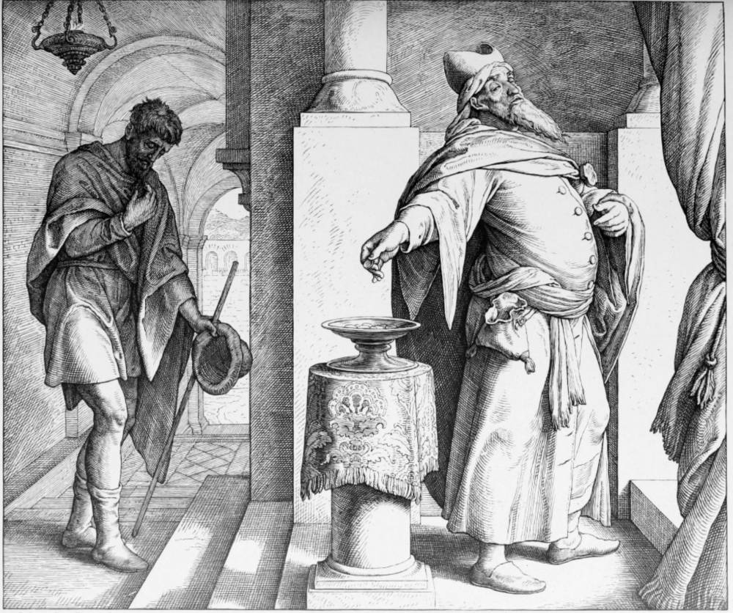
‘The Parable of the Pharisee and the Tax Collector’ by artist Julius Schnorr von Carolsfeld. The artist has drawn the two characters in Jesus’ parable What stands out for you when you look at this picture?
What do you like and dislike here?
Prayer Spaces in Schools: Good learning for all
Notes:
Image credit: Die Bibel in Bildern [Picture Bible] – Artist: Julius Schnorr von Carolsfeld. Leipzig: Georg Wigands, 1860.
Hathi Digital Trust Library online version of a copy in the Getty Library.
https://victorianweb.org/art/illustration/german/schnorr/89.html

Slide 18
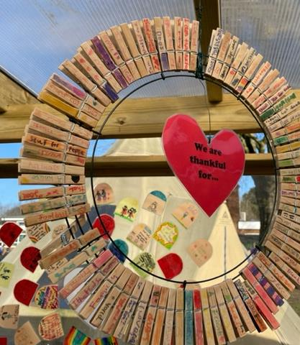
In this lesson you:
Used a discussion circle to explore through dialogue some varied ideas about praying.
Read some Christian people’s views about prayer and the reasons why it matters to them.
Considered one of Jesus’ parables about a good and a bad attitude to praying.
What did this lesson make you think about?
What ideas of your own have come into clearer focus?
Has your own position on the value or pointlessness of praying changed or developed?
Prayer Spaces in Schools: Good learning for all
Notes:
Image from Prayer Spaces website.
This last slide offers a chance for some summary feedback on the lesson and could be done in conversations, pairs or written work.

